Slide 1
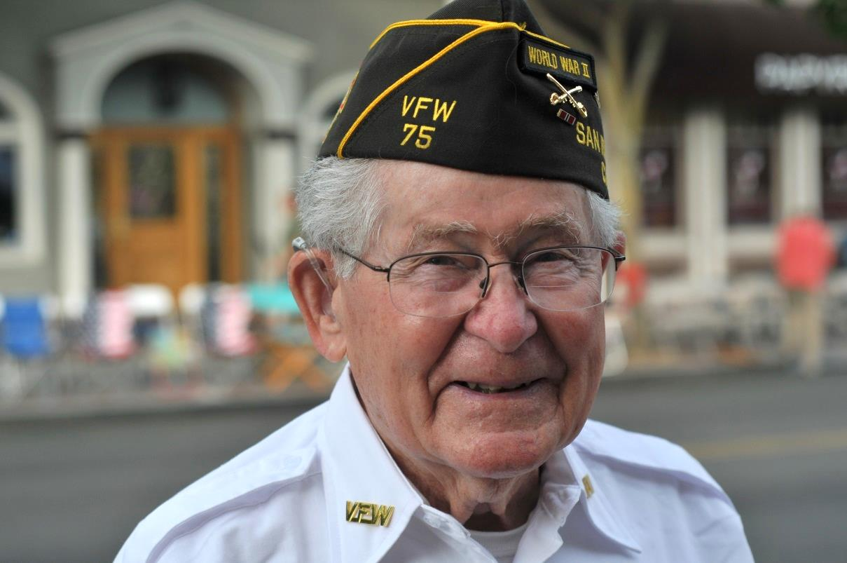
Celebration of a Life Well-Lived
Arthur Allen Gaskins
8/29/1918 – 6/17/2018
Veterans Memorial Building Years

Slide 2
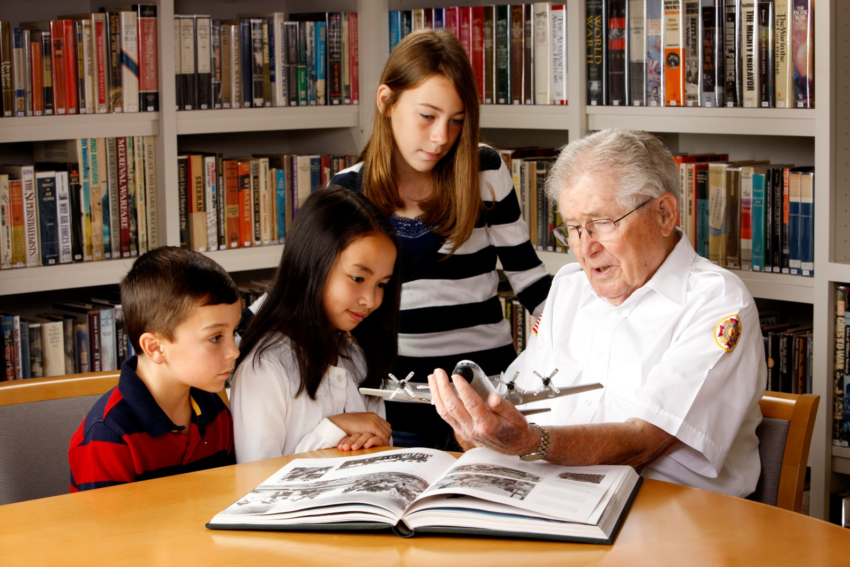

Always ready to teach, mentor, help out

Slide 3
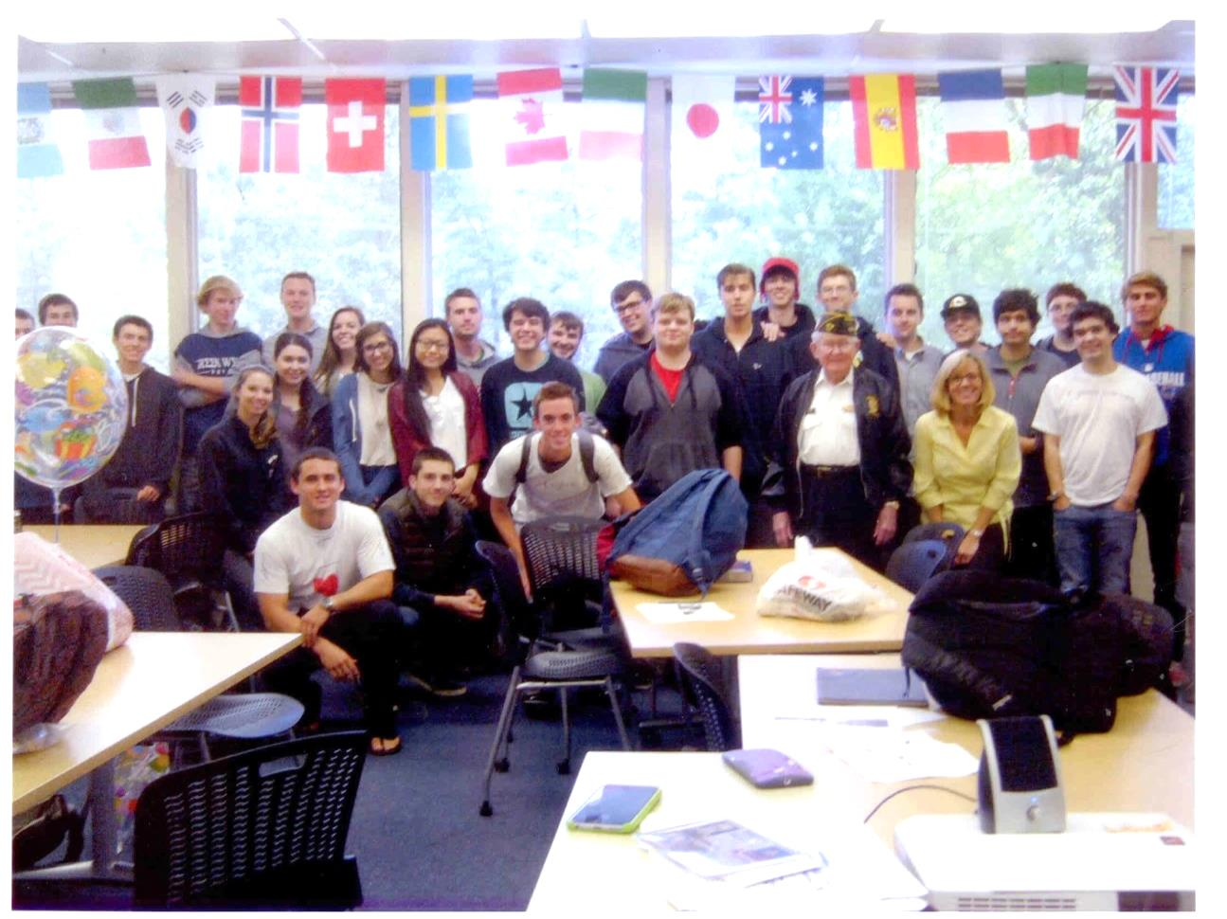
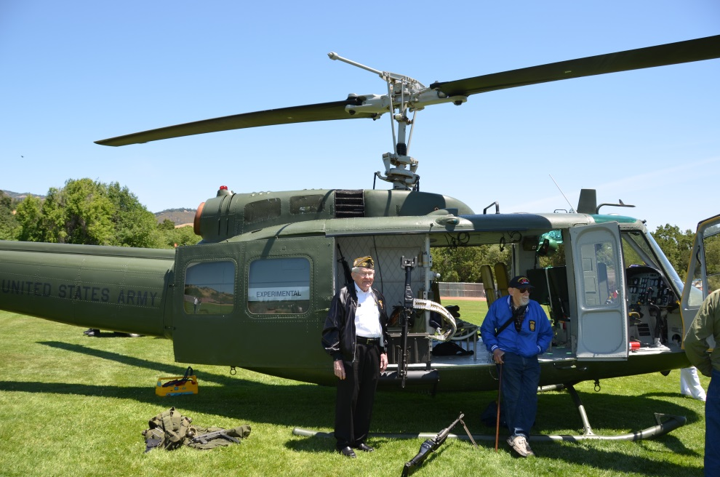
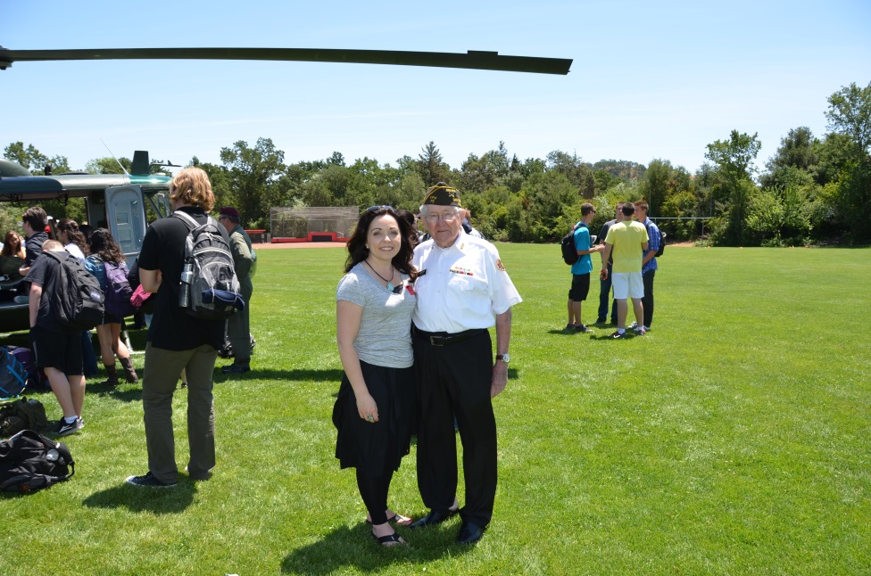
A grand entrance to Monte Vista High School

Slide 4
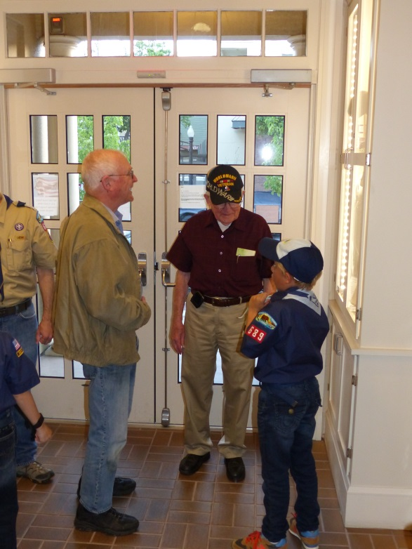
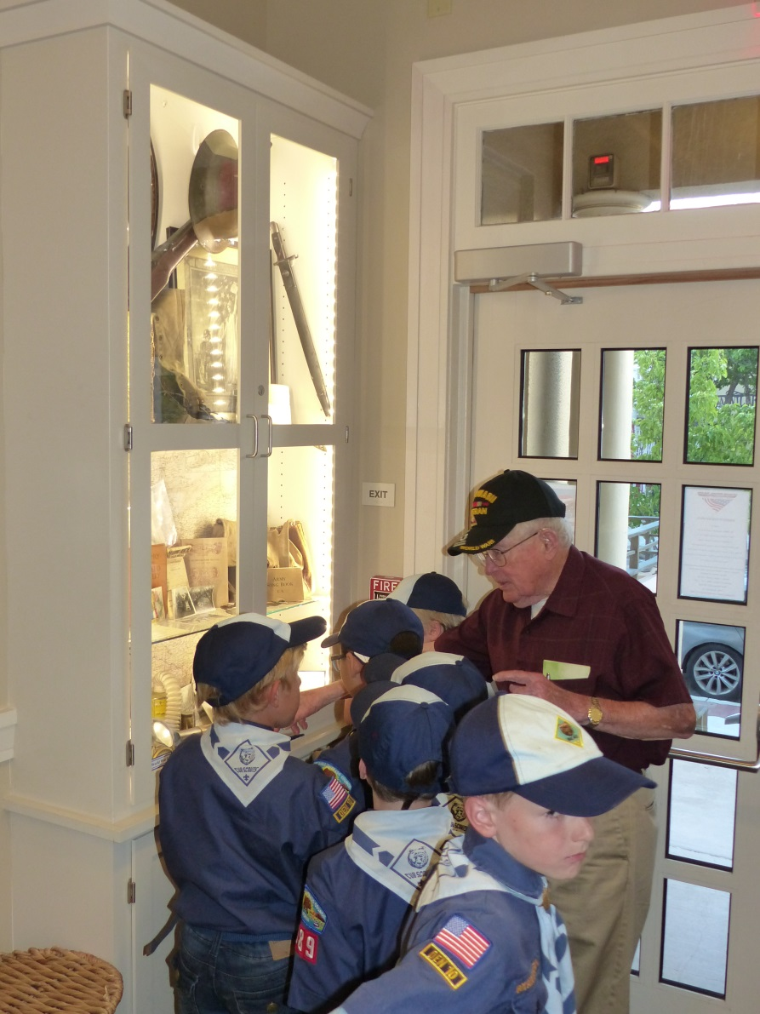
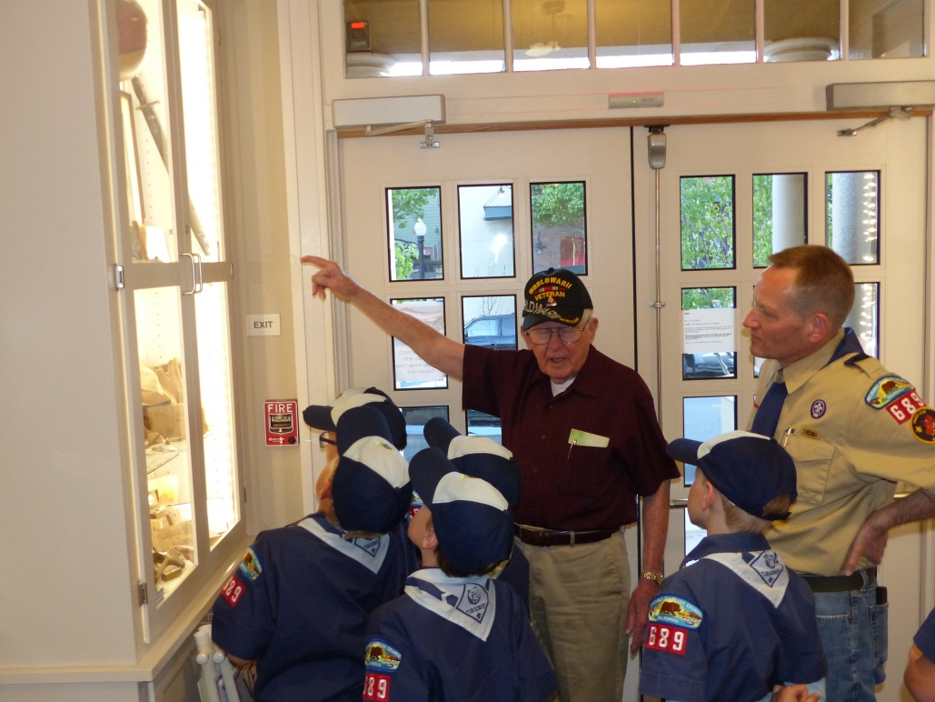
Art loved the Scouts

Slide 5
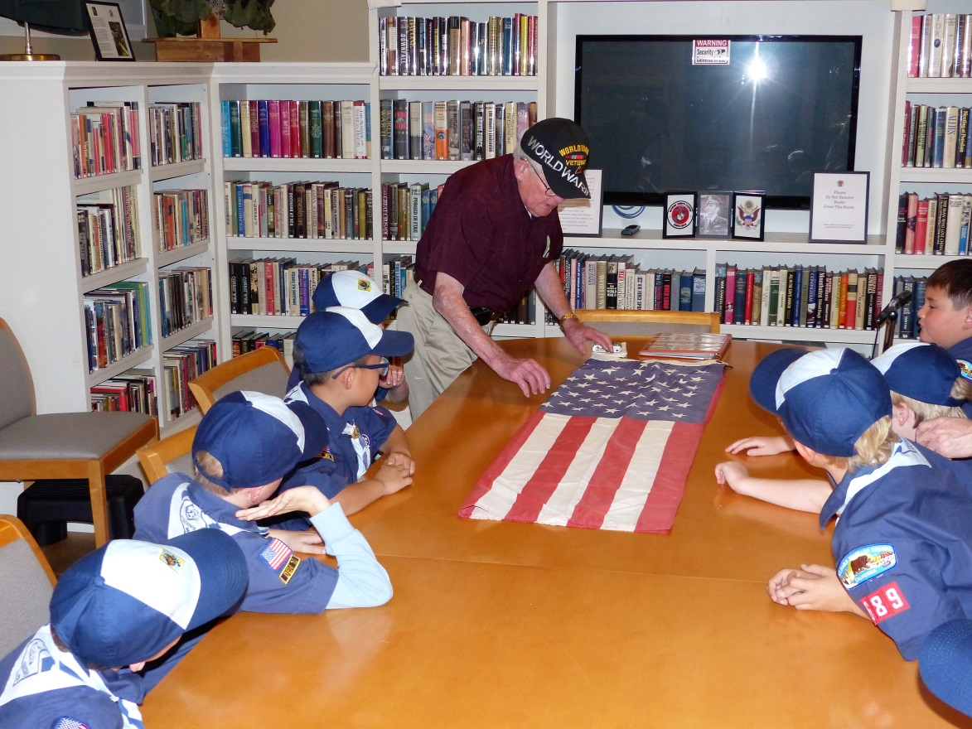
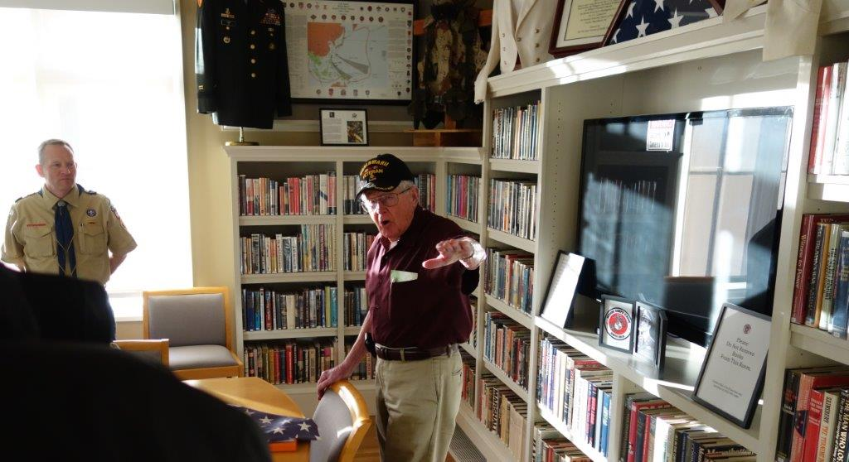
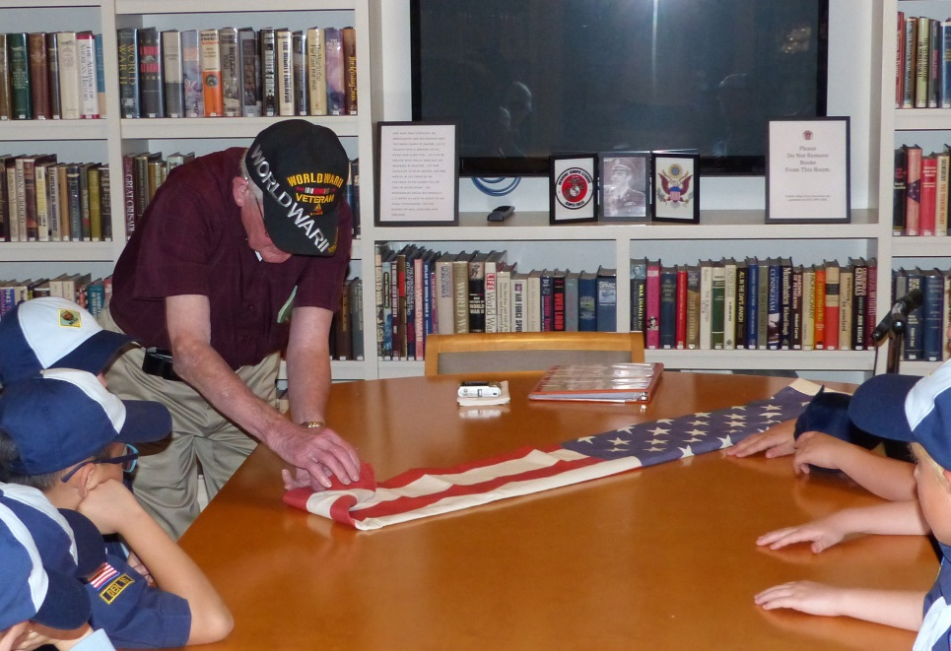
Flag folding lessons

Slide 6
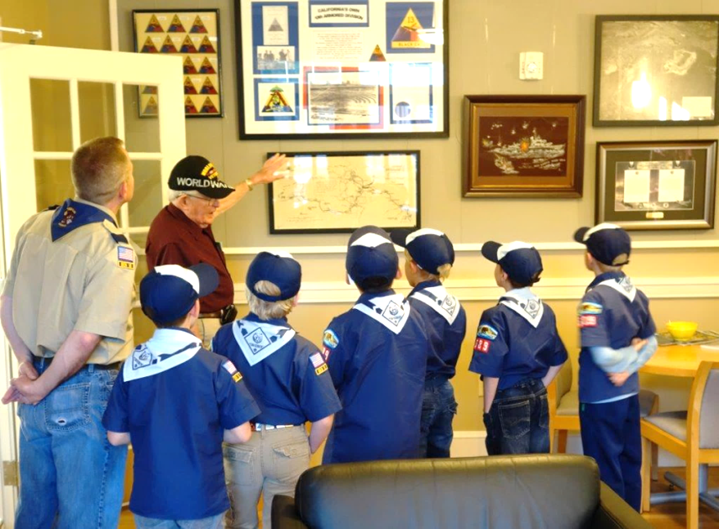
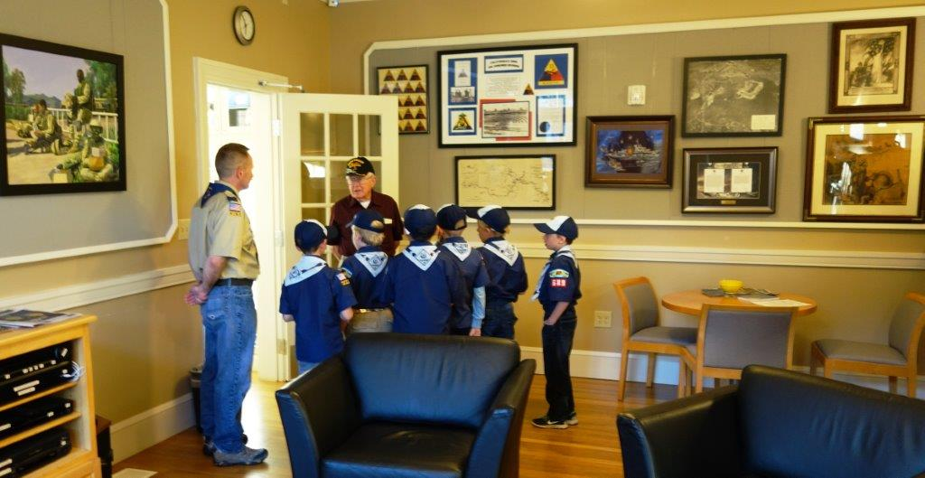
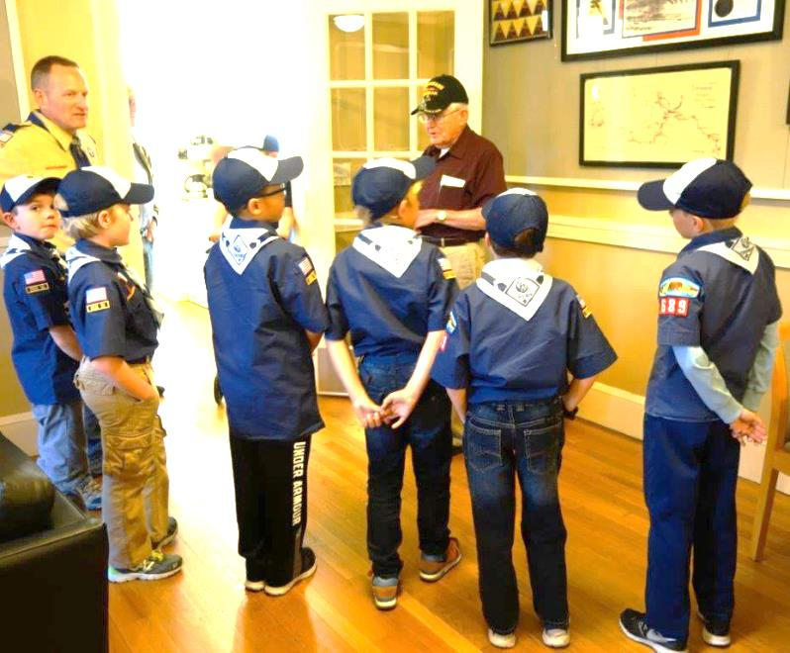
And more Scouts

Slide 7
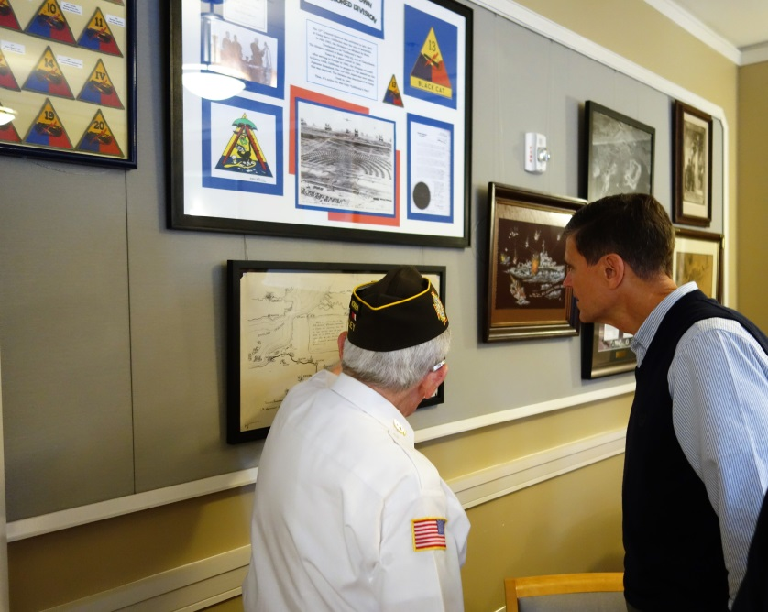
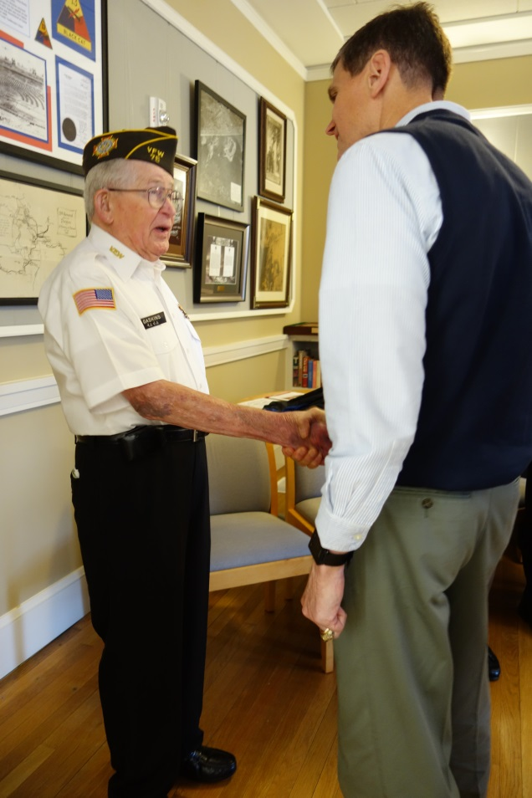
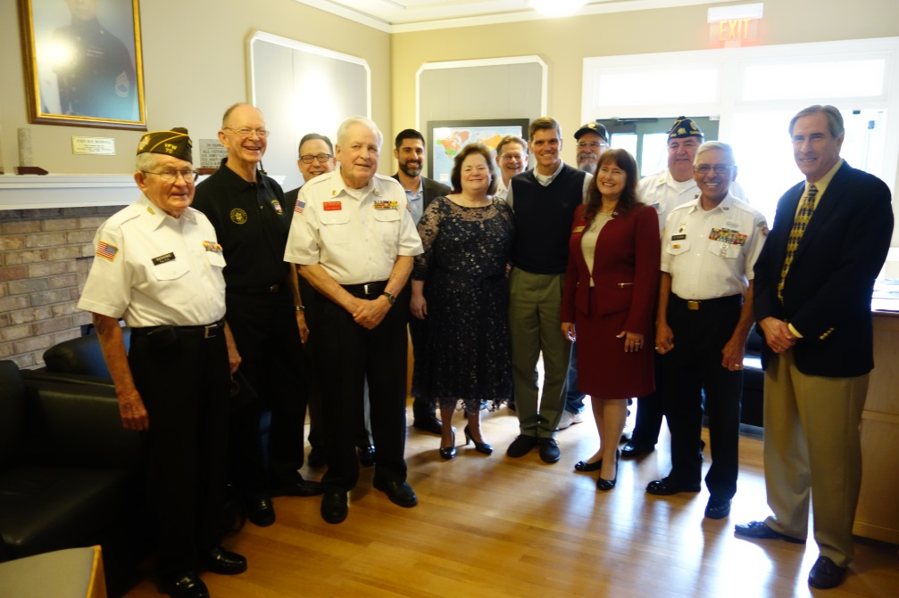
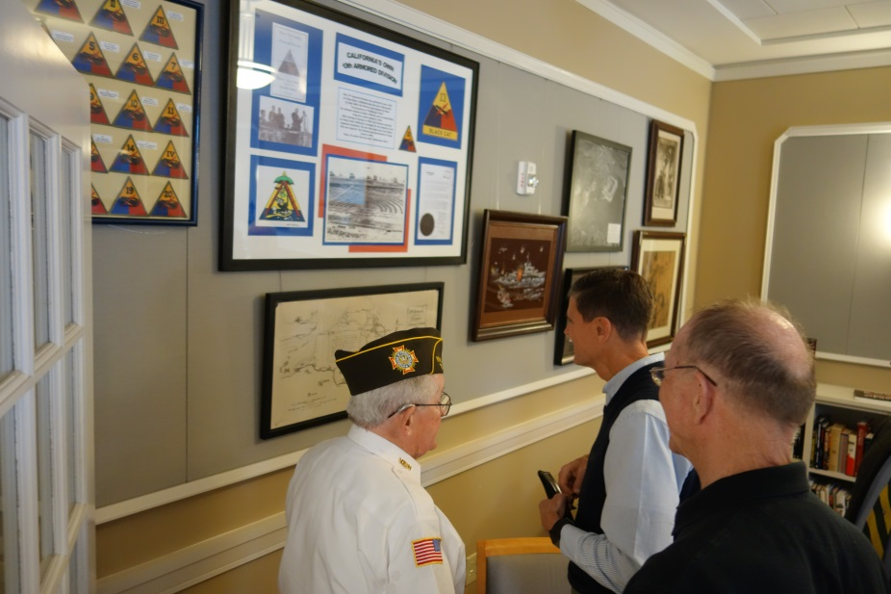
AND NOT AFRAID TO TEACH A GENERAL A THING OR TWO
OR TWO GENERALS

Slide 8
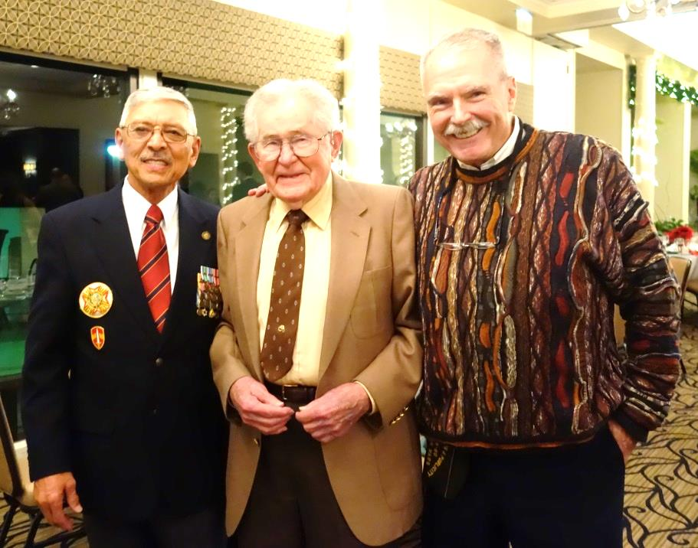
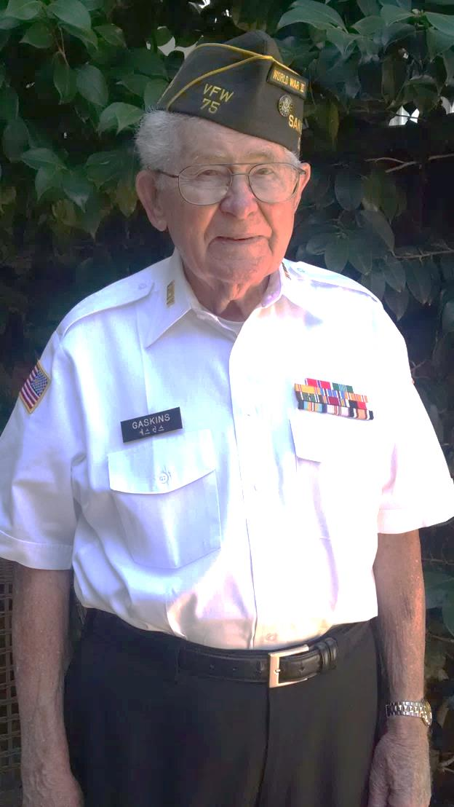
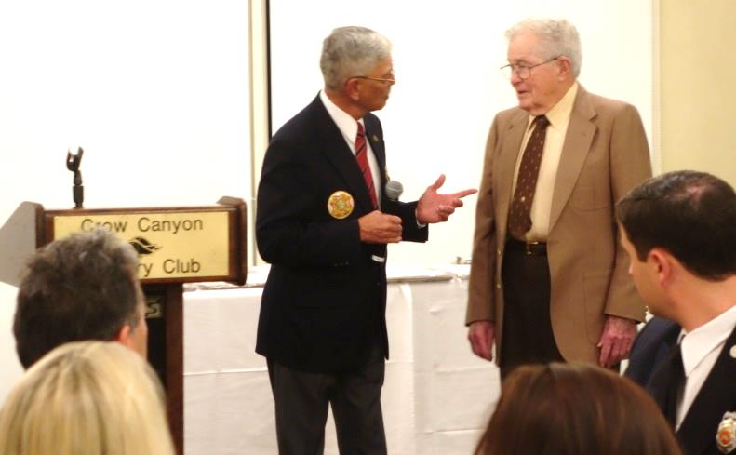
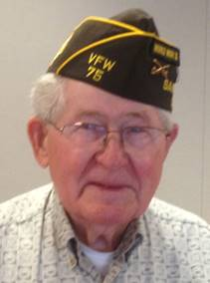
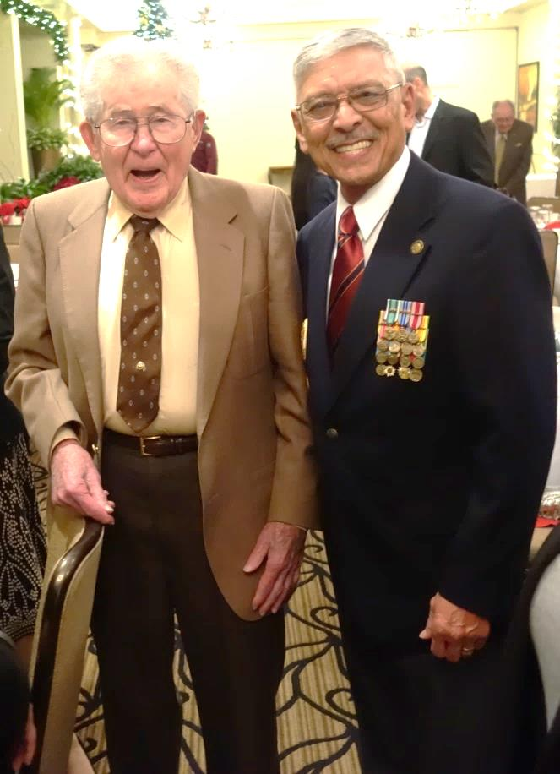
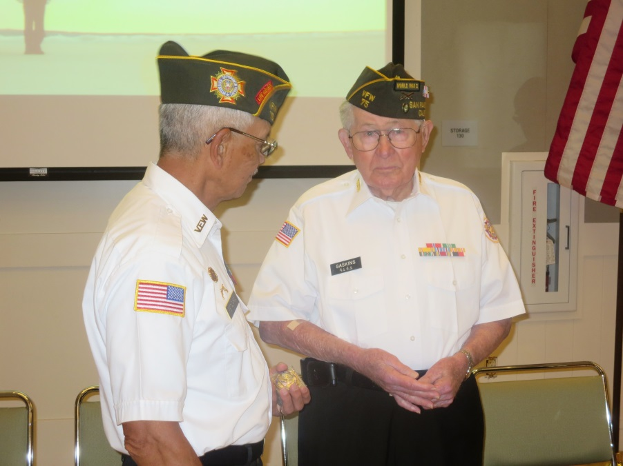

Proud Member
VFW POST 75

Slide 9
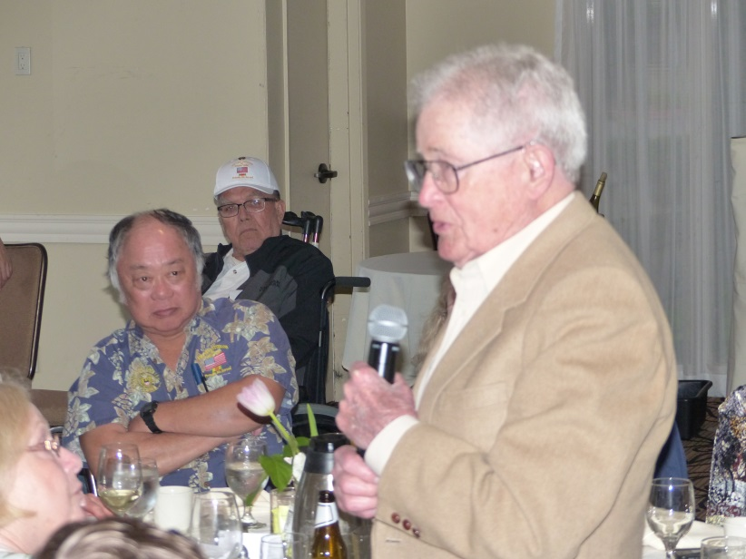
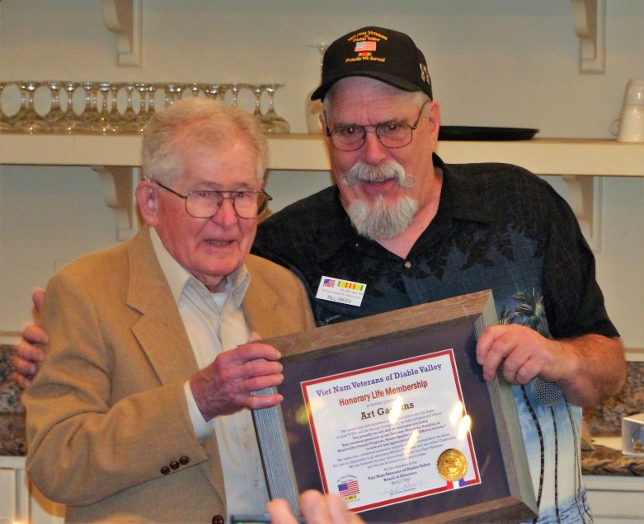

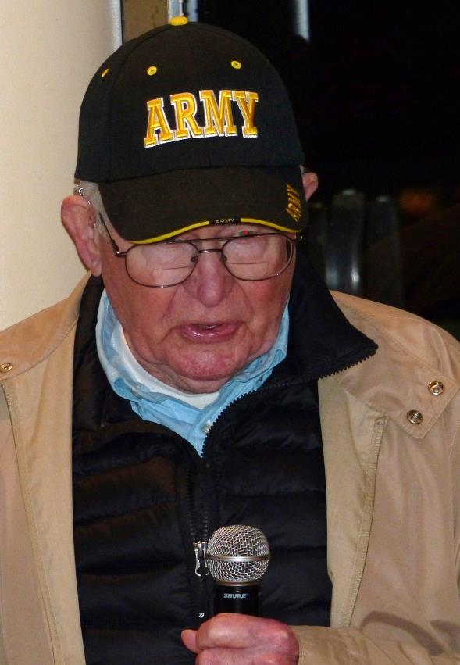
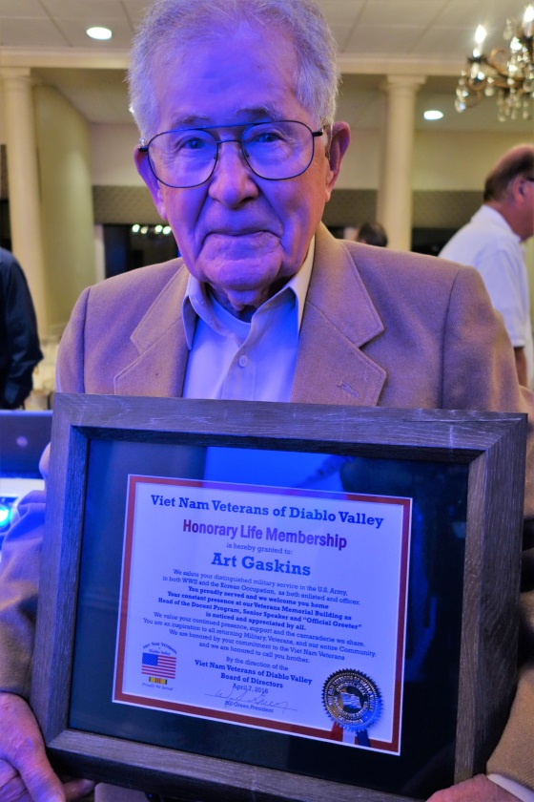
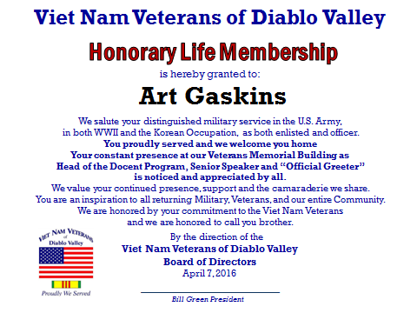
Honorary Life Member of the Viet Nam Veterans of Diablo Valley

Slide 10
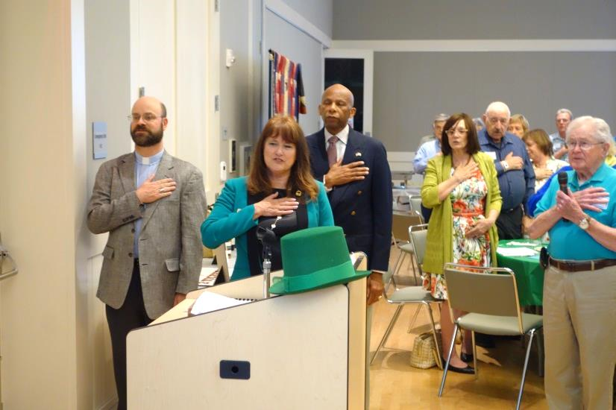
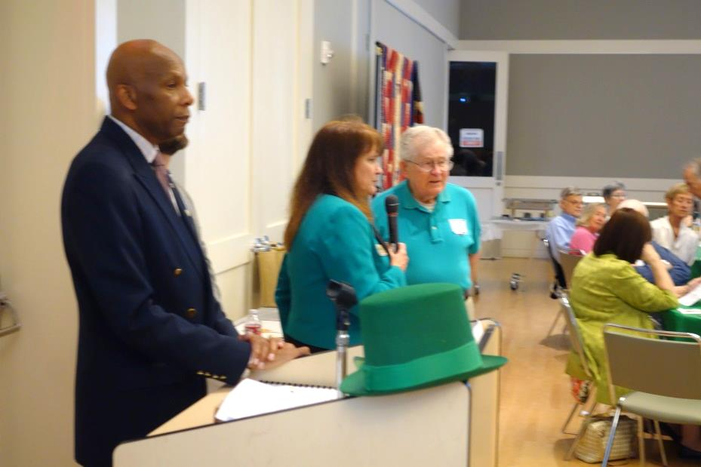
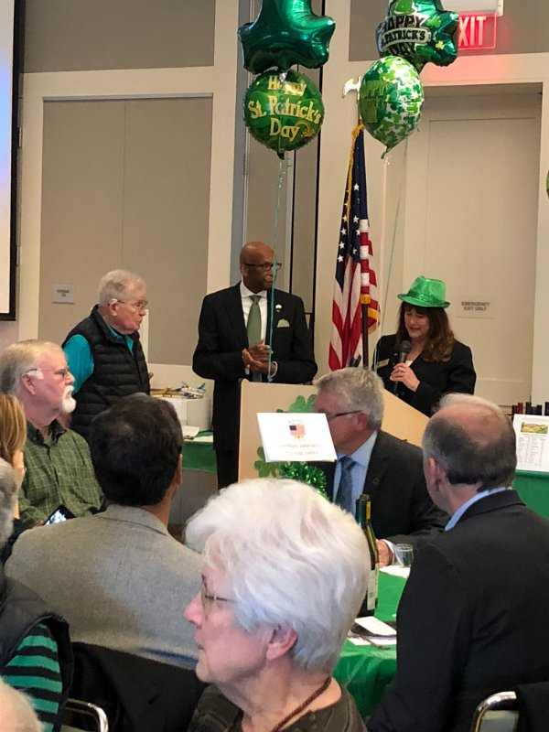

Corned beef and cabbage dinner fundraiser for the Veterans Memorial Building
One of Art’s responsibilities was to lead the Pledge of Allegiance

Slide 11
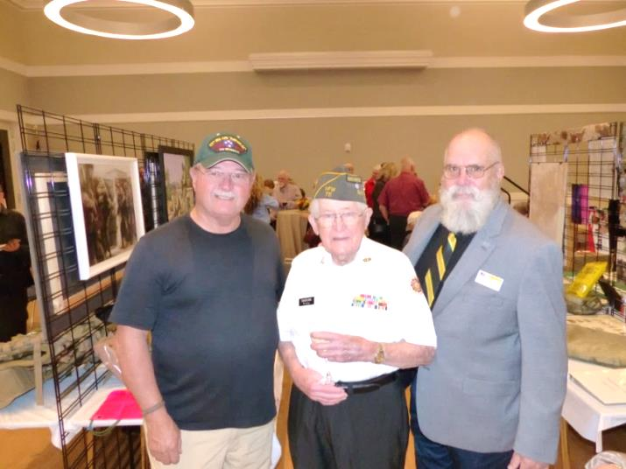
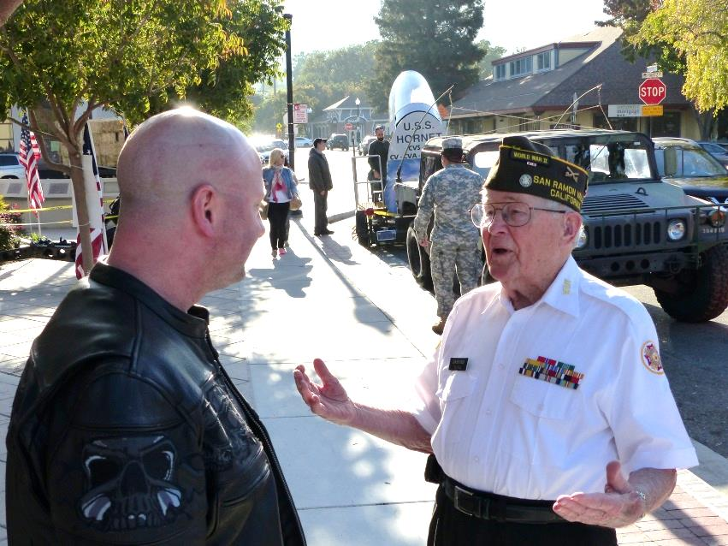
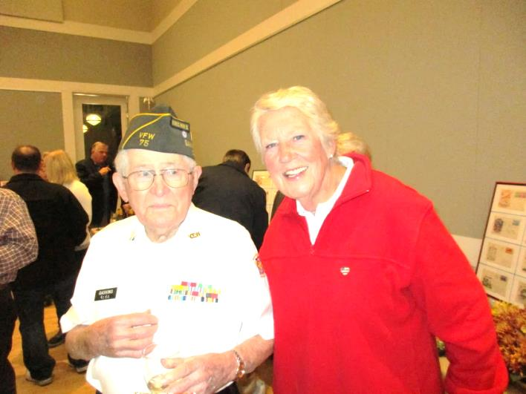
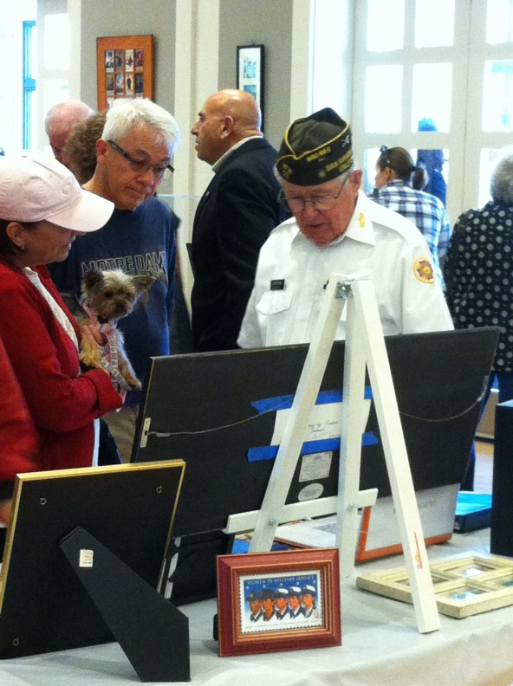
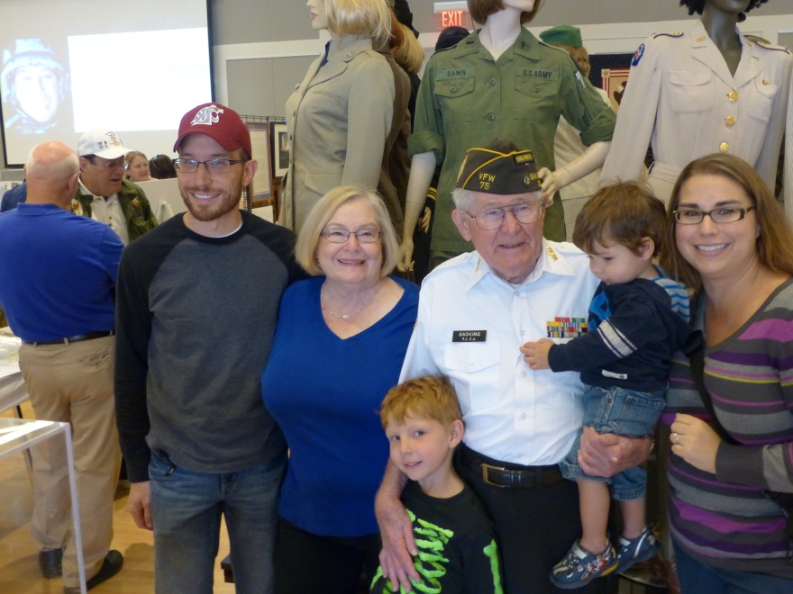
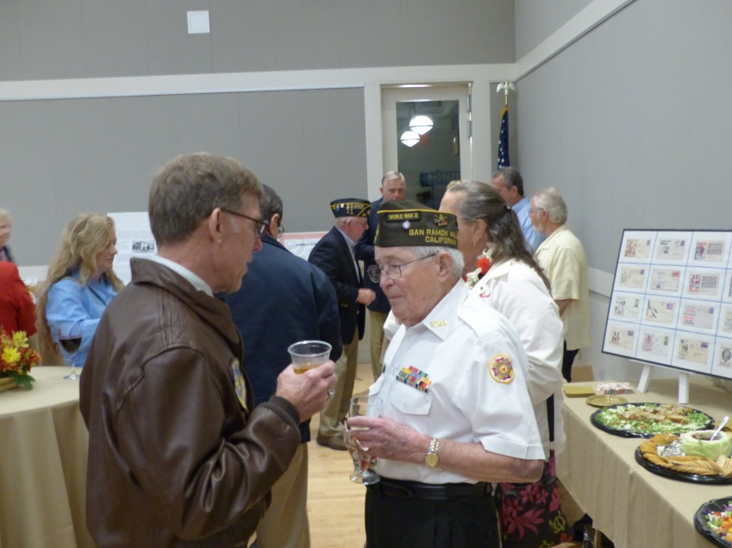
Veteran’s day weekend open house museum
Veterans Day (weekend) Open House Museum at the Veterans Memorial Building

Slide 12
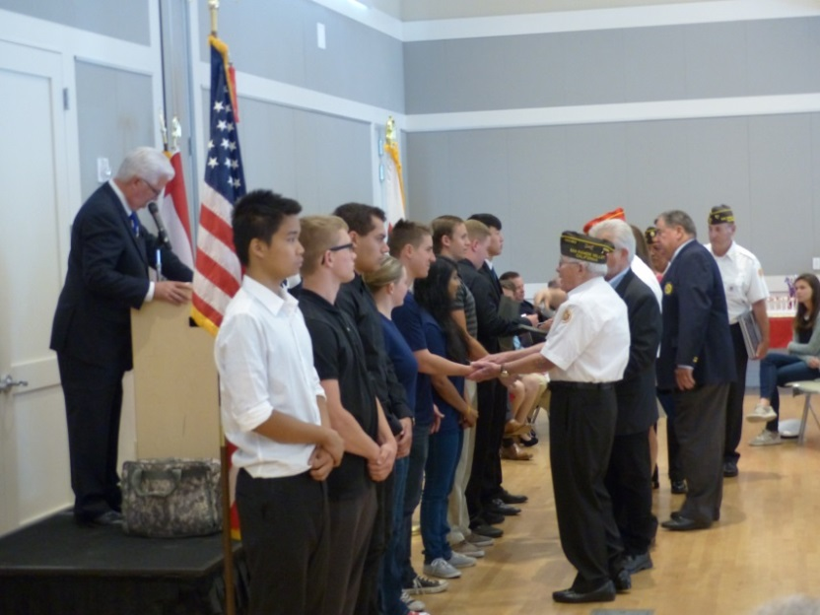
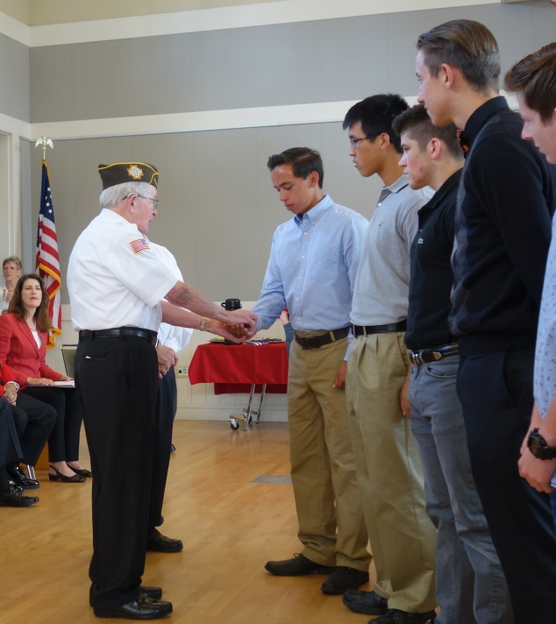
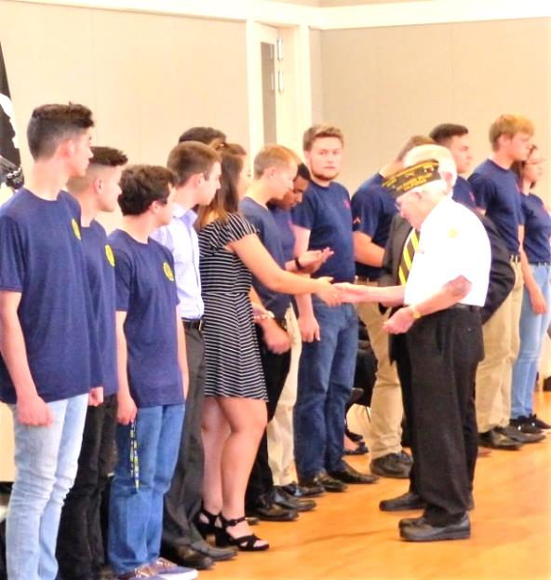
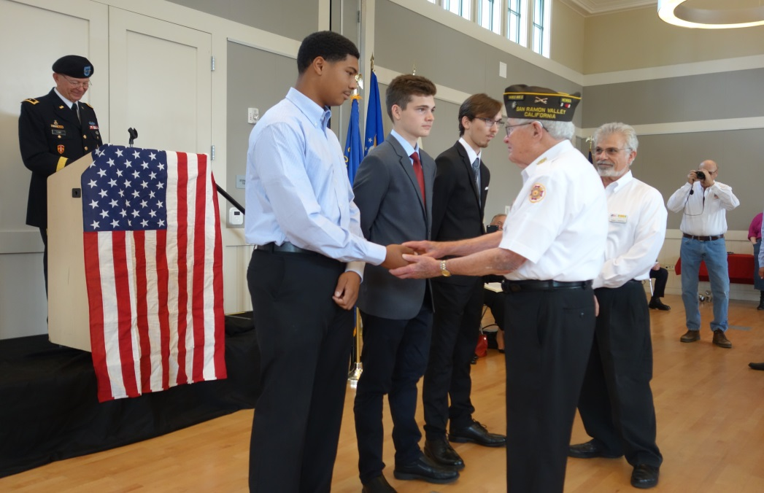
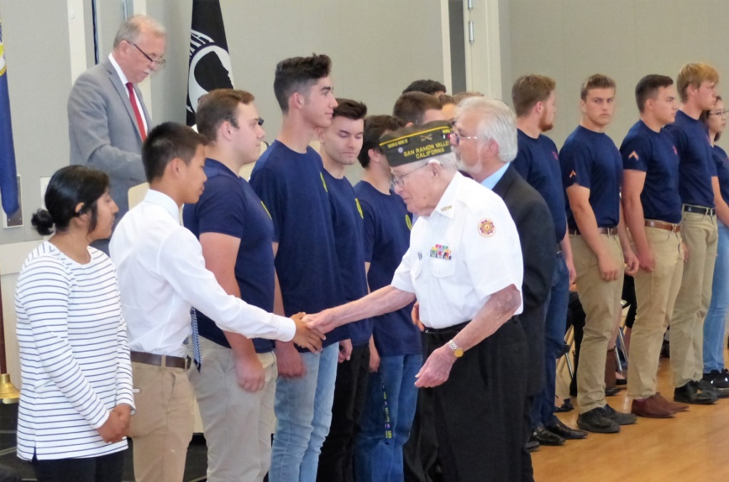
SWEARING-IN CEREMONY

Slide 13
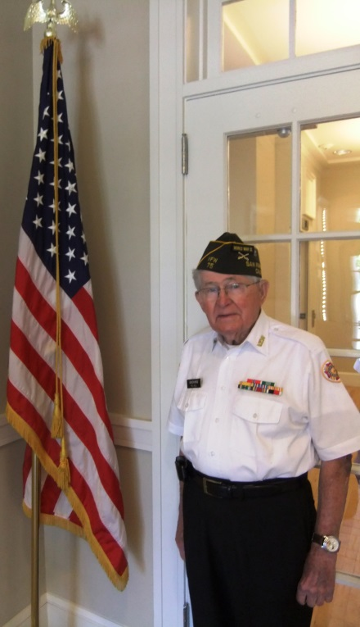
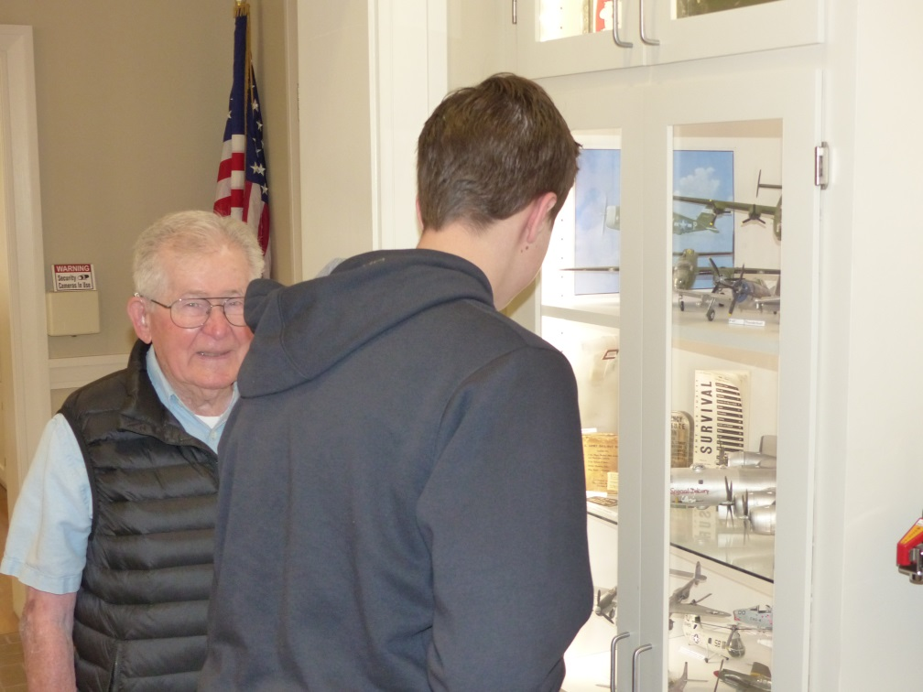
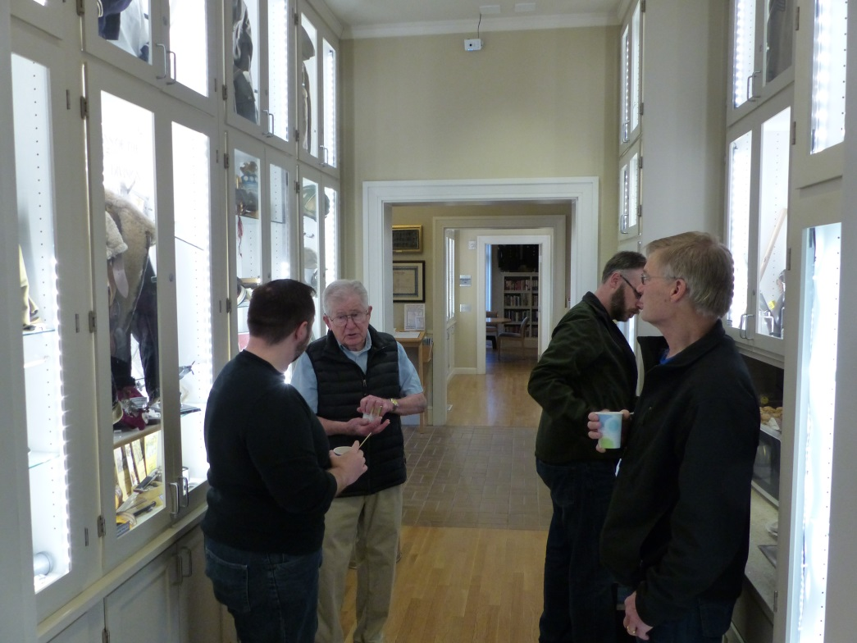
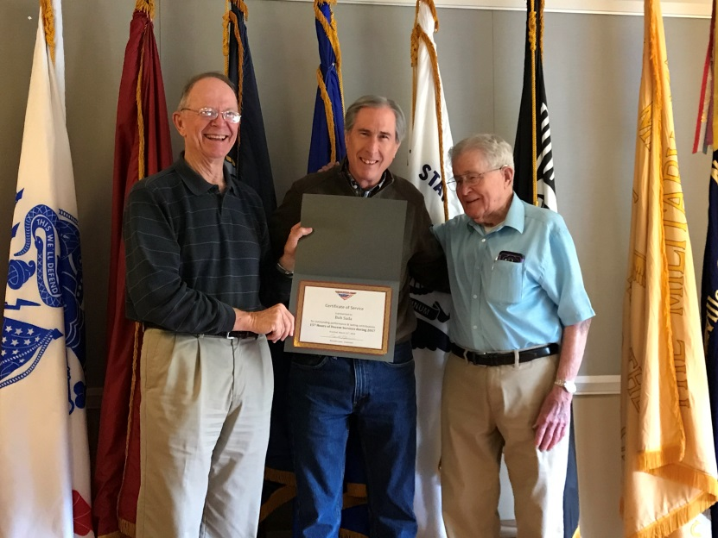
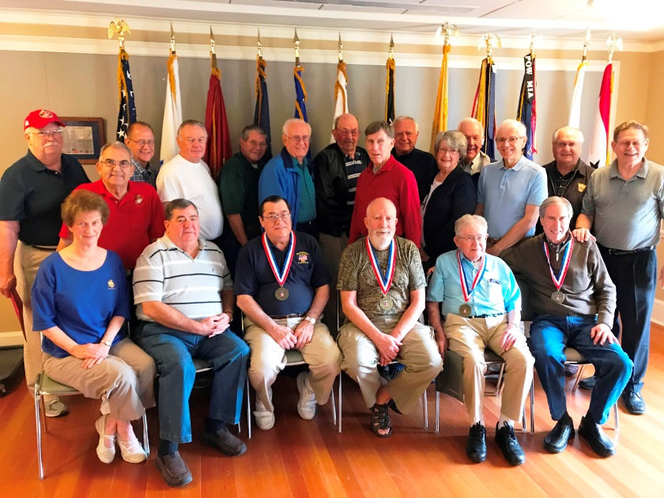
Not only did Art create the Docent Program at the VMB, but he ran it and scheduled it (with a little help from Lee and Lynne).

Slide 14

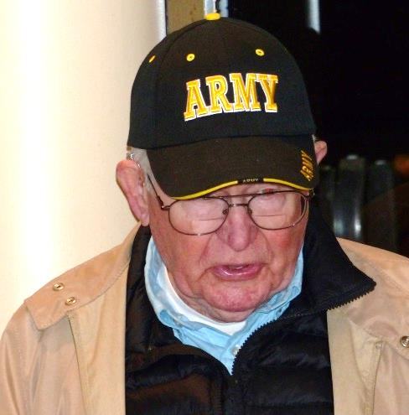
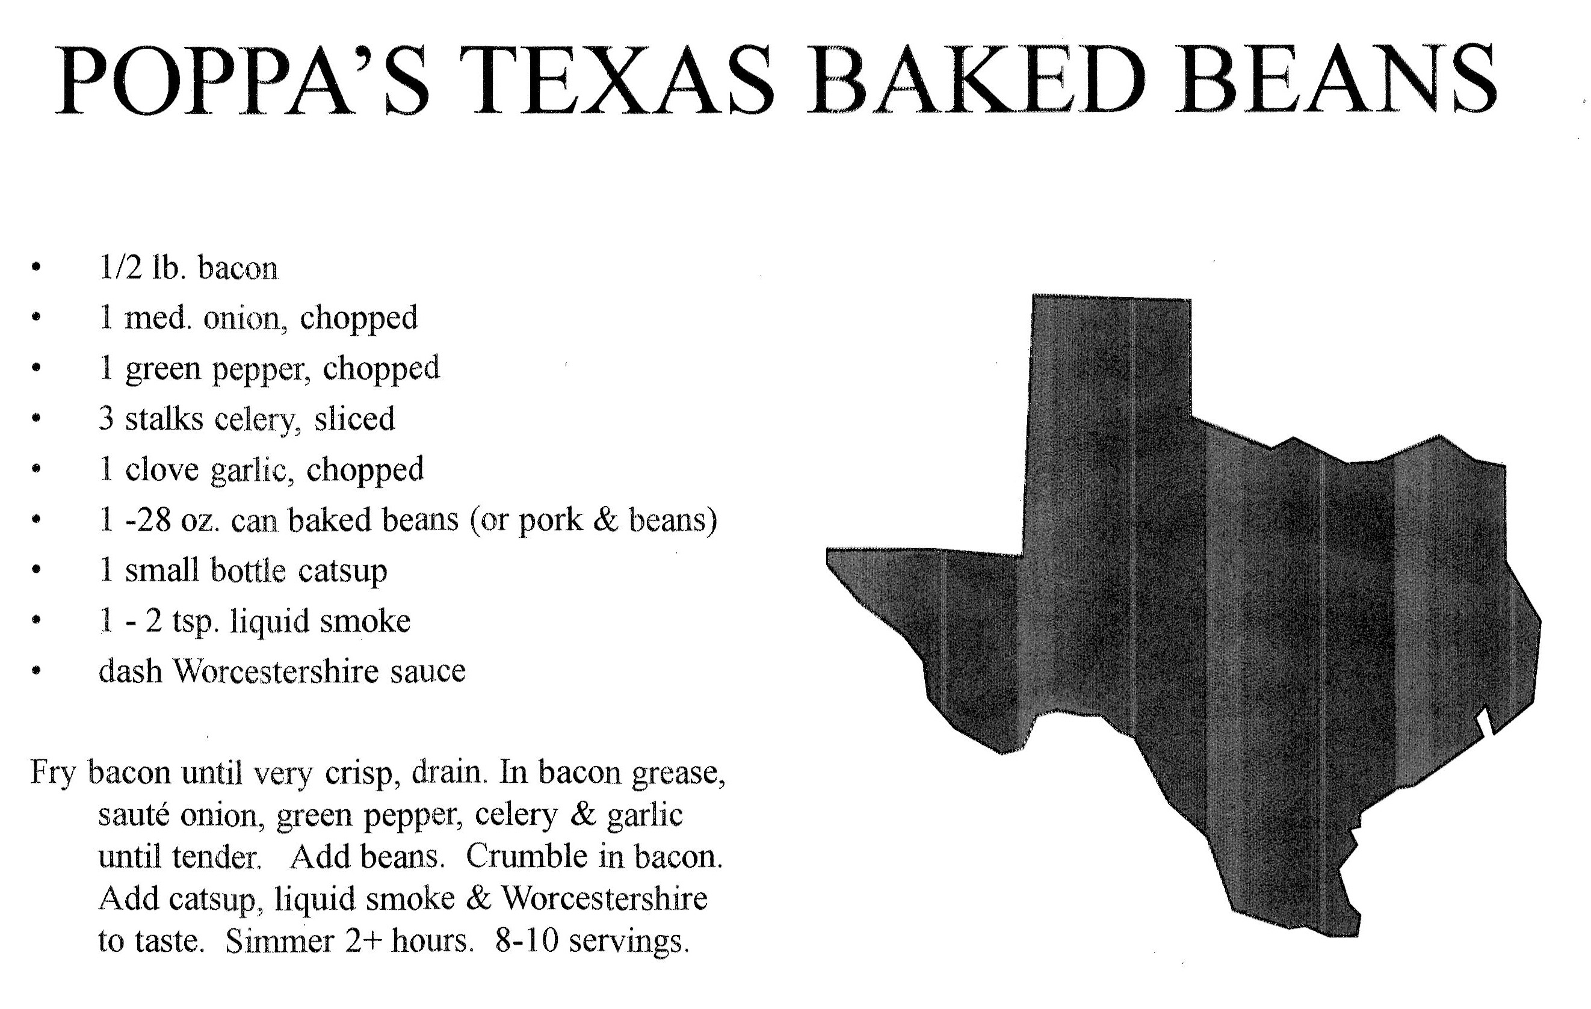
Of course, anyone who has been to the VMB for Army-Navy games knows the best beans ever- Art’s

Slide 15





Hung out with Medal of Honor Recipients

Slide 16




VETERAN’S DAY CEREMONY AT
SAN RAMON VALLEY HIGH SCHOOL

Slide 17








Art had a way of making us all feel special

Slide 18






2013
2015
DANVILLE’S
4TH OF JULY PARADE
2016
2012 in Jeremy Orvik's replica WW II motorcycle and sidecar

Slide 19



Town of Danville WW II Veteran Tribute
Viet Nam Veterans of Diablo Valley
“Veteran of the Year”
Town of Danville
Special Recognition 2007

Slide 20




Art was also was the primary docent and greeter for years. A perpetual plaque was created to honor him.
Veterans Memorial Building
WW II Veteran Tribute in 2014
Art was the first receipriant of the Arthur A. Gaskins “Docent of the Year” award in 2015.

Slide 21

Art’s treasures- VFW hat, challenge coins,
his dog tag in front and quilt in background

Slide 22





Danville’s 9-11 Ceremony at Oak Hill Park
VNVDV Memorial Day Ceremony at Oak Hill Park

Slide 23




13th Armored Division Reunion and Ceremony in 2015 at the
WW II Memorial
in Washington DC
Art standing next to his home State of Texas Momument
Meeting Bob Dole at WW II Memorial with granddaughter Jennifer
Saluting the Color Guard

Slide 24



2015 visit to the National Museum of the Marine Corps
In Washington, DC

Slide 25




94th Birthday 2012
Birthdays at Country Waffle
95th Birthday

Slide 26





Birthdays at Country Waffle
96th Birthday 2014
97th Birthday 2015
99th Birthday 2017

Slide 27

So long, our friend.
It has been an honor to know you.

