Slide 1
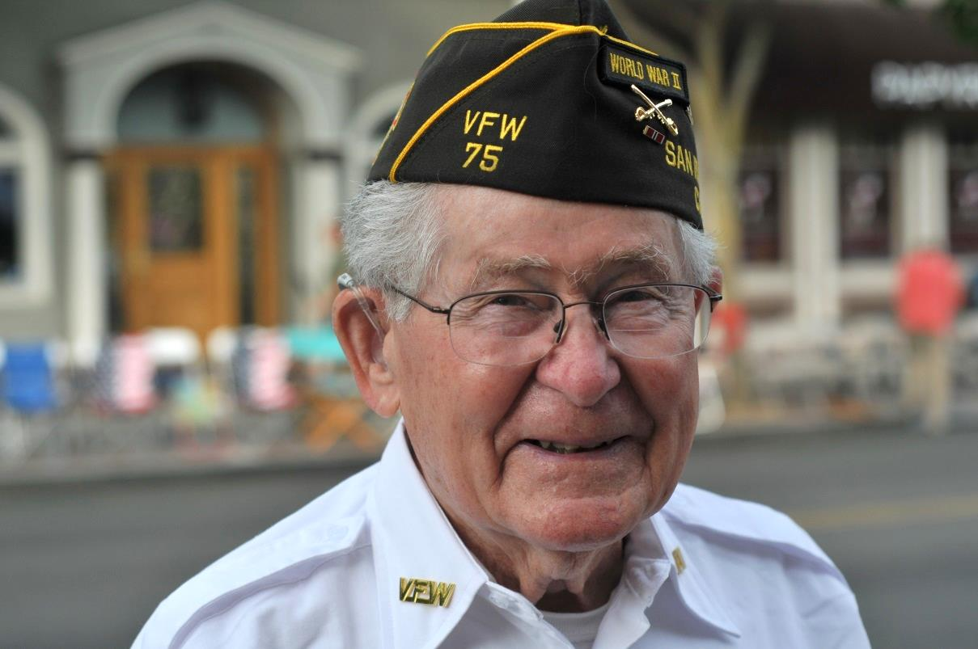
Celebration of a Life Well-Lived
Arthur Allen Gaskins
8/29/1918 – 6/17/2018
Post Military

Slide 2
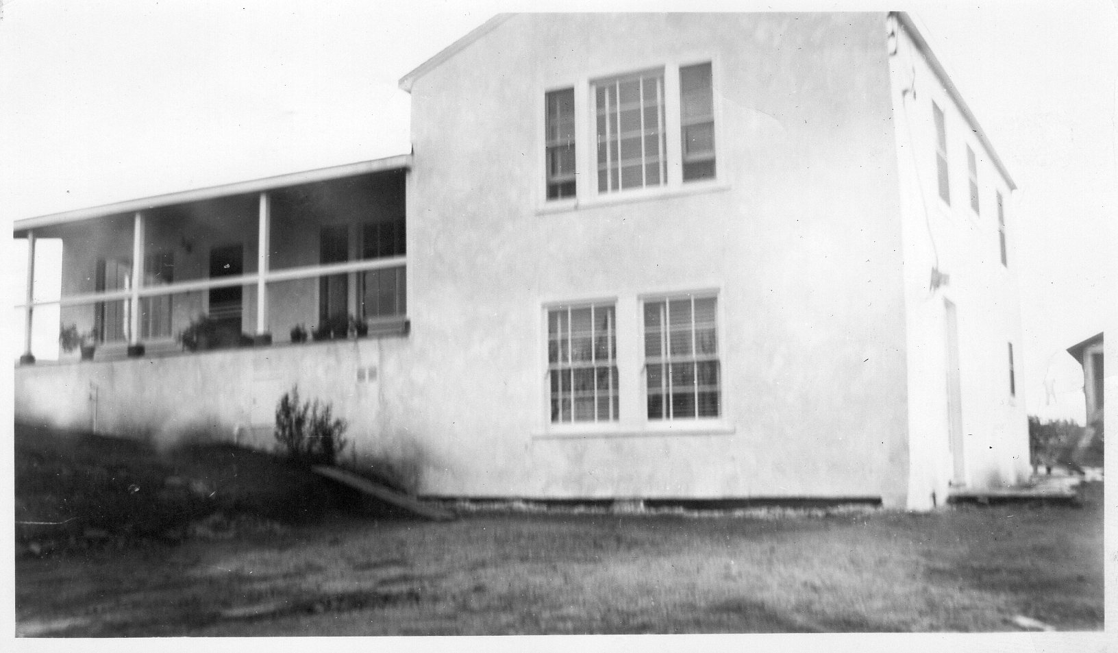

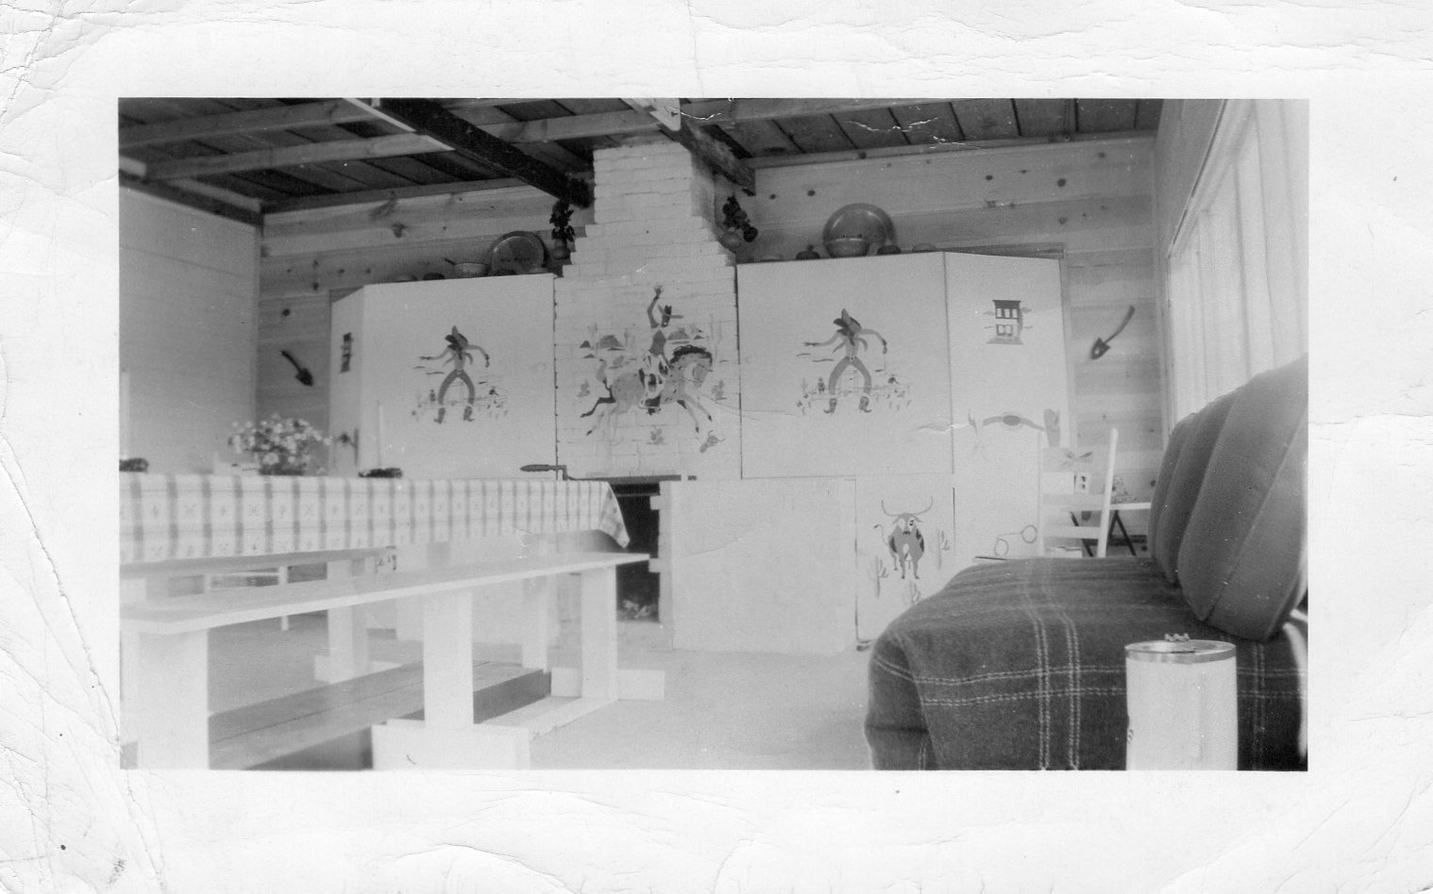
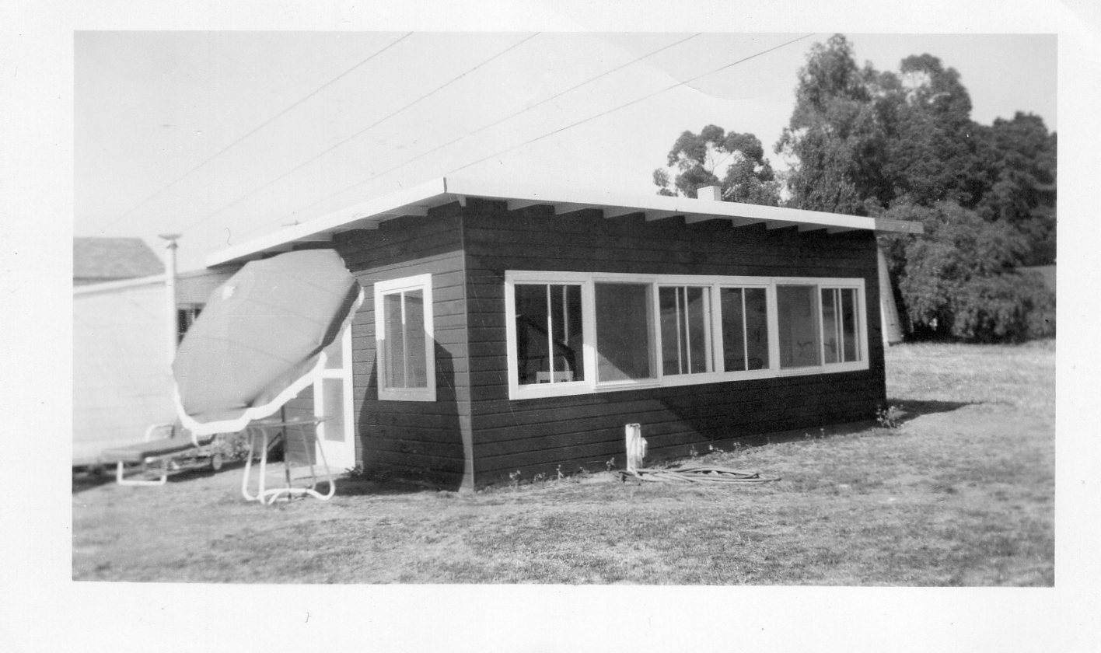
3991 East Ave Ranch Hayward CA
Hayward Home Approx. 1945-1950
Interior of rumpus room at Hayward. Art painted and decorated the fireplace in a western motif
Exterior of rumpus room Art built in 1948

Slide 3
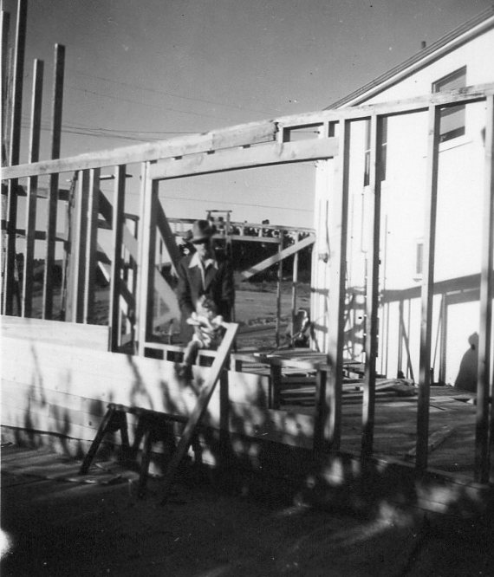
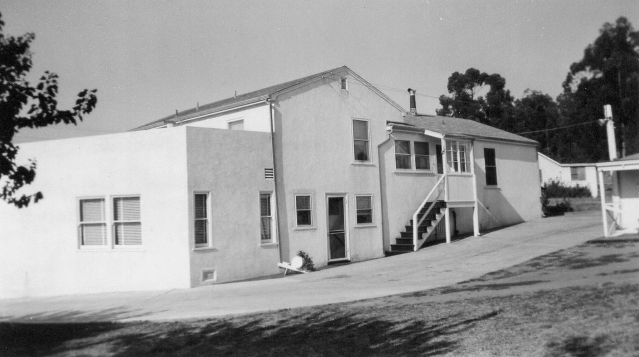
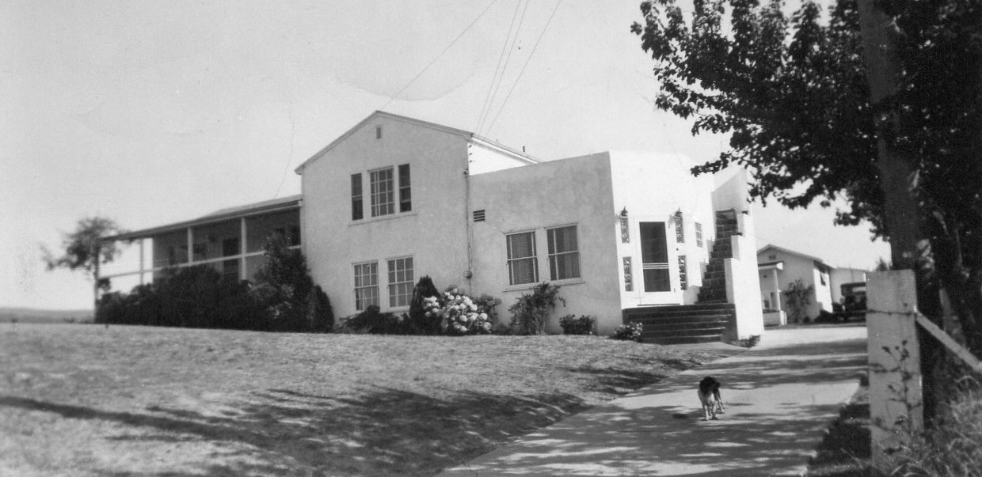
Art in the process of building the Rumpus Room Addition
Completed

Slide 4
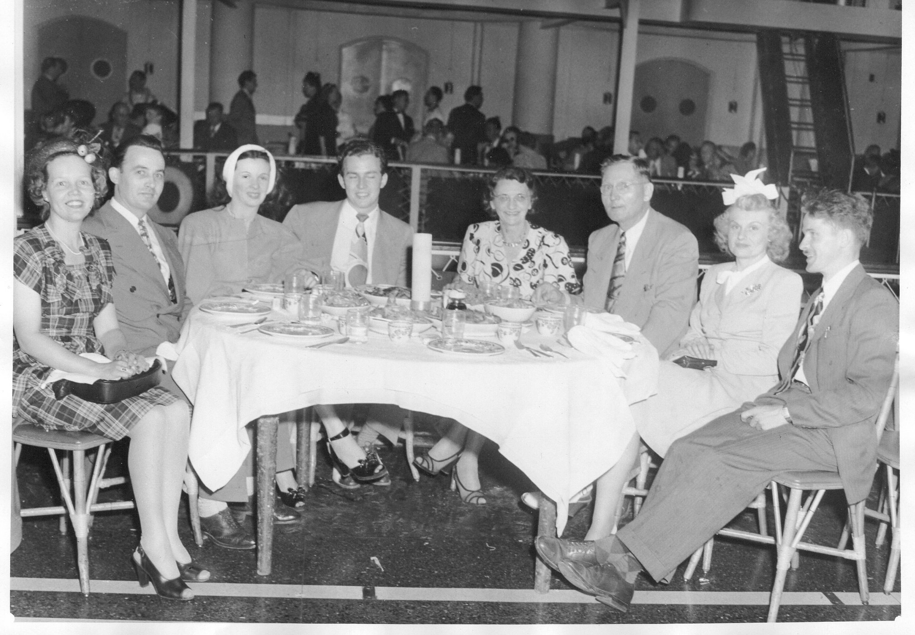
Art took over Charlie’s Steakmaker (machinery made for butcher shops) Franchise in Oakland, CA.
In 1949 Steakmaker was purchased by Hobart Manufacturing. Art was offered a job as assistant General Sales Manager covering dealers from Chicago to San Francisco.
This lasted three years until Art, tired of the constant travel, parted ways with Hobart.
Art and Dorothy at the Tonga Room (far right)
Jun 21 1947

Slide 5
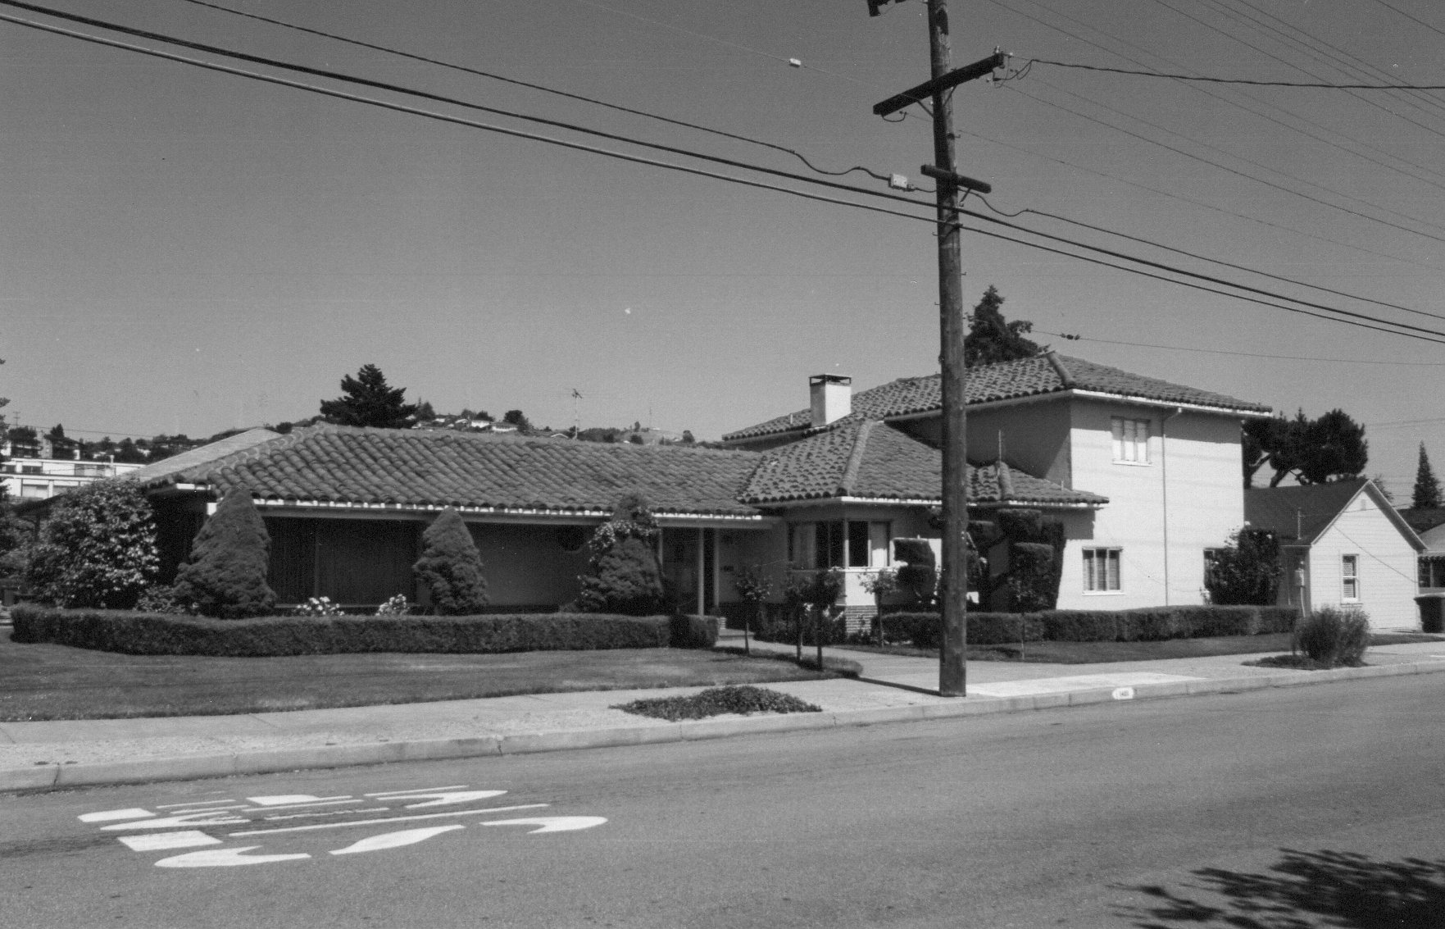
In 1950 Art moved from Hayward to San Leandro. In January 1952 Art started work as a Purchasing Manager for American Blower in San Leandro.
San Leandro House 1951-1989

Slide 6
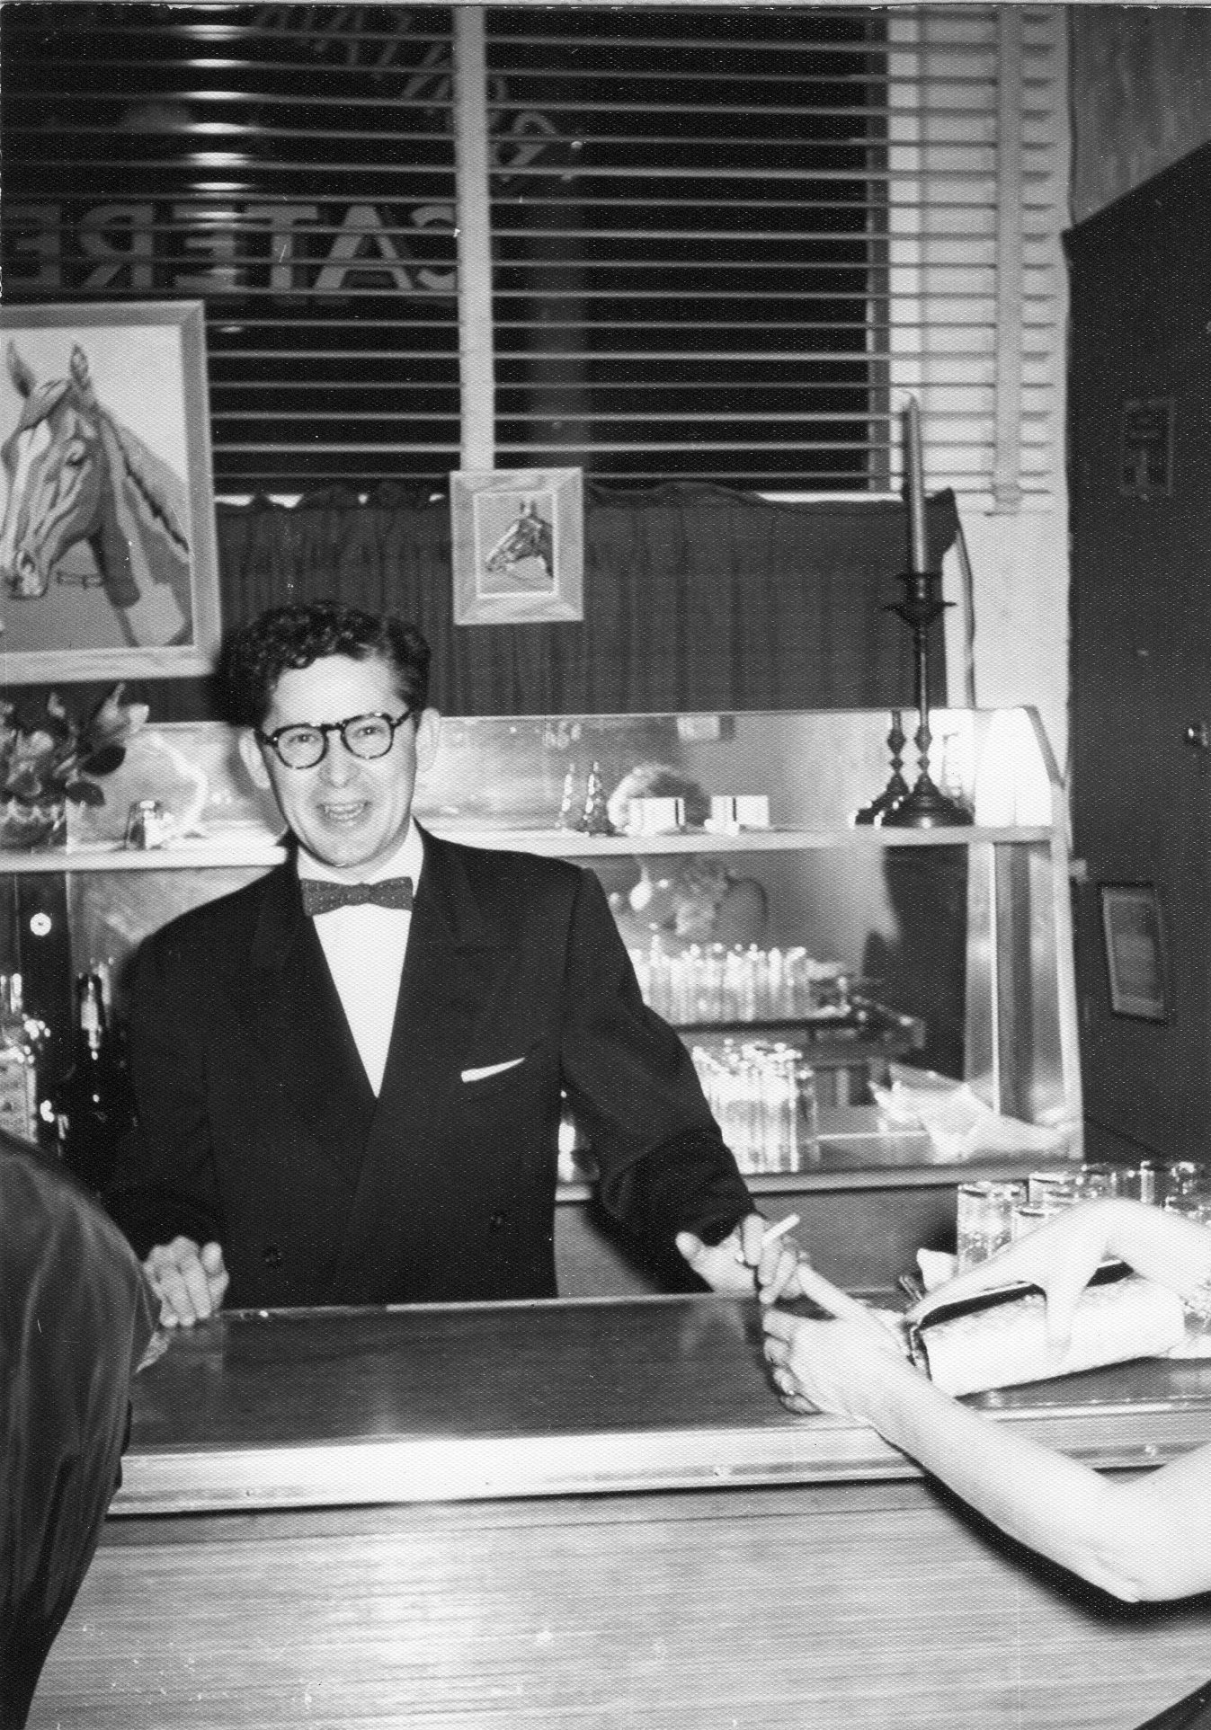
In January 1952 Art started work as a Purchasing Manager for American Blower in San Leandro. By 1954 he had also took on the job of personnel manager.
American Blower San Leandro Plant closed in 1964 and Art decided not to be transferred to the east or midwest.
1952 Christmas party at
American Blower

Slide 7
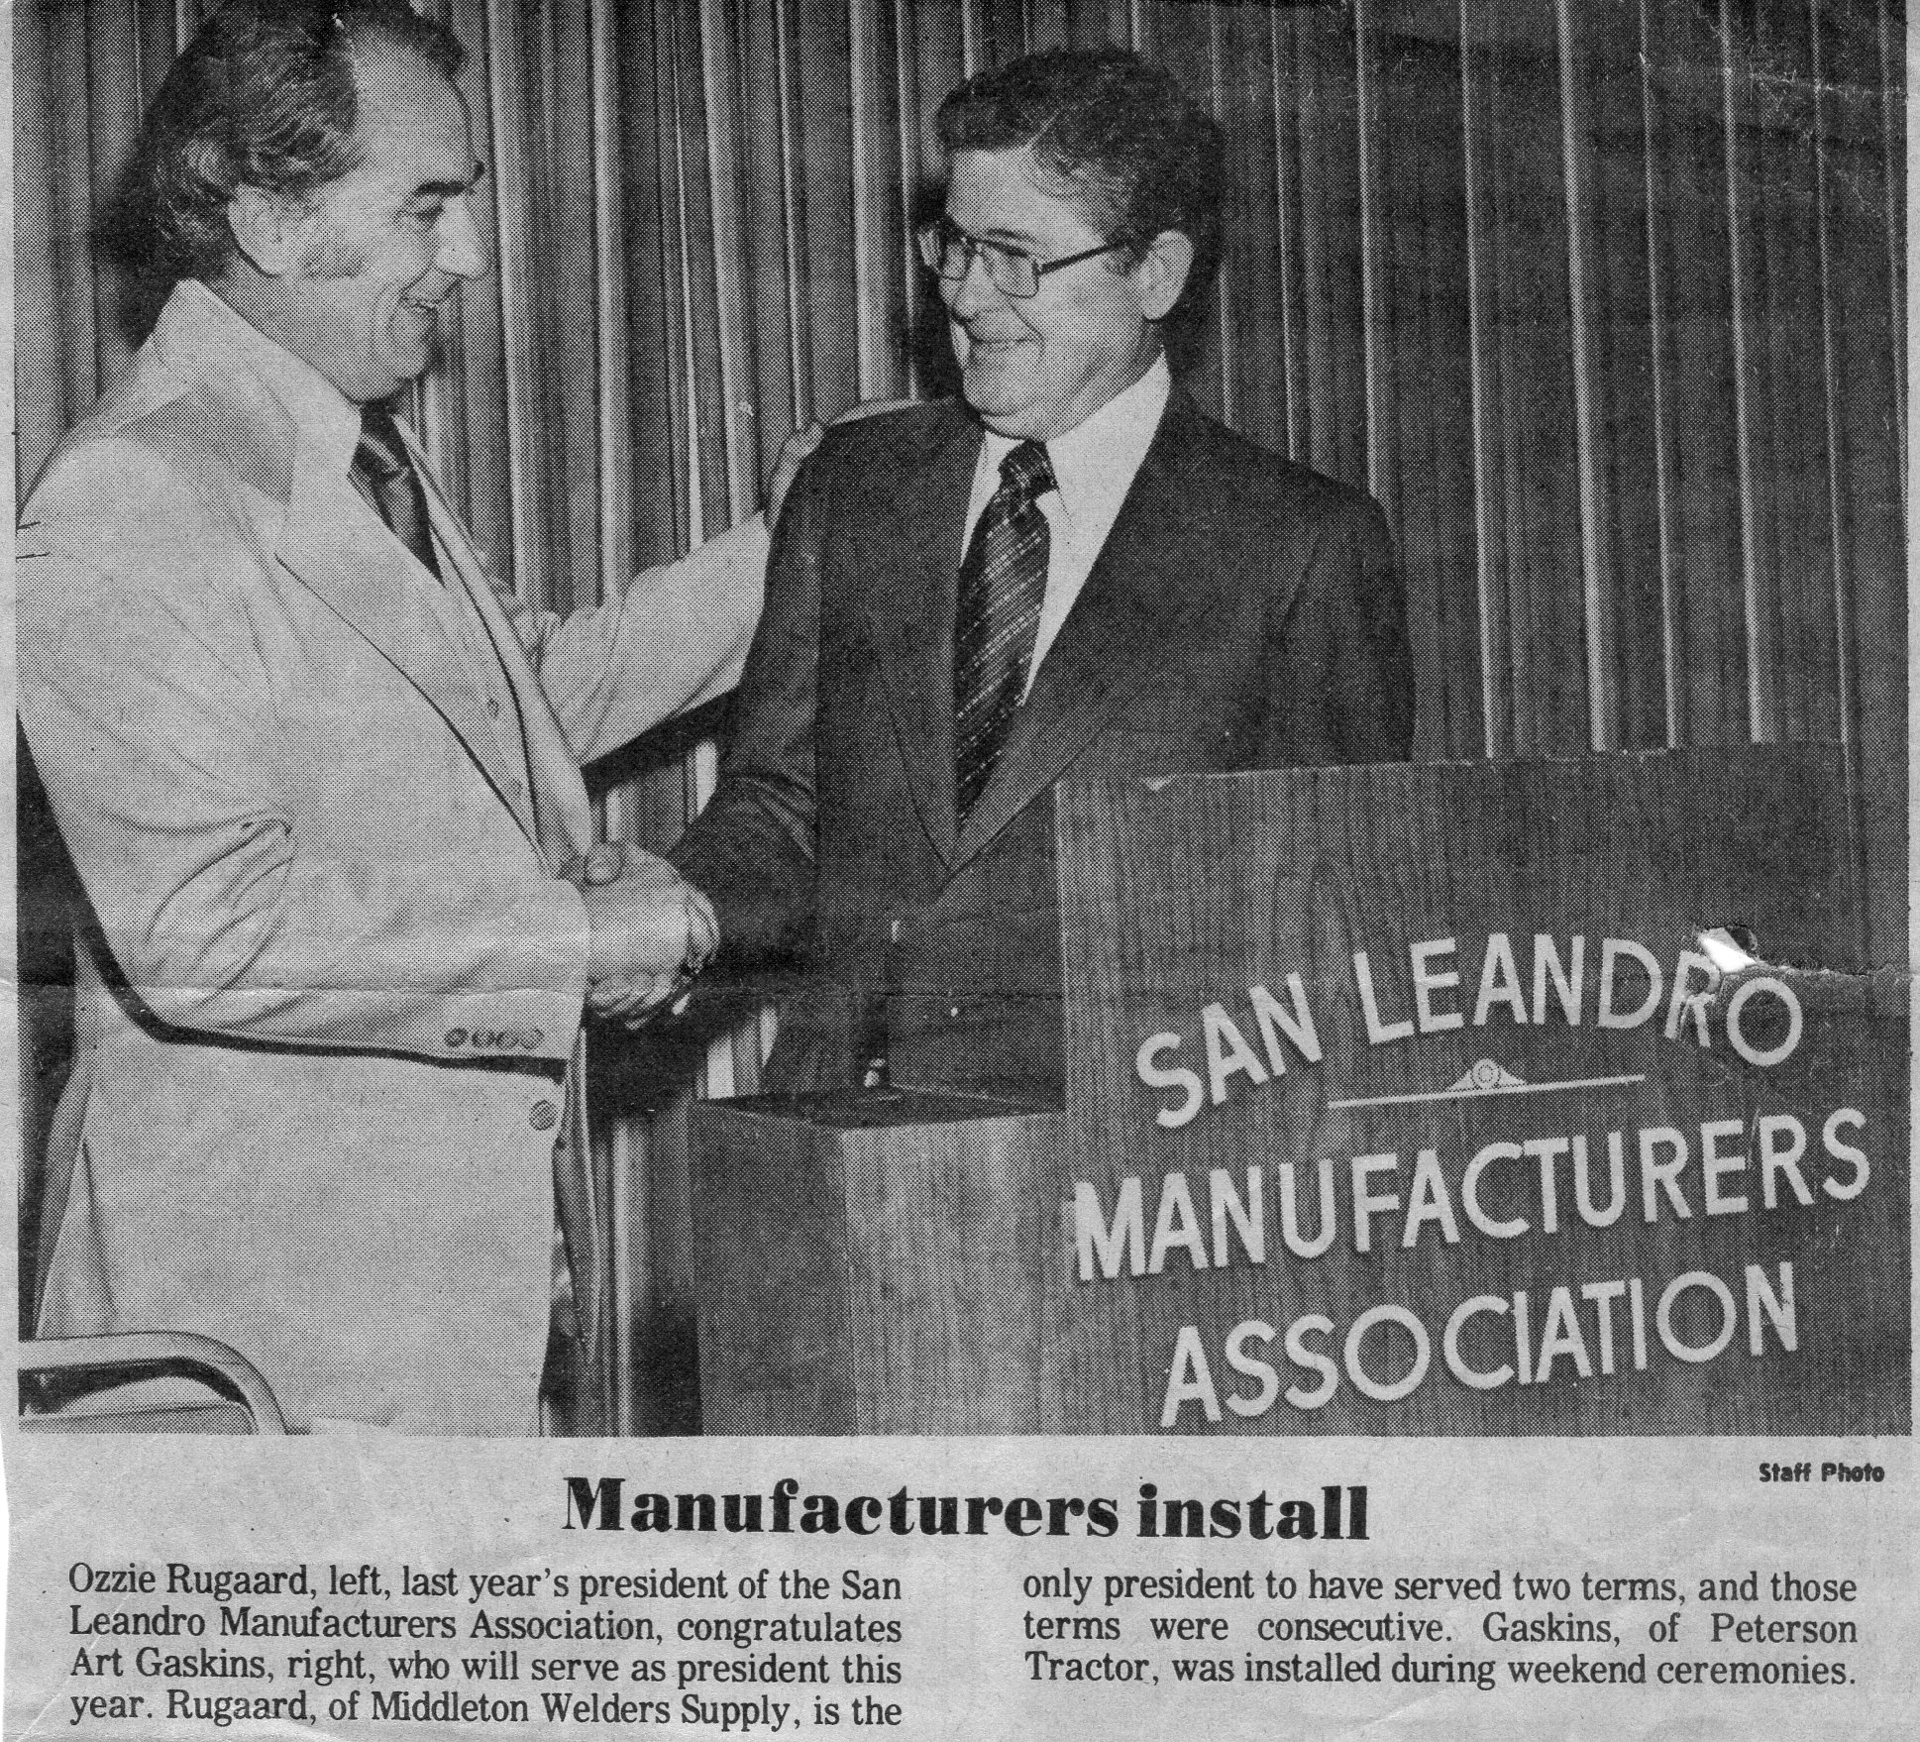
Shortly after leaving American Blower, Art took a similar position with Peterson Tractor Company in San Leandro.
He remained there for 23 years.
During his business years Art was very active in the Community and Business Committees including:
Director and president of San Leandro Manuf. Assoc.
Citizens Advisory Comm. of the East Bay Muni. Utilities District
Matthews Scholarship Comm.
Board of Trustees, Doctors Hospital of San Leandro
City of San Leandro Development Committee
San Leandro Chamber of Commerce Director
Art being installed President of the San Leandro Manufactures Association in1977 while working for Peterson Tractor

Slide 8
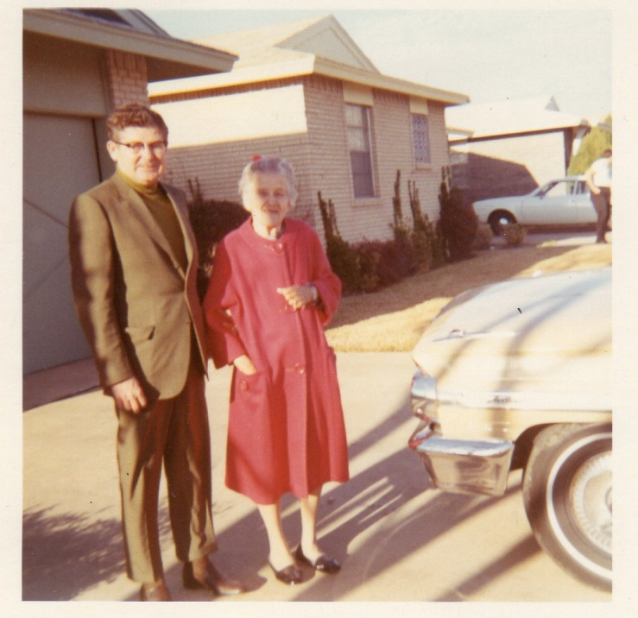
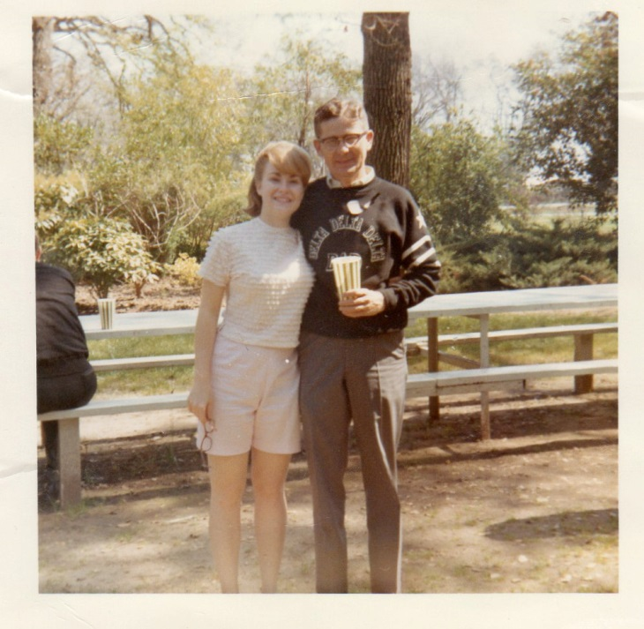
Art and his mother Winnie Gaskins
Art and Lynne at sorority
Dad's Weekend 1966
In 1965 Dorothy passed away of cancer.

Slide 9
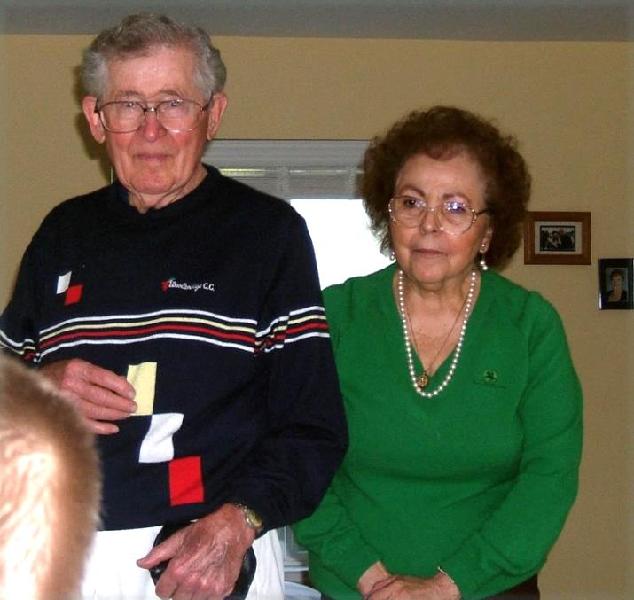
Art met Violet Caito in late 1966 and they were married in April 1969

Slide 10
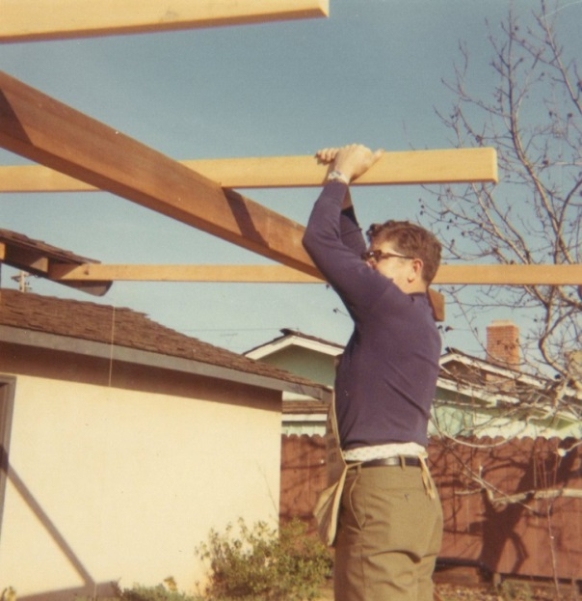
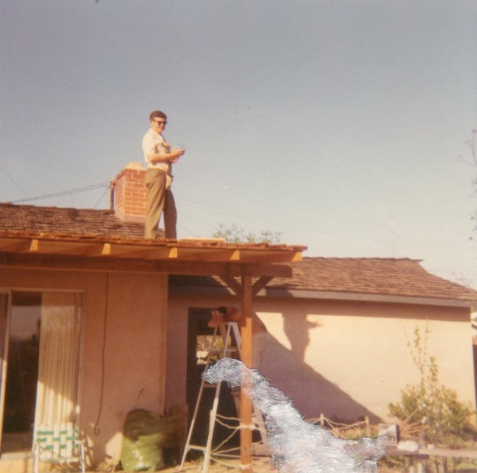
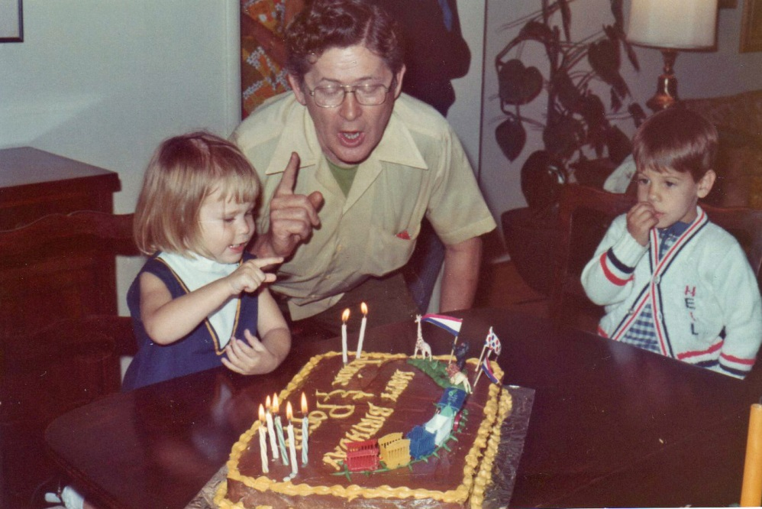
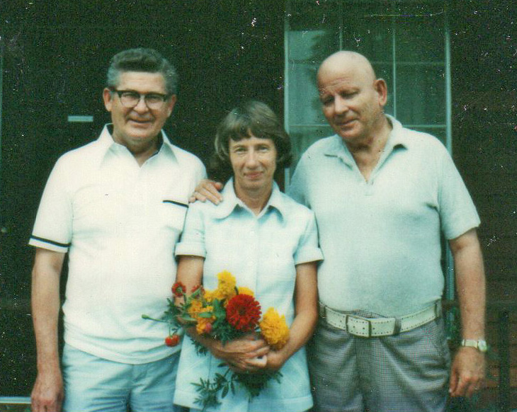
Art building a patio cover on Lynne's house 1971
Joint birthday party 1973
Grandaughter Jennifer, Grandson Neil and Art
Art, Sister Frances and Brother Ward
1976

Slide 11
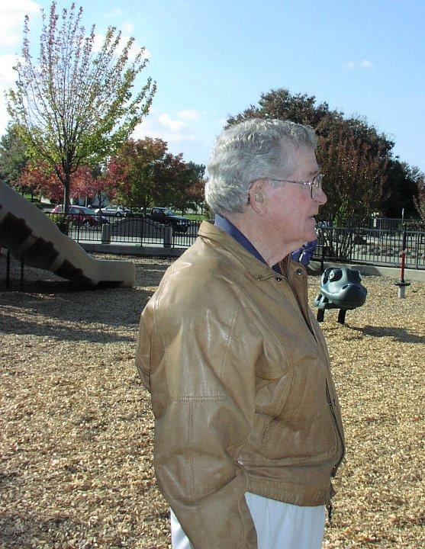
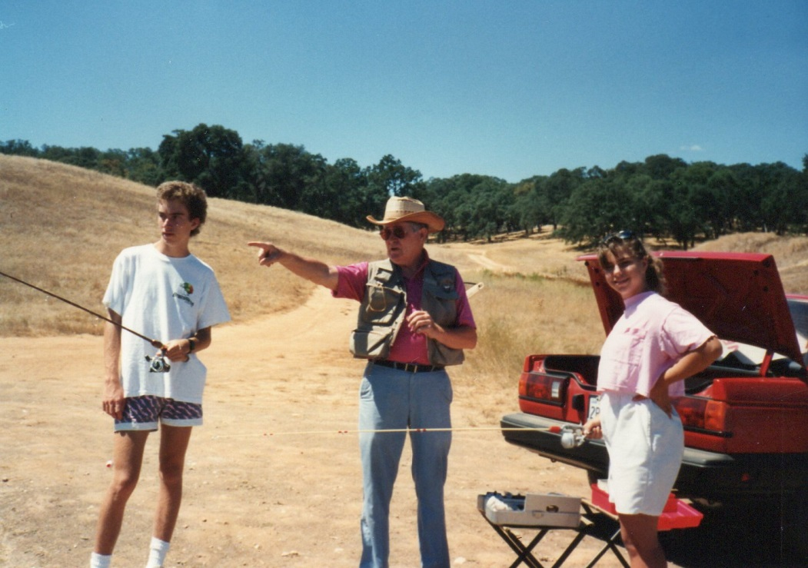
Fishing at Rancho Murieta with grandson Scott and granddaughter Lindsay about 1990

Slide 12
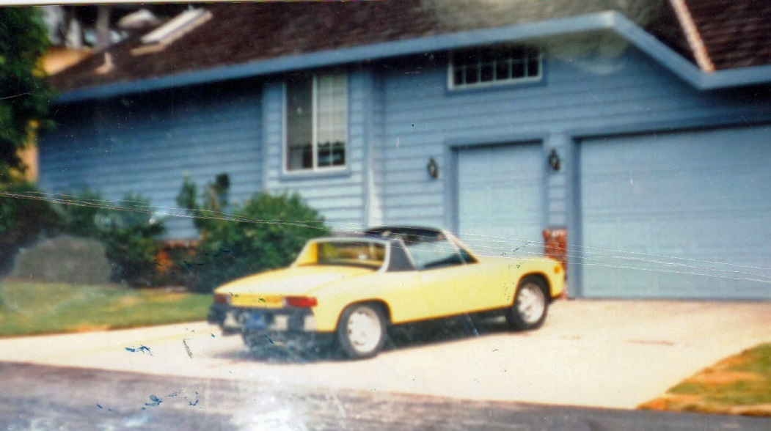
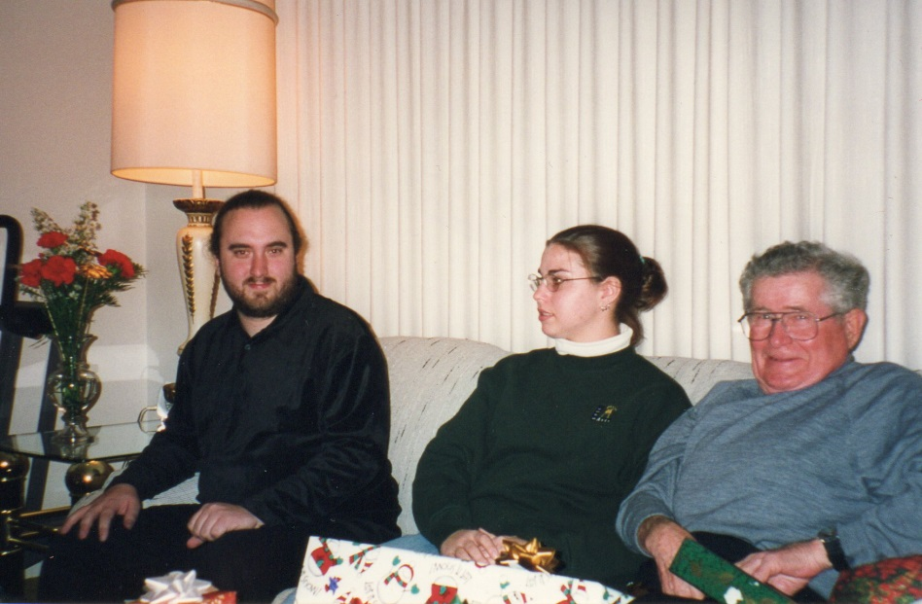
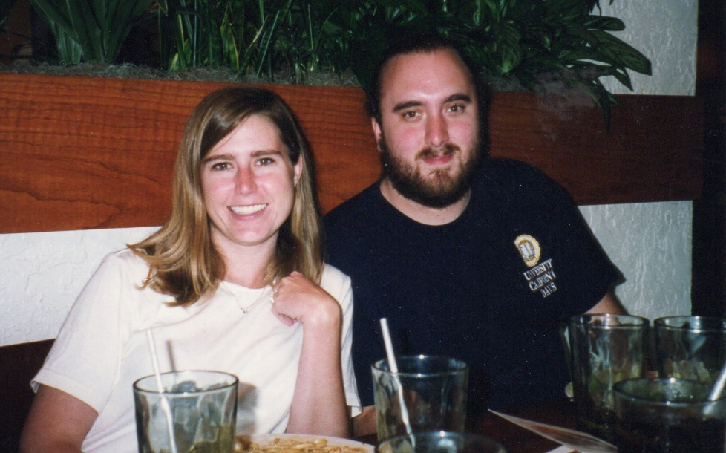
Between 1969 and 1987 Art and Vi traveled, mostly to Mexico. Art retired from Peterson in 1987 and they moved to Rancho Murieta in 1989. Art took up Golf
Art's beloved yellow Porche at
Rancho Murieta house
1989-2007
Grandchildren Scott and Lindsay,
Christmas 1999
Jennifer and Scott 1999

Slide 13
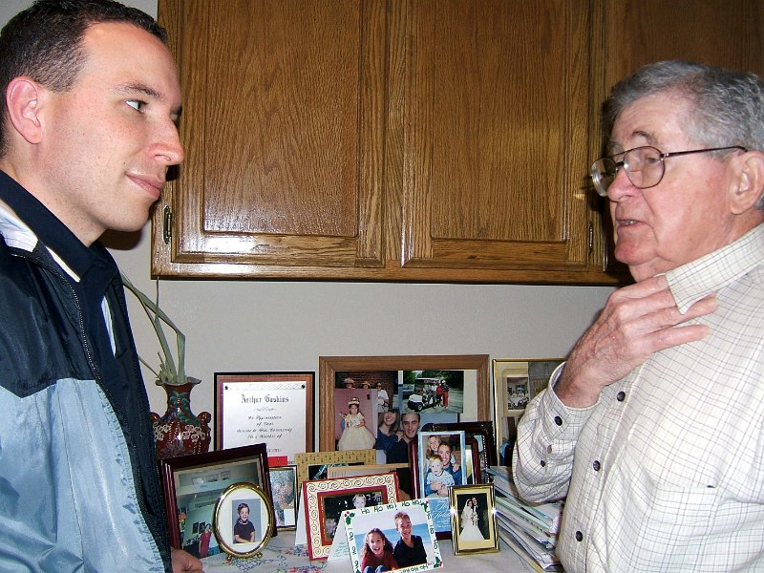
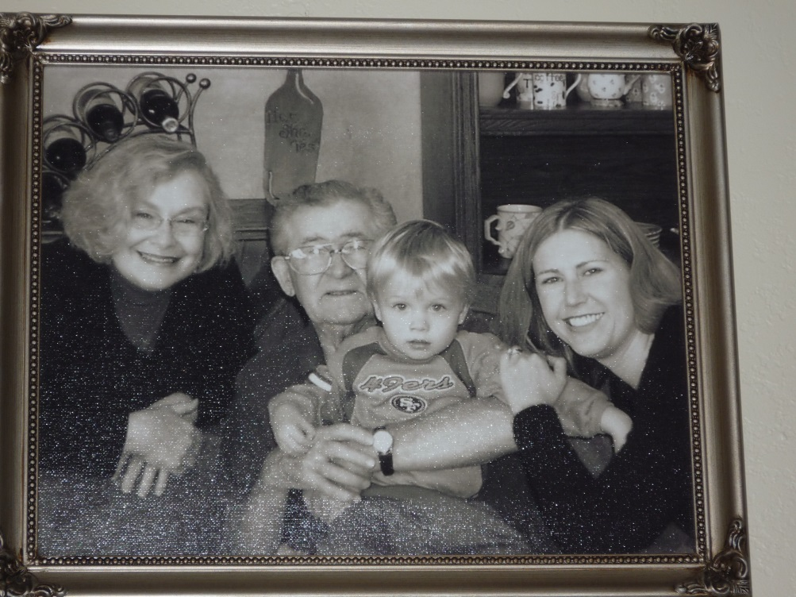
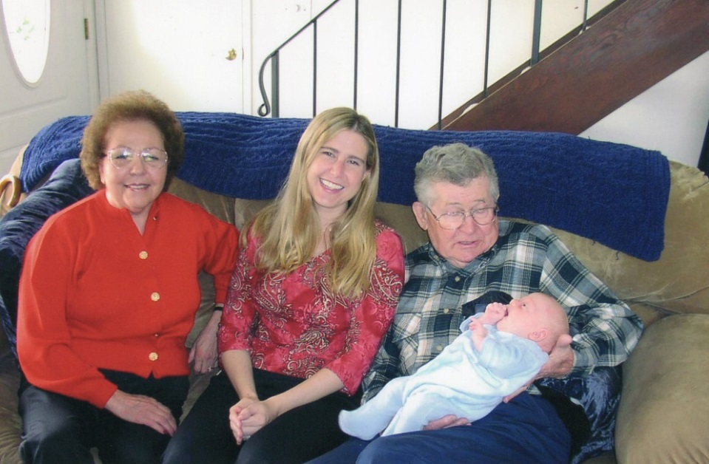
Grandson-in-law Kris and Art
Lynne, Art, Jordan and Jennifer 2005
Vi, Jennifer, Art and Great-grandson Jordan 2004

Slide 14
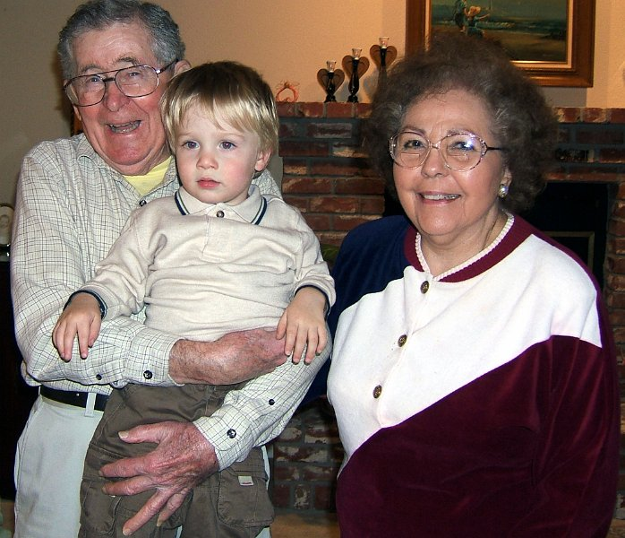
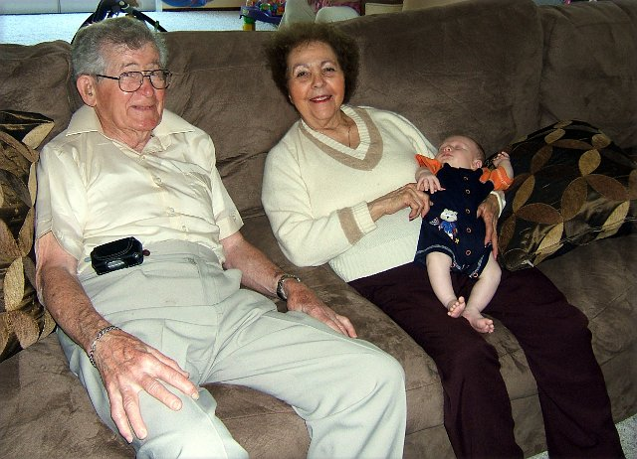
Art, Vi and Great-grandson Grant
Art , Vi and Great-grandson Jordan
In 2007 Art and Vi moved to Oakland to be closer to Family and medical facilities.

Slide 15
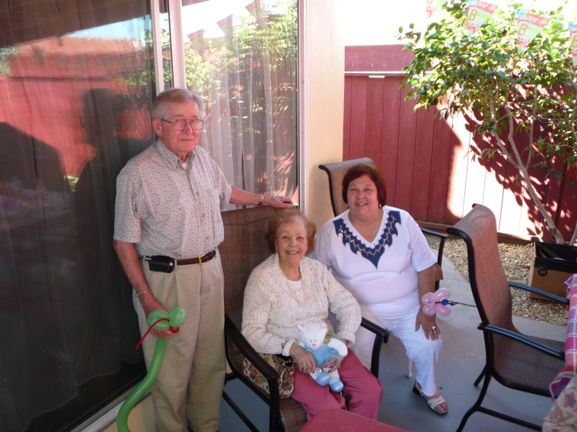
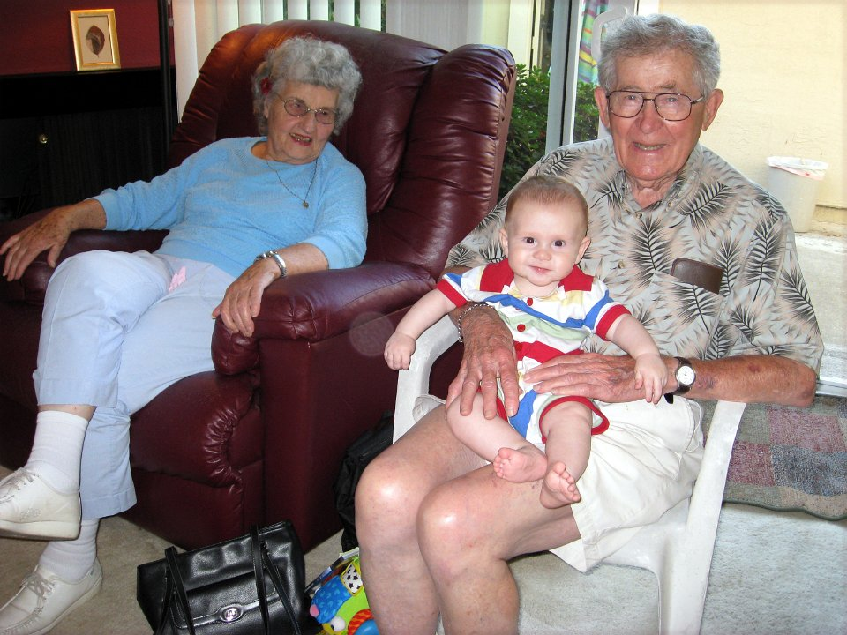
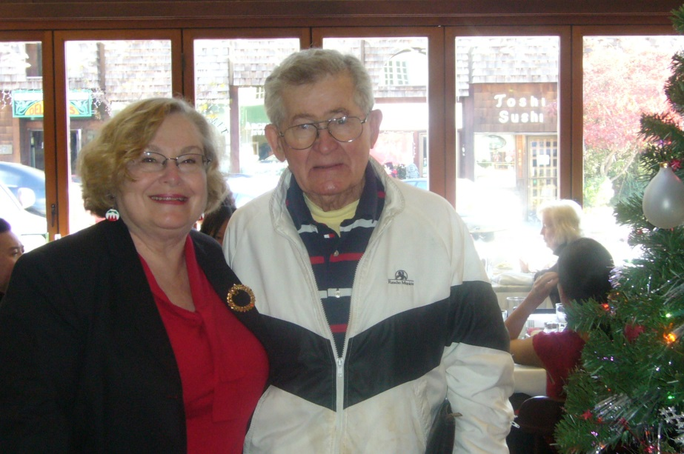
Art with Vi and her daughter Sharon in 2009
Art with Angie Call and Great-Grandson Grant 2008
In 2008 Vi moved into a board and care home due to Altzheimer’s. She passed shortly after.
Lynne and Art Christmas lunch 2008

Slide 16
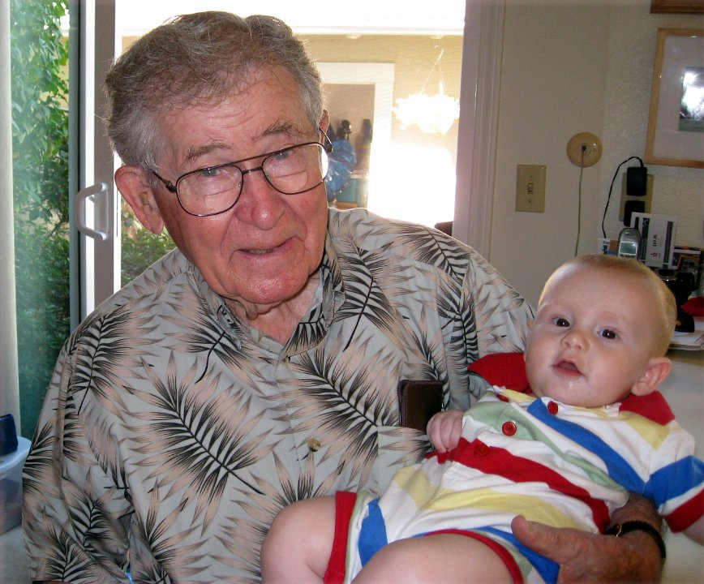
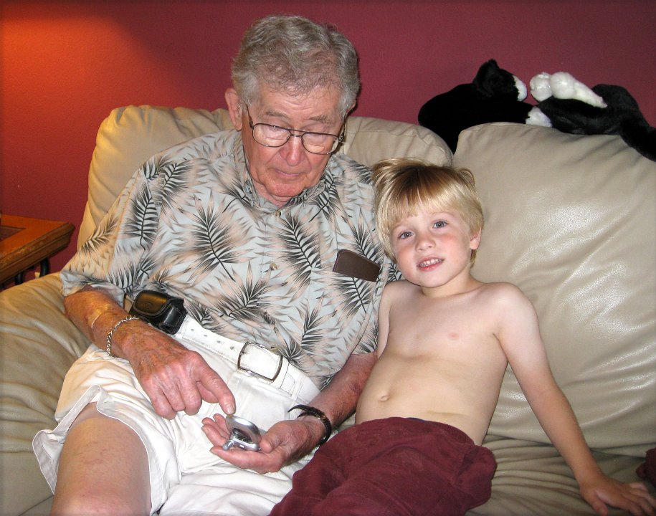
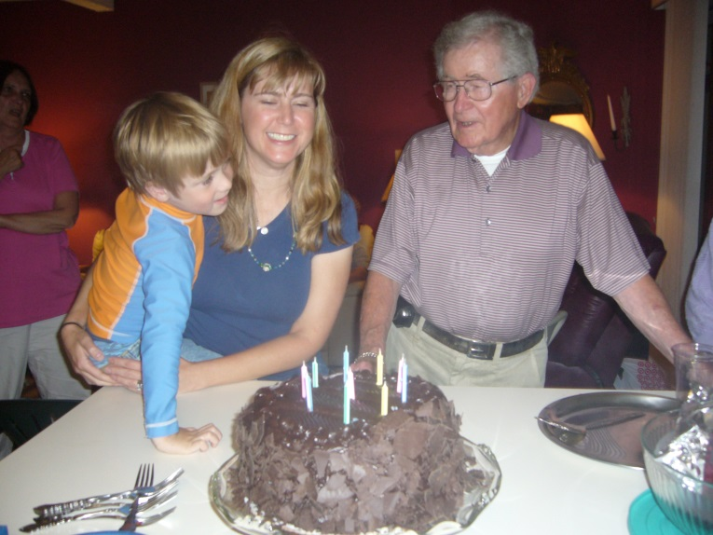
Art with 2nd great grandson Grant in 2008
1st great grandson Jordan at age 4 in 2008
Art Moved to Danville in 2009
Birthday Celebration with
grandaughter Jennifer in 2009

Slide 17
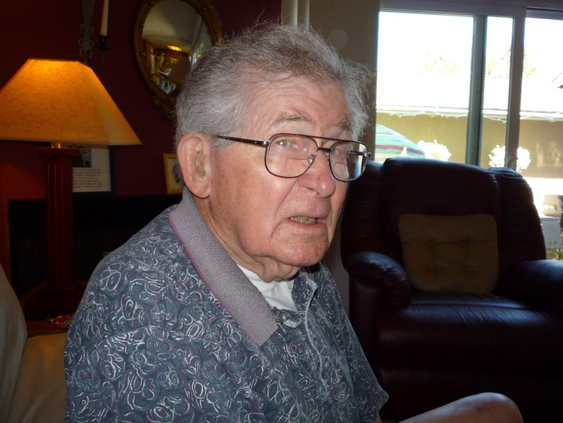
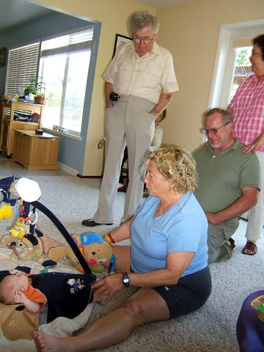
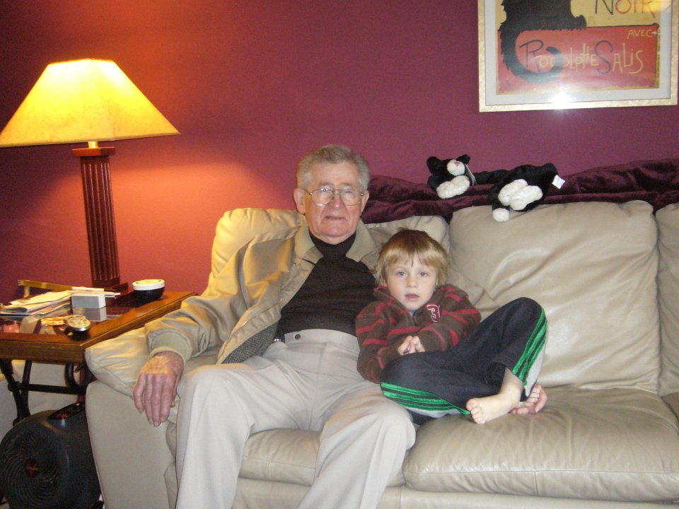
Art’s first “Selfie”
Art is standing. His step- daughter Sharon and her husband Jeff Perkins are on the right. Seated is Sue Orvik (Rusty's mother). Everyone is looking at Grant Orvik as an infant in 2008.
Art and Great-Grandson Jordan

Slide 18
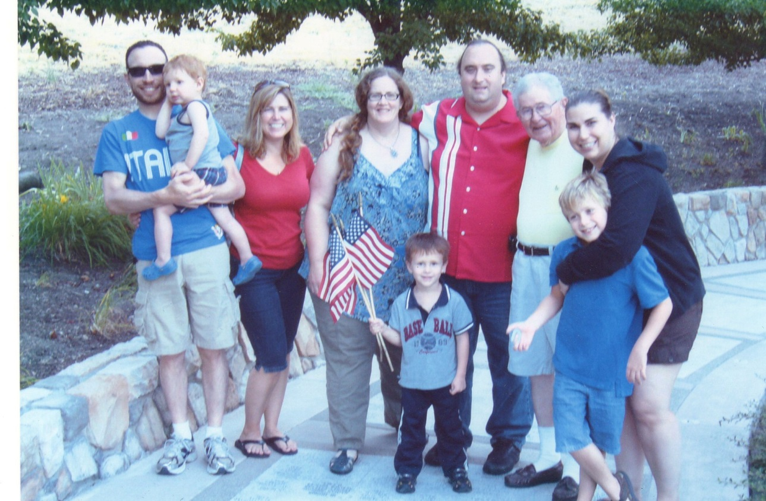
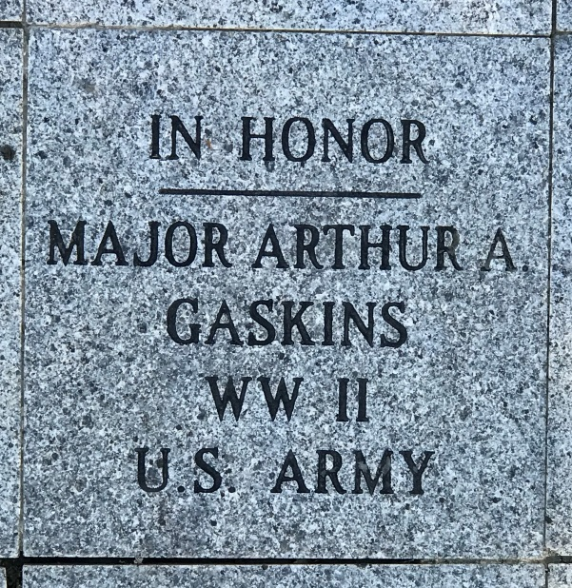
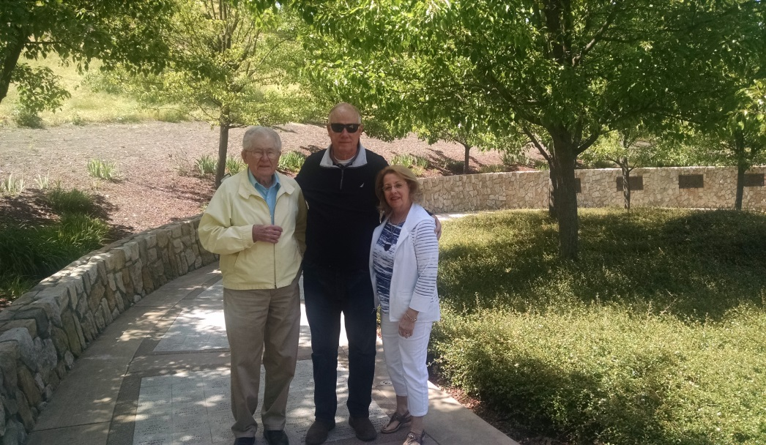
Family 2012 unveiling of Art's paver
With Nephew Danny Epps (USAF, Ret.)
and his wife Carol

Slide 19
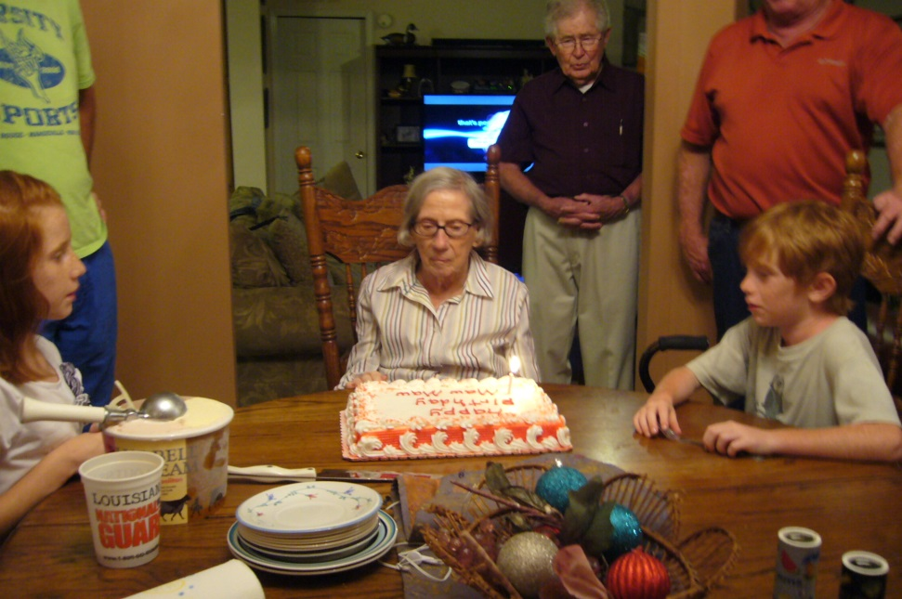
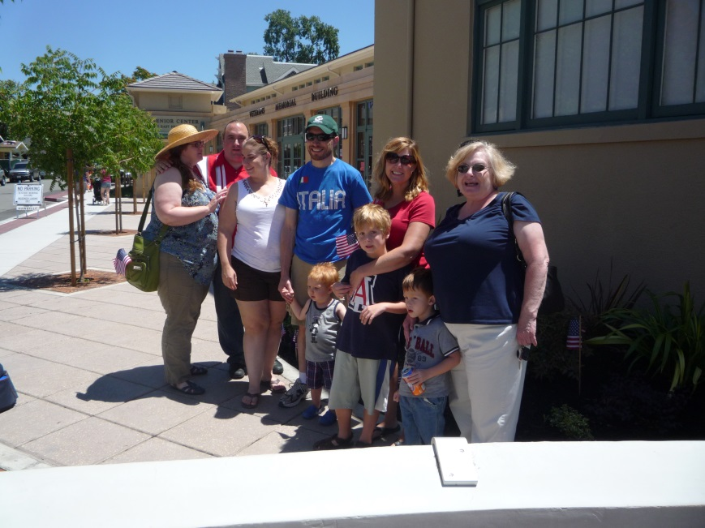
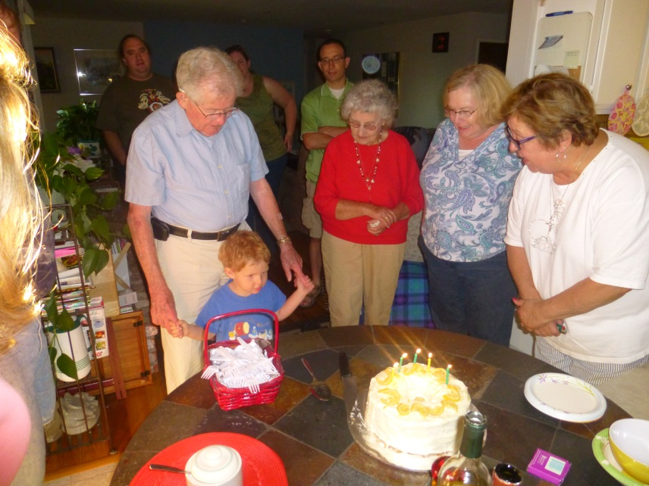
With sister Frances on her 90th Birthday
in New Orleans 2013
At the Veterans Building in 2012
Art's 95th birthday--getting help blowing out candles from great grandson Tanner.

Slide 20
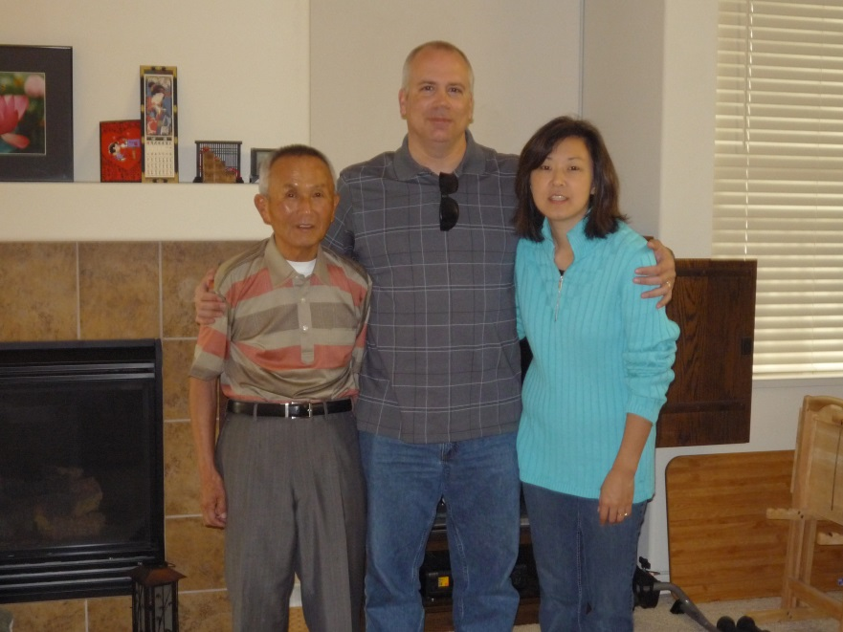
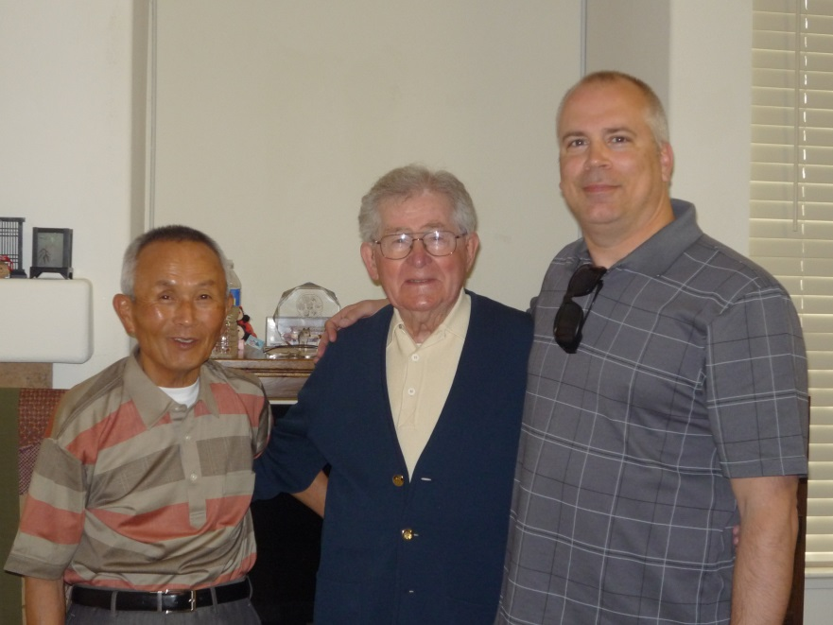
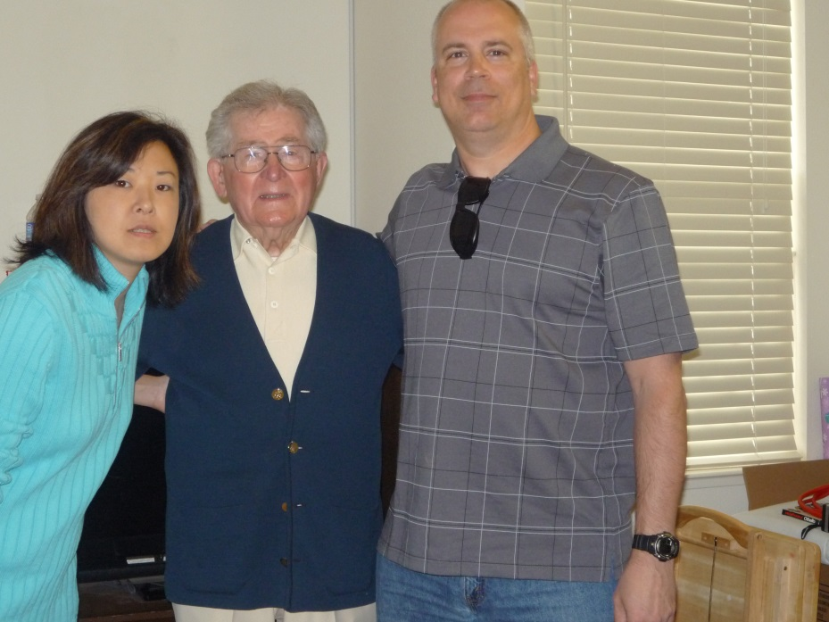
James Quest who Art worked with on the “History of Camp Beale” and his wife Junko and her father

Slide 21
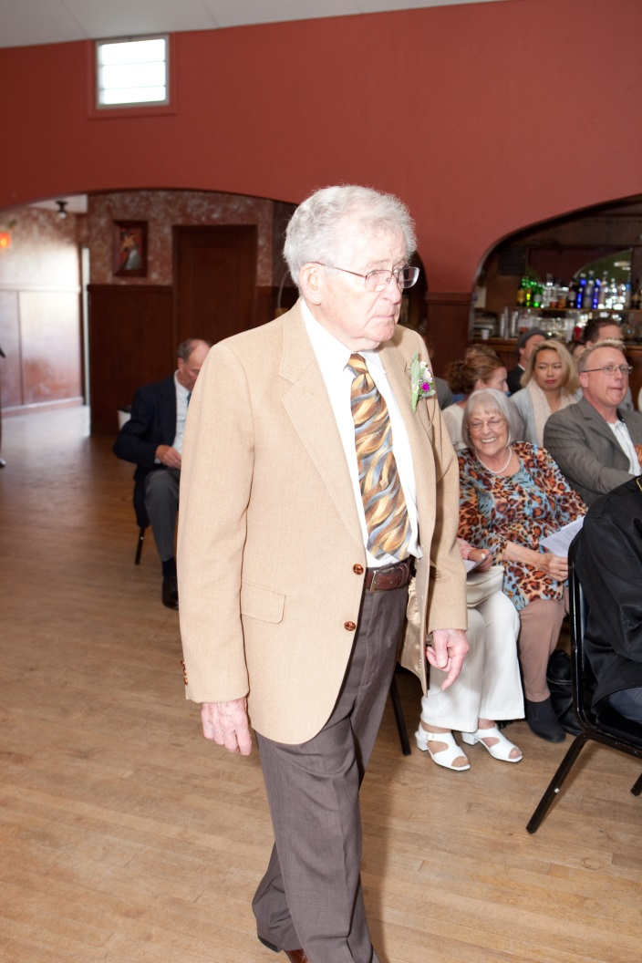
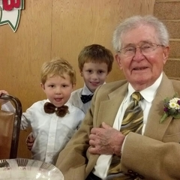
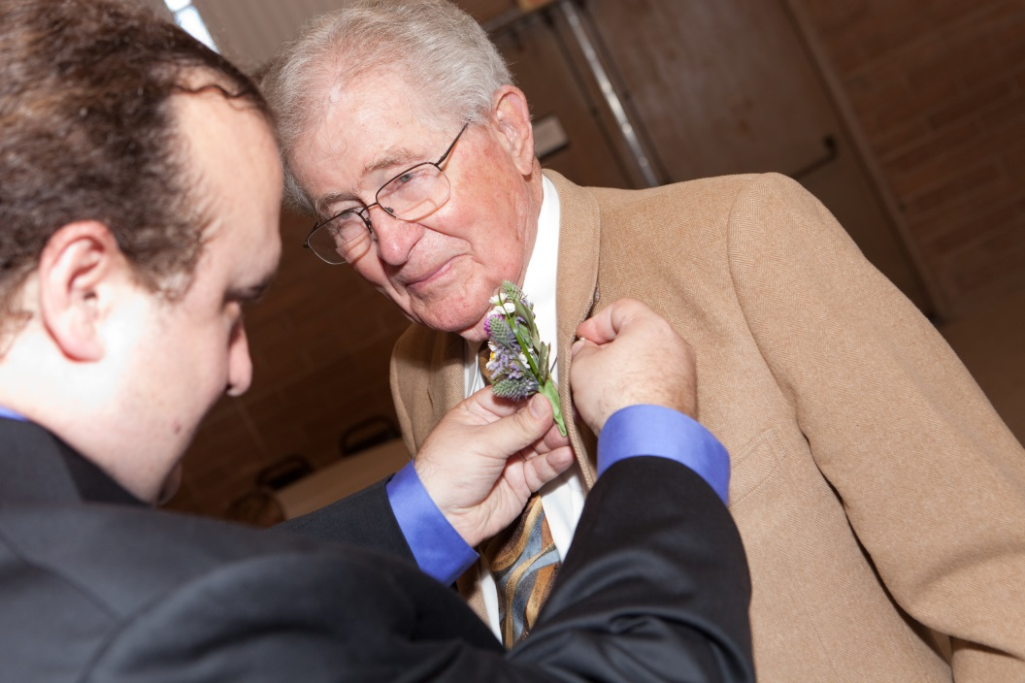
Art with great grandsons Tanner and Grant at grandson Scott's and Annabelle's wedding.
Scott’s wedding in 2013

Slide 22
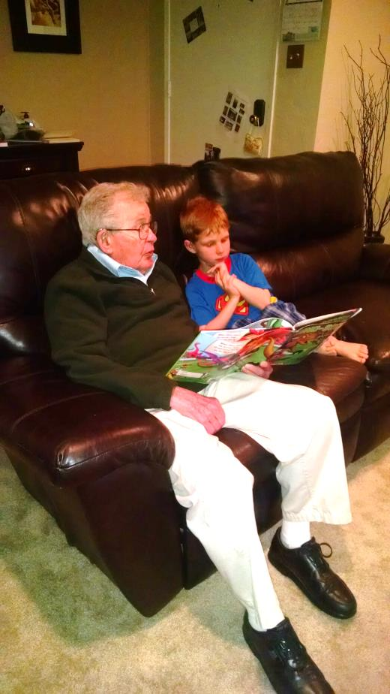


With four oldest Great Grandsons 2015
Reading to Great Grandson Tanner in Livermore 2016
5 Great Grandsons Christmas 2017

Slide 23


Rusty's retirement, March 2017.
From left, Jordan, Rusty, Jennifer and Grant.
Art with Jen at Ft. Belvoir Virginia 2015

Slide 24




Great- granddaughter Kacey Taylor.
Art and great- grandson Kellan
in January 2018.
Art getting computer lessons from great-grandson Grant
5 great grandsons March2018

Slide 25



Art with Terry cat who liked to jump
on his shoulder
Nightly routine with Terry Houdini 2017

