Slide 1
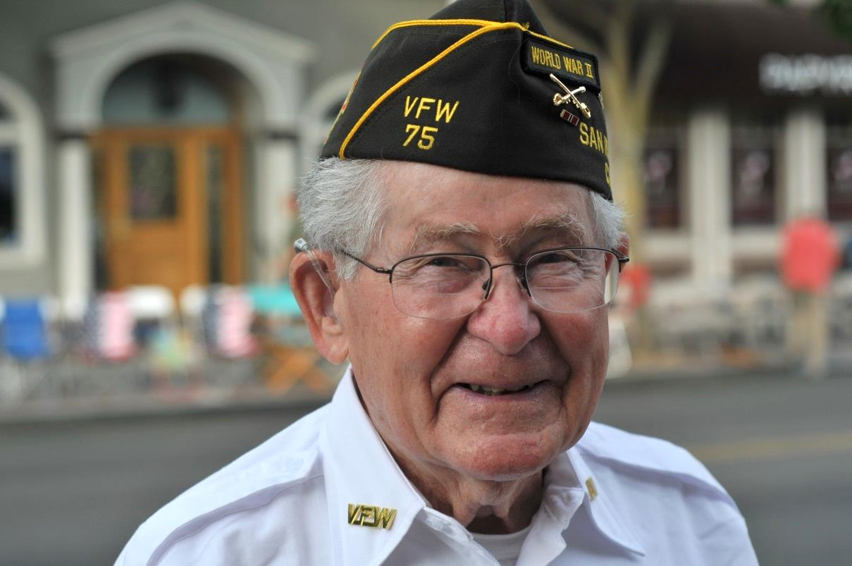
Celebration of a Life Well-Lived
Arthur Allen Gaskins 8/29/1918 – 6/17/2018

Slide 2
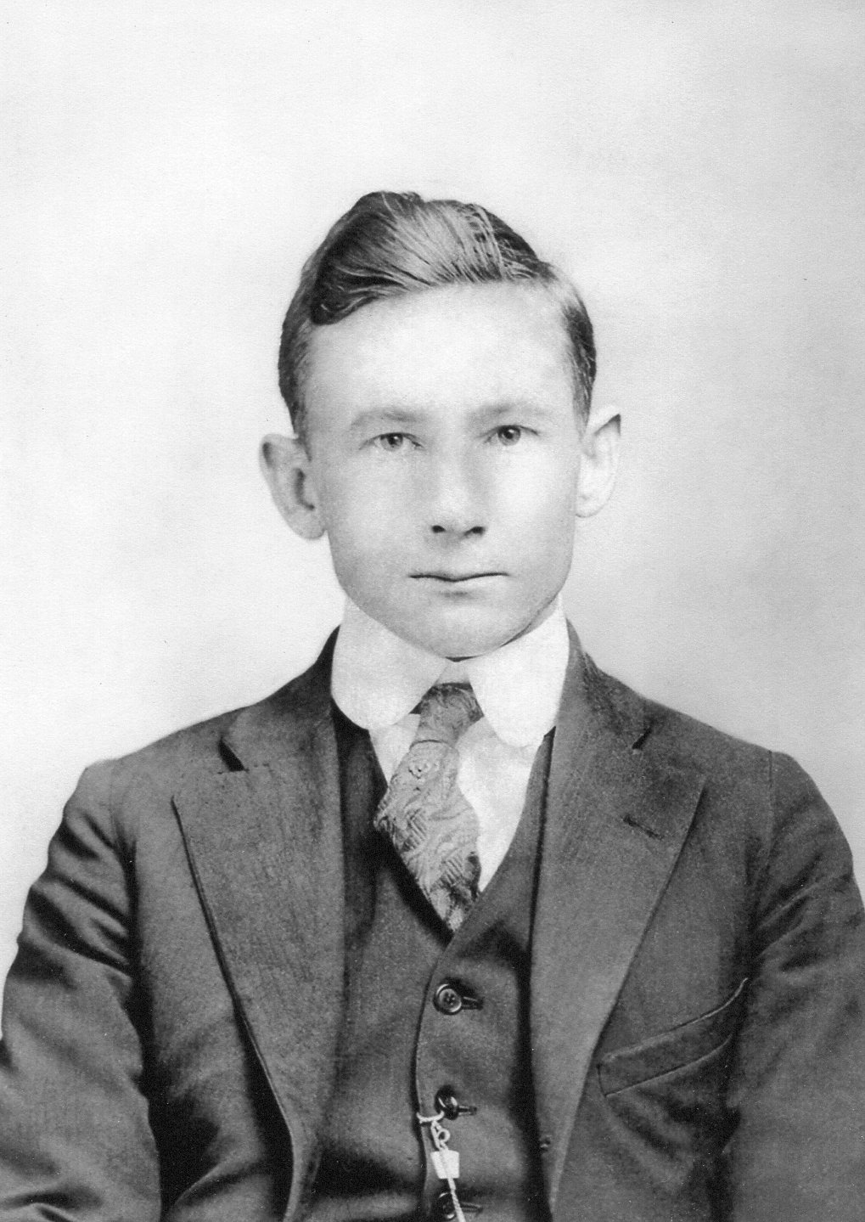
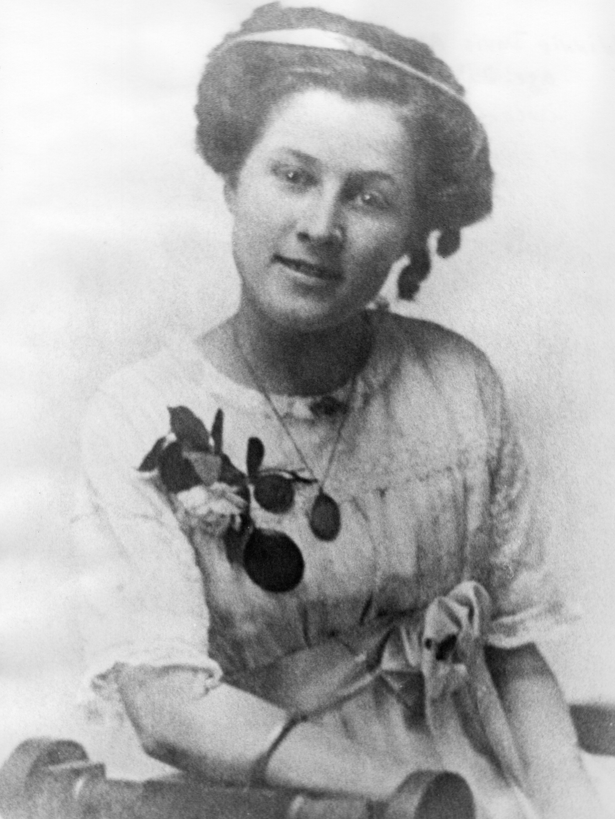
Art's Father Arthur Earl Gaskins
1909 age 22
Art's Mother Winnie Davis Allwine

Slide 3
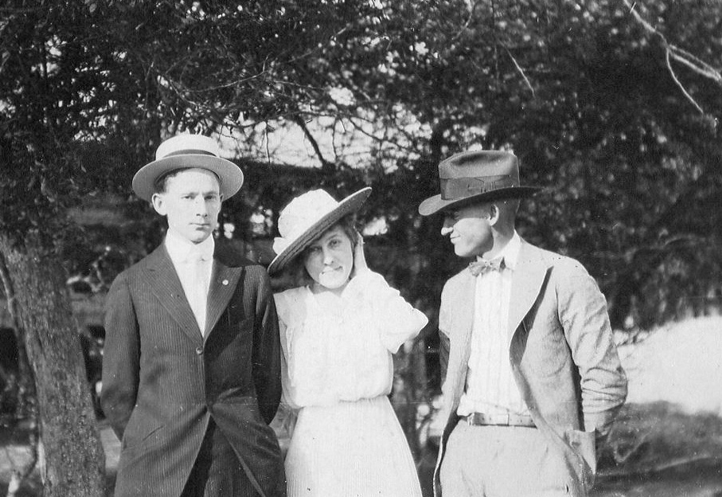
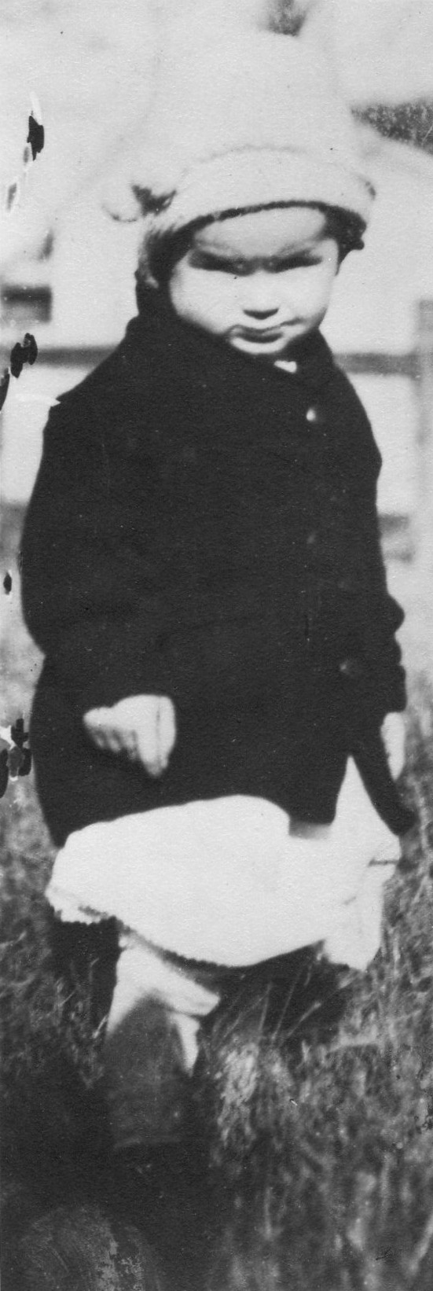
Art’s father Arthur E Gaskins and mother Winnie Davis Allwine and Hickory Jones (business partner) in 1916
Art two years old

Slide 4
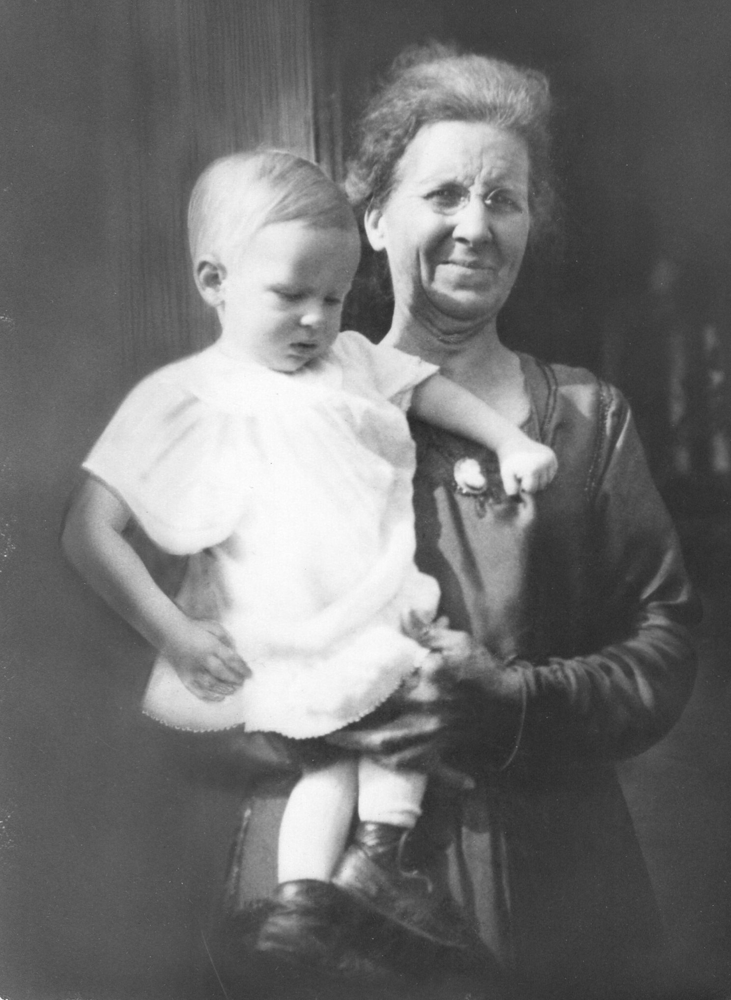
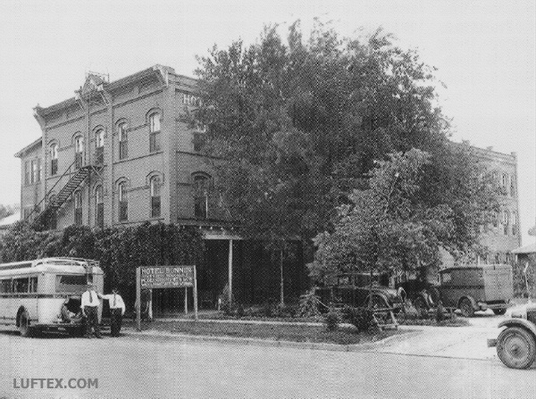
Art was born in Lufkin, Texas on August 29, 1918 to Arthur Earl Gaskins and Winnie Davis Allwine.
He soon had a brother Ward, born in 1920 and a sister Frances, born in 1923.
They lived at the Bonner Hotel
Bonner Hotel Lufkin Texas
Art at 2 with Grandmother Massingale

Slide 5
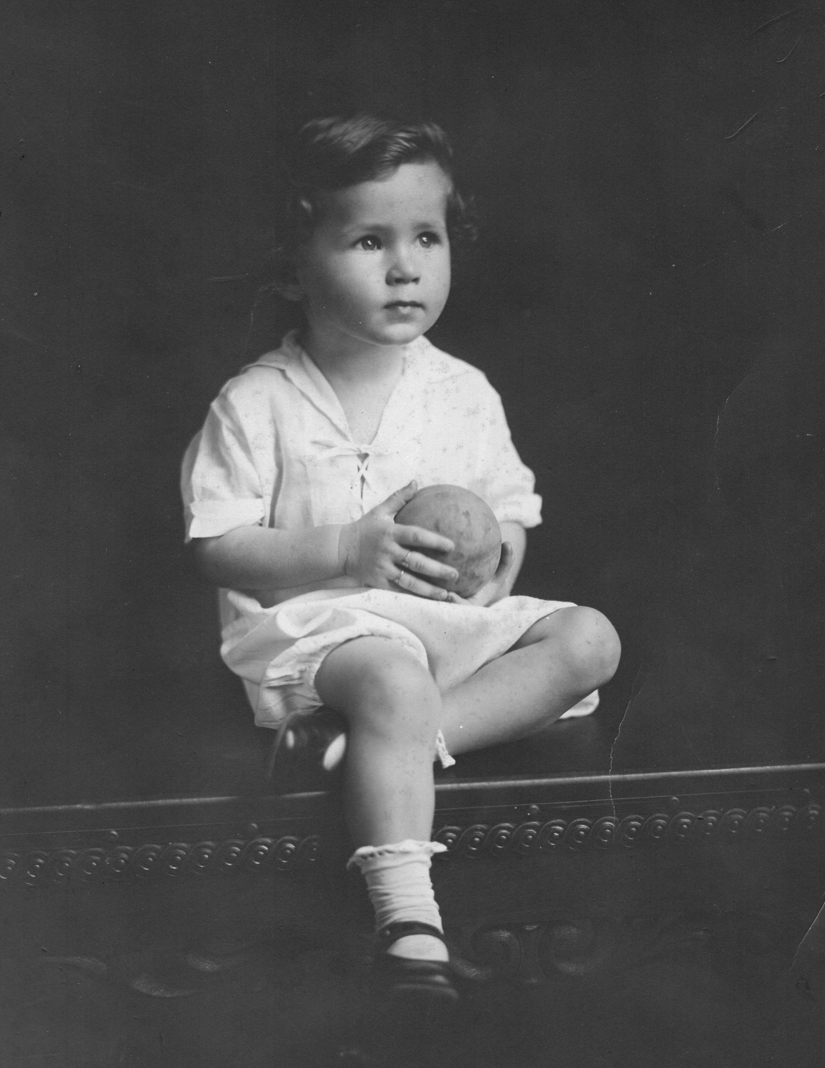
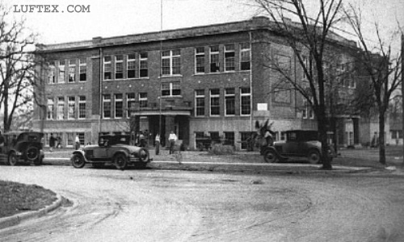
Lufkin High School
where Art Graduated in 1936
In his free time, Art enjoyed hunting and fishing in the nearby woods and fields.
He joined the Boy Scouts at 12, where he learned Morse Code, semaphore and wireless.
After graduating H.S., Art worked that summer at Dairyland Ice Cream scooping and delivering the empty cartons for refilling.
Art age 4

Slide 6
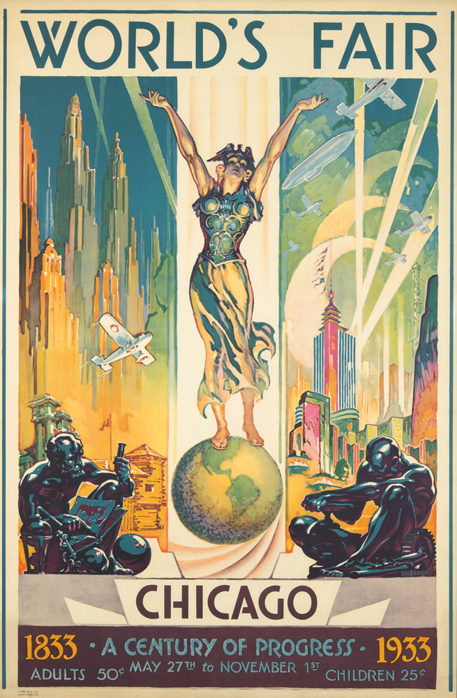
Art’s first job was Custodian of the Church and it paid $3.75 per month.
His first trip out of Texas was in 1933, when the Scout Master took him and two other scouts to the World’s Fair in Chicago.
Art went on to John Tarleton College in Stephensville, Texas. Everyone participated in ROTC and he also worked in the mess hall.

Slide 7
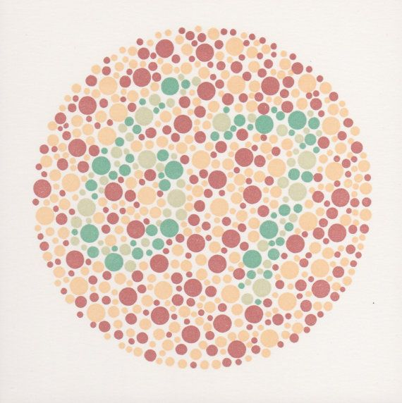
Art left after two years as everyone knew the war was coming.
The family moved to Dallas in 1937. Art always wanted to fly airplanes and there he had a chance to fly with a friend.
Art soon applied to the Army Air Corps but he failed the eye test, as he was color blind.
He did construction bookkeeping work with his father until 1941.

Slide 8
Art’s Military Years

Slide 9
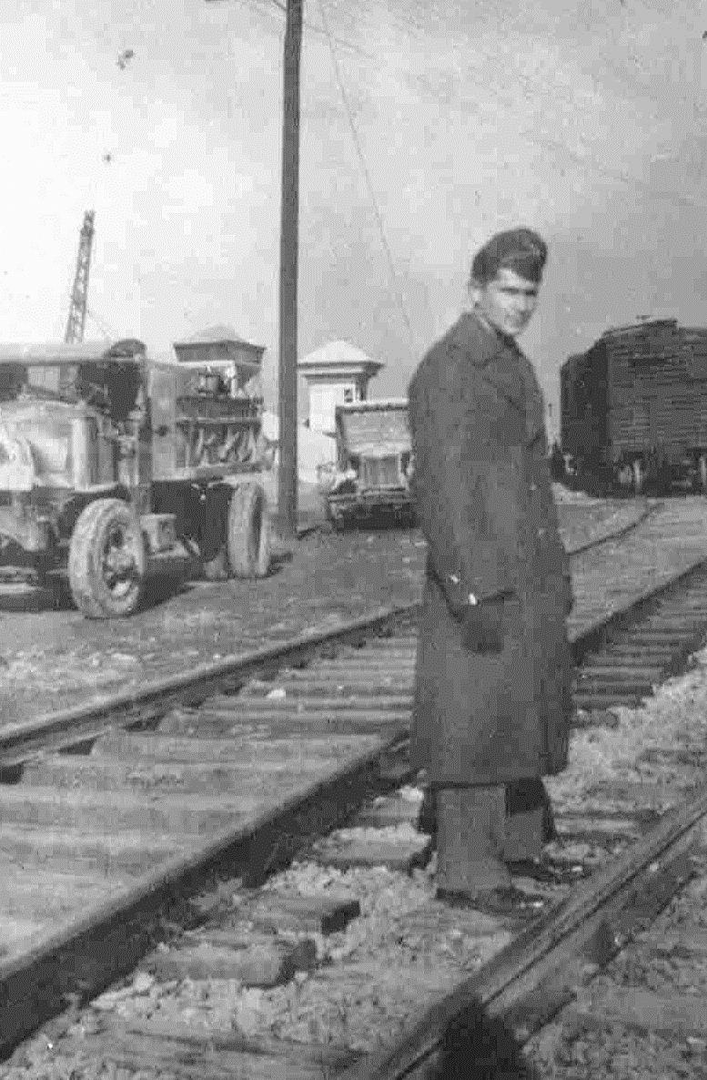
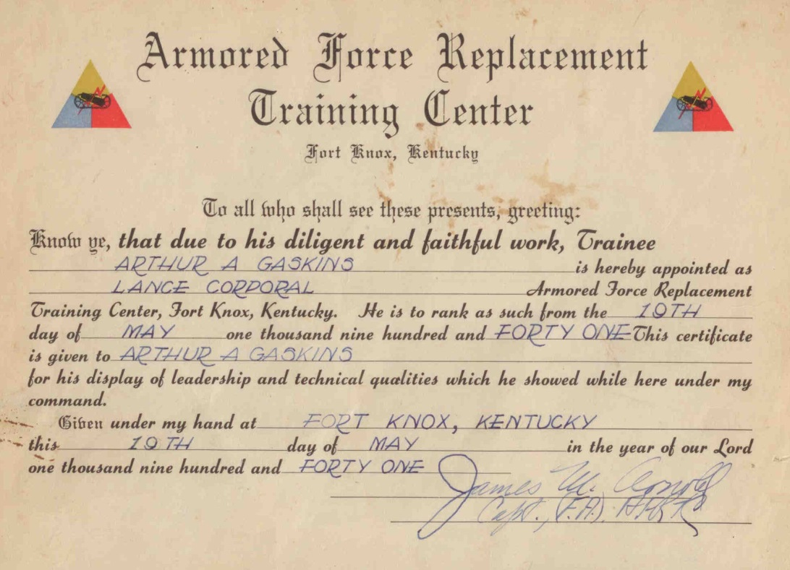
March 21, 1941 Art enlisted in the Army from Dallas Texas. He was immediately sent to Ft. Sill, OK, and then was assigned to Ft. Knox, KY for armored training. He made Corporal because of his ROTC training, then was sent to Ft. Benning, GA where he trained to be a tank driver.

Slide 10
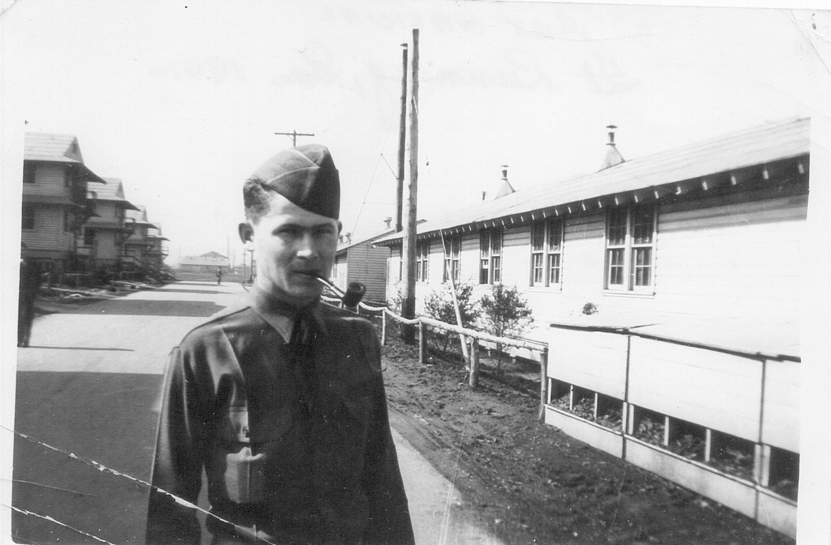
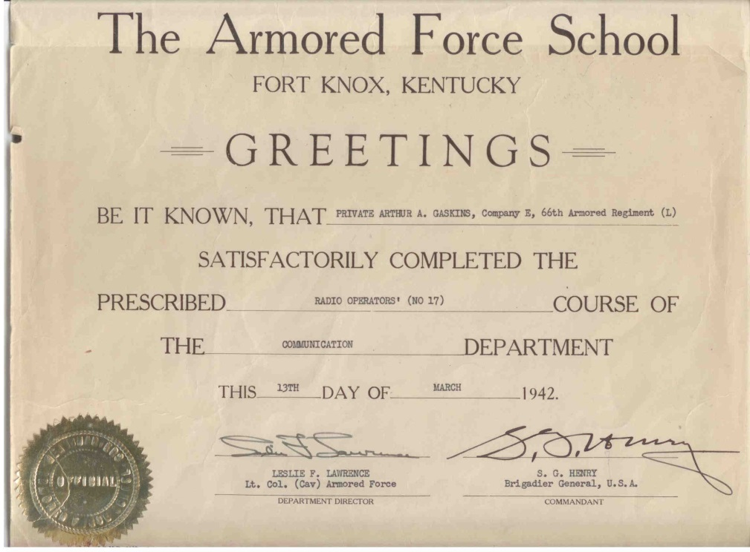
In October 1941 he was again sent to Ft. Knox to Communications School. He was scheduled to leave the service in January 1942, but Pearl Harbor was bombed and everyone was then
“in for the duration”
Completion of Radio Operators Course 1942

Slide 11
SECOND ARMORED DIVISION 1941
Ft. Benning, Georgia
Louisiana Maneuvers
(First large unit training since WW I)
DETAIL BARRACK AT
SAND HILL
FT. BENNING
E. Co. 66TH INFANTRY
2ND ARMORED DIVISION
BARRACK SCENE
1941
FT. BENNING
E-66

Slide 12
1941 GENERAL PATTON
REVIEWING OPERATIOS WITH TROOPS OF 2ND ARMORED DIVISION
FT. BENNING
On left side, man with pointing stick is General Patton
1941 DRESS DUTY UNIFORM
WAITING FOR BUS TO NEW STATION
PROBABLY TO SCHOOL

Slide 13
1941
TANKERS’ WINTER UNIFORM
FT. BENNING
COLUMBUS, GA AIRPORT
JUNE 1941
I TOOK THIS FROM A CURTIS ROBIN

Slide 14
1941
LOUISIANA
“DOWN TIME”
LAUNDRY DAY
MEDIUM TANK 1941
FT. BENNING, GA
NOTE GUN IN RIGHT SPONSON

Slide 15
1941 MESS KITCHEN
LOUISIANA
1941 LOUISIANA
M-3 LIGHT TANK – E-3
66TH ARMORED REGIMENT
(NOTE—NO GUN)

Slide 16
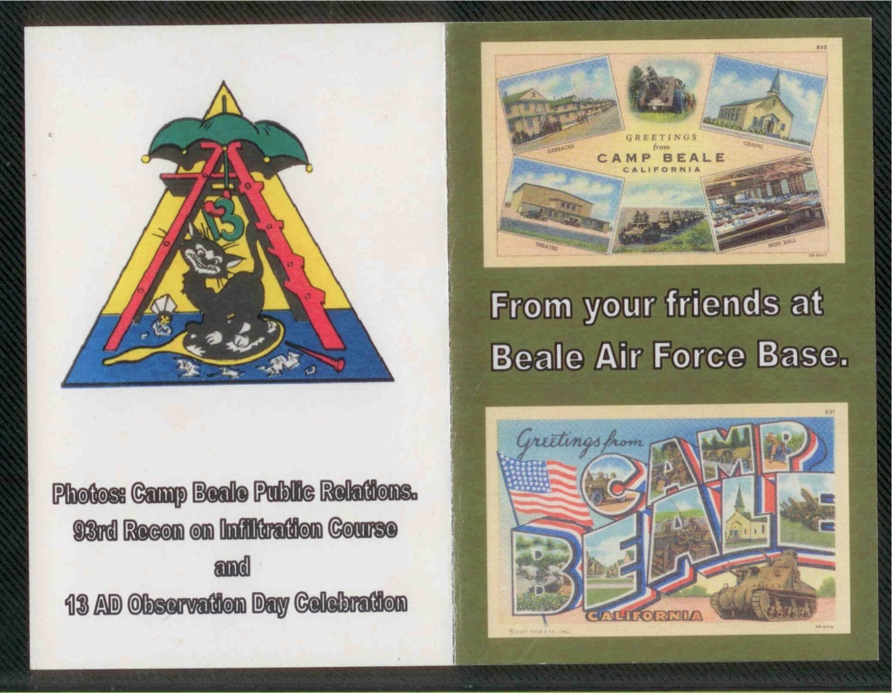
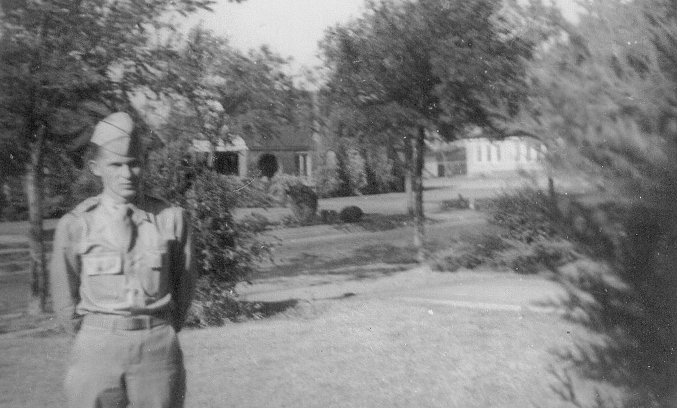
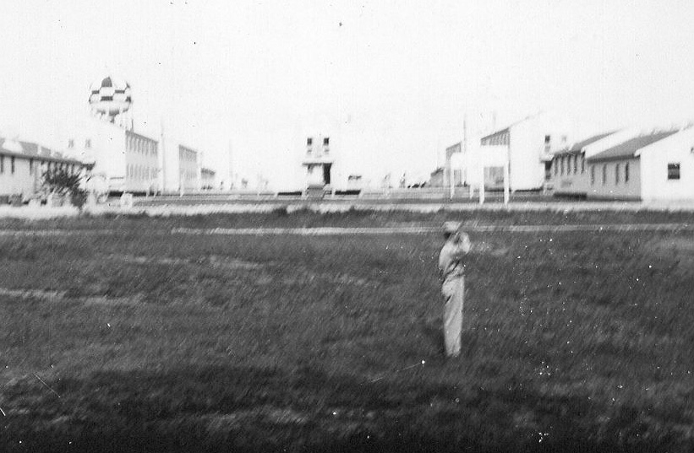
In late 1941 his Captain recommended he apply for Officer Candidate School.
He made 2nd Lieutenant upon graduating from OCS -although only half the class graduated.
1942 Dallas new Lieutenant
Camp Beal Retreat 1942

Slide 17
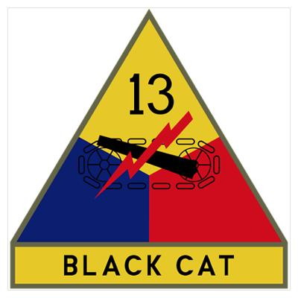
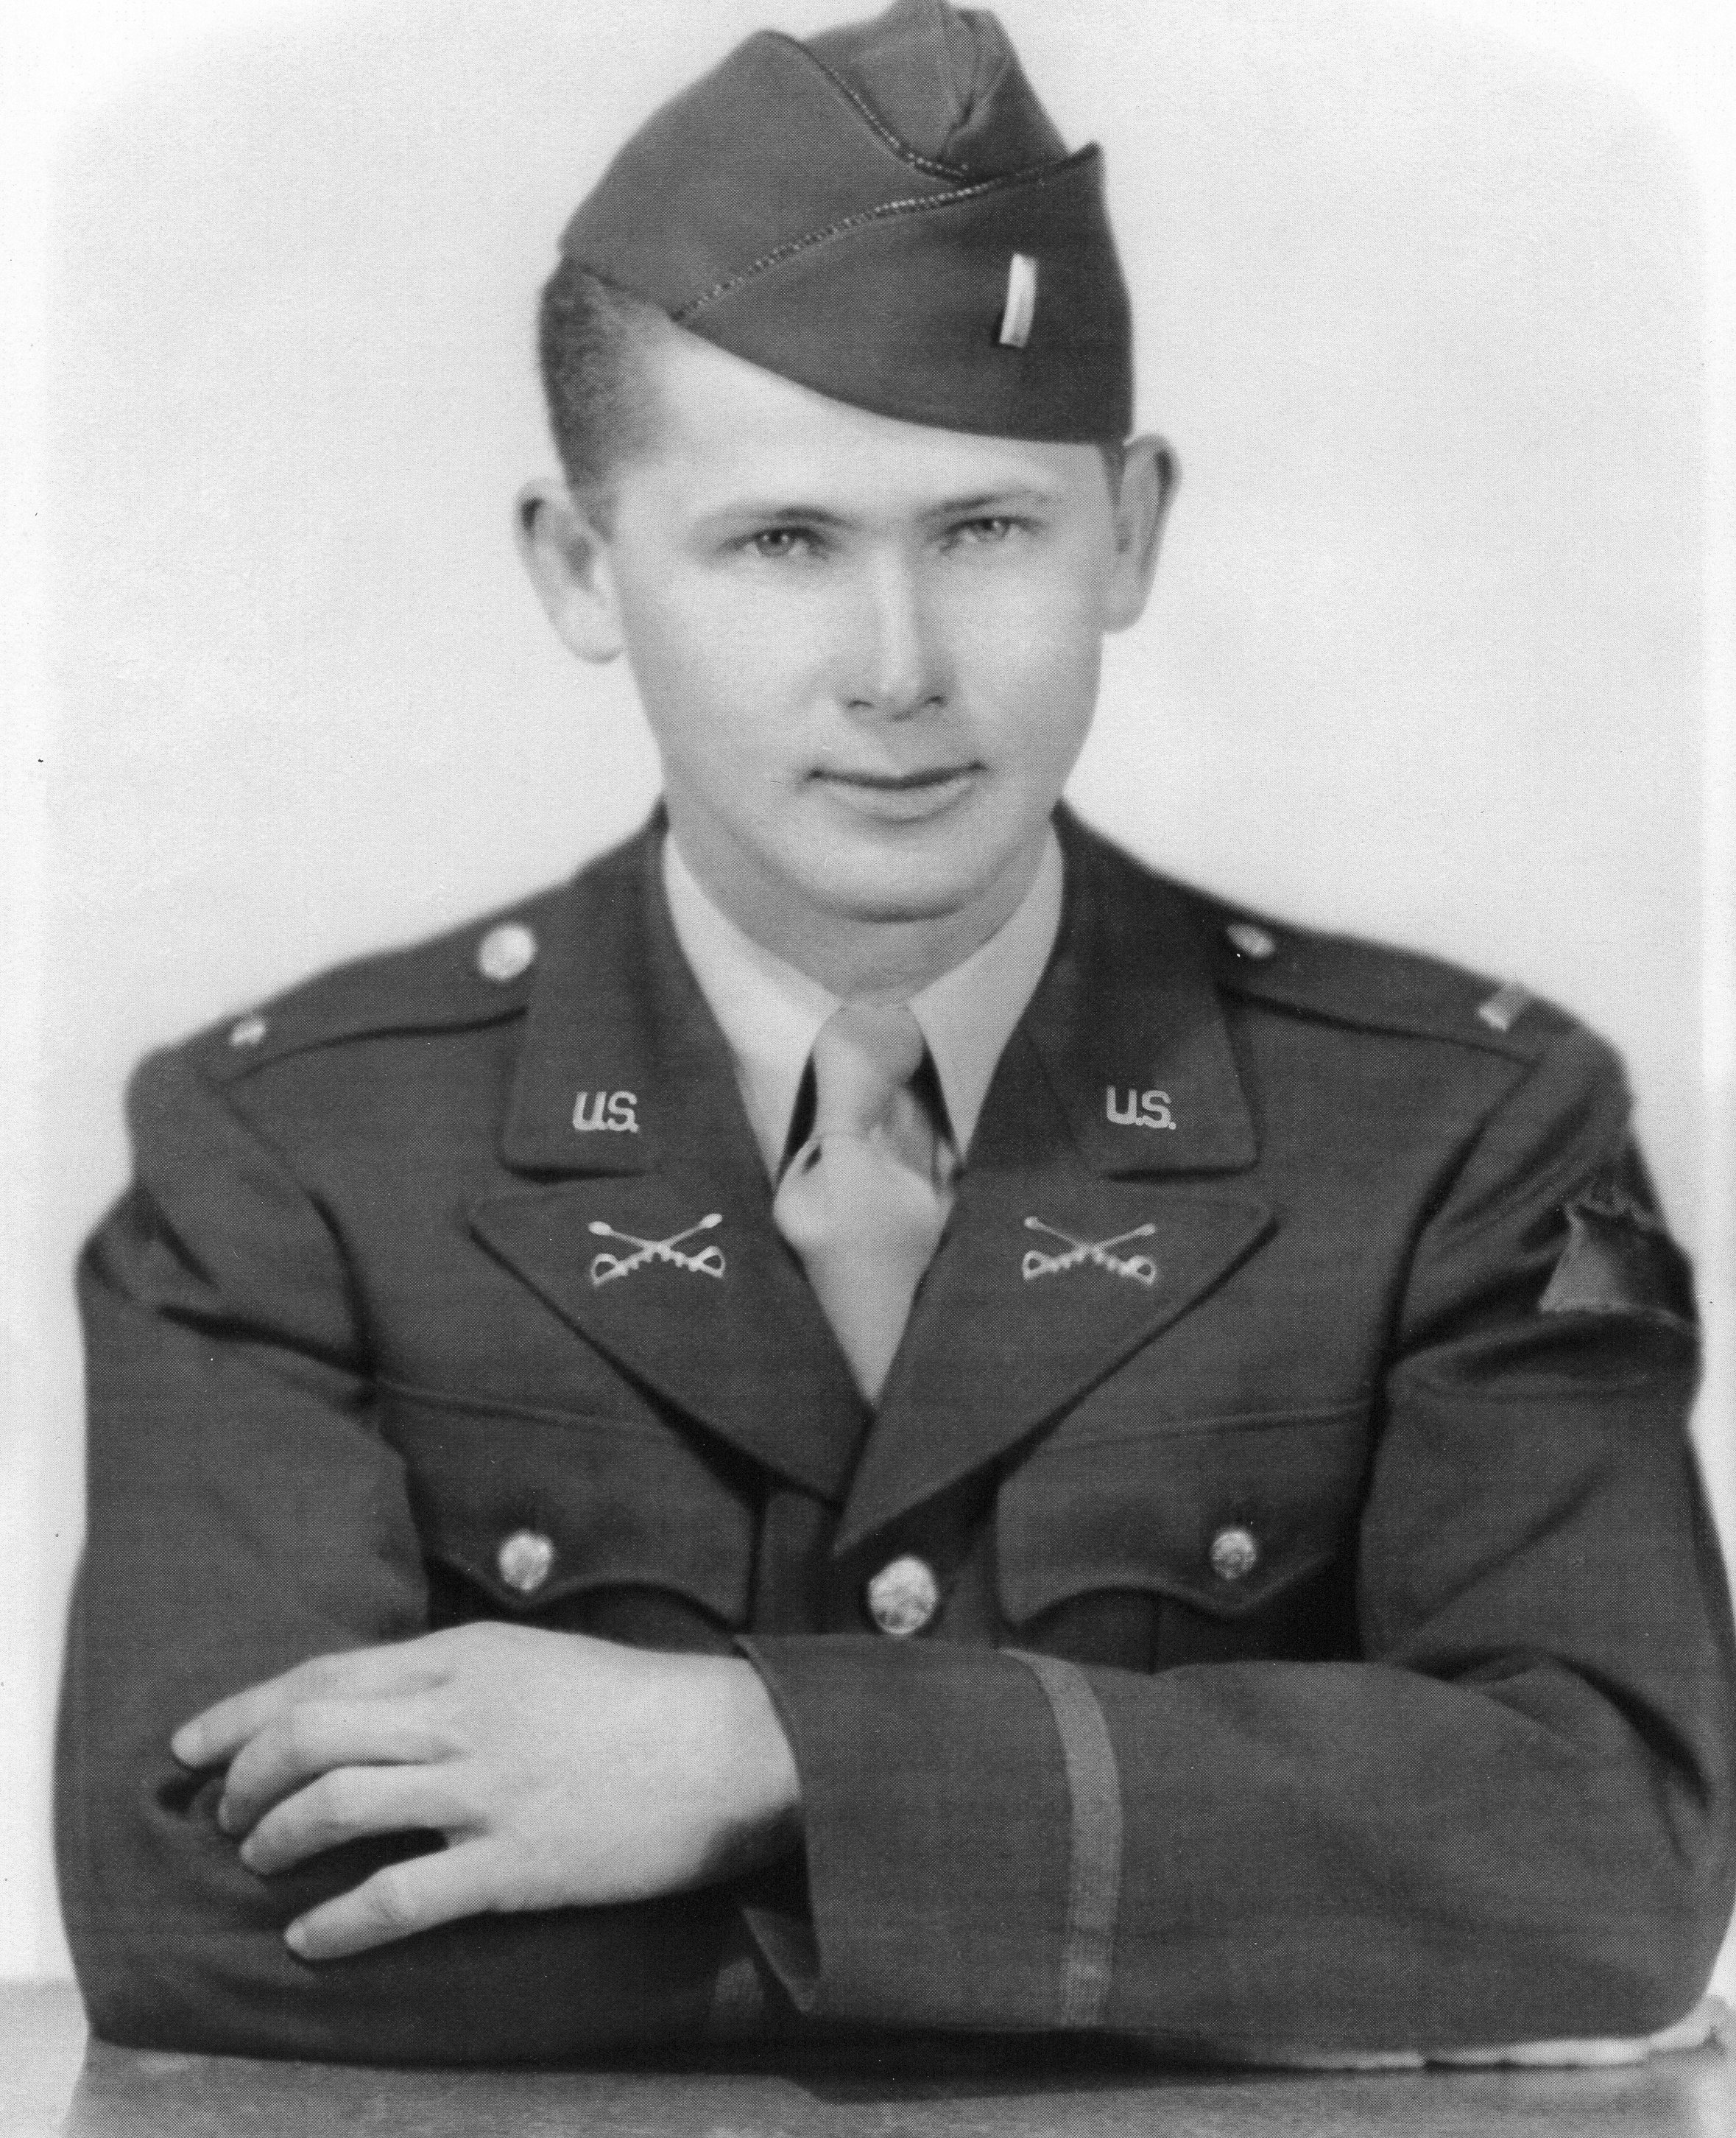
Art was posted to the 13th Armored Division in CA which was to be activated later that year. Assigned to the 46th Regiment, he spent his time training new recruits.
Lt Gaskins 1943

Slide 18
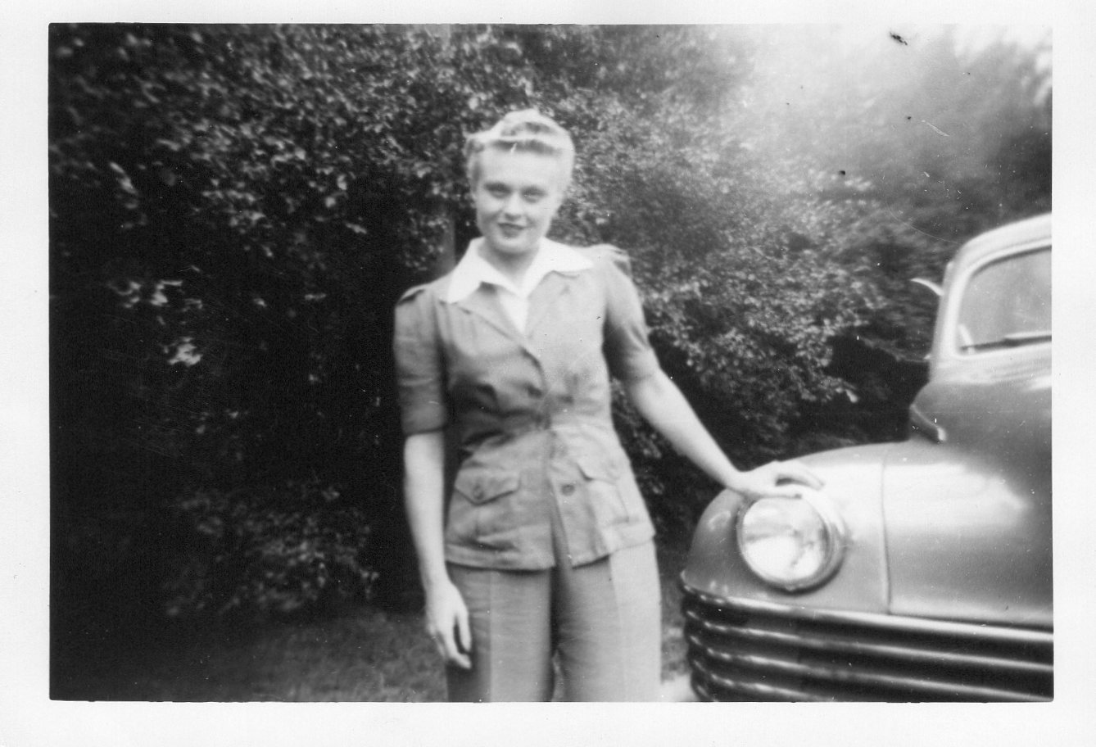
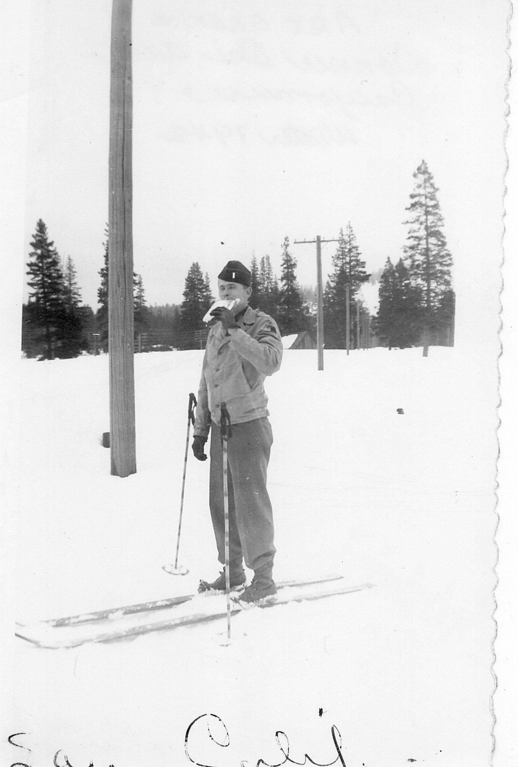
Art met Dorothy Werling Setz in the winter of 1942-43. She lived in San Leandro and Art would drive down as often as he could.
Art and Dorothy were married in Manhattan, Kansas on Christmas Eve 1943.
Dorothy Ellen Werling
1942 Donner Ski CA

Slide 19
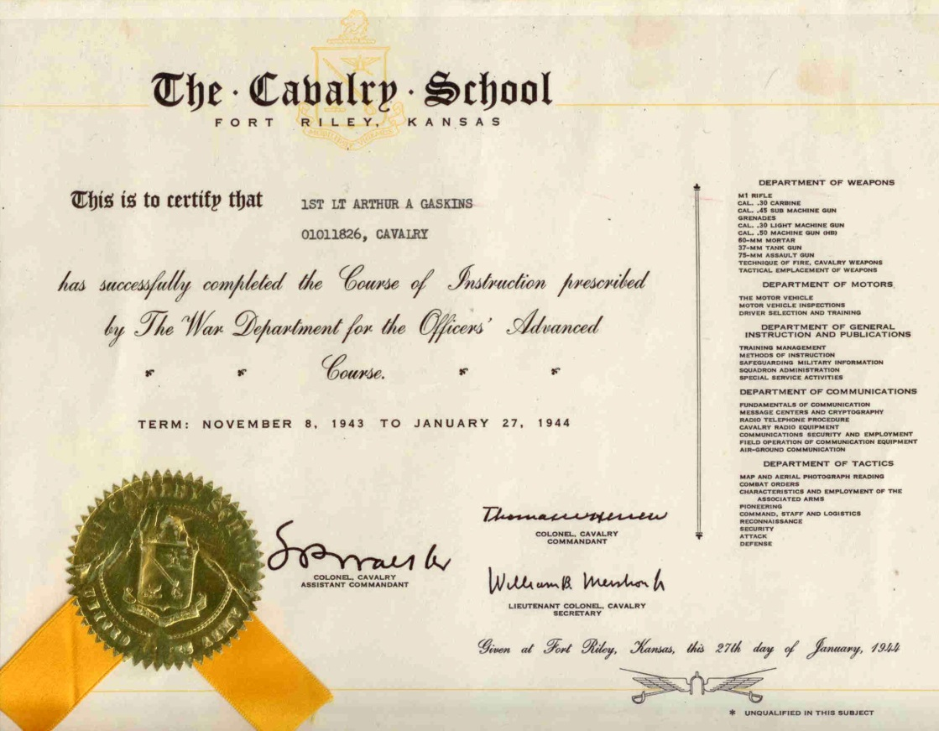
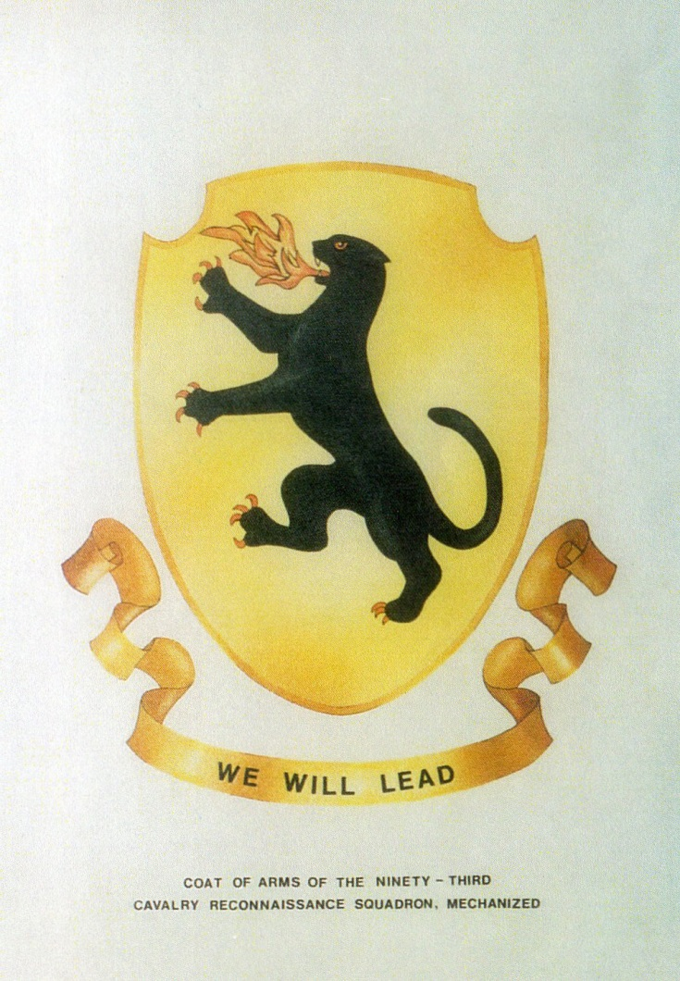
In November 1943 Art was ordered to Cavalry School in Ft. Riley, KS to study advanced tactics for Cavalry Officers.

Slide 20
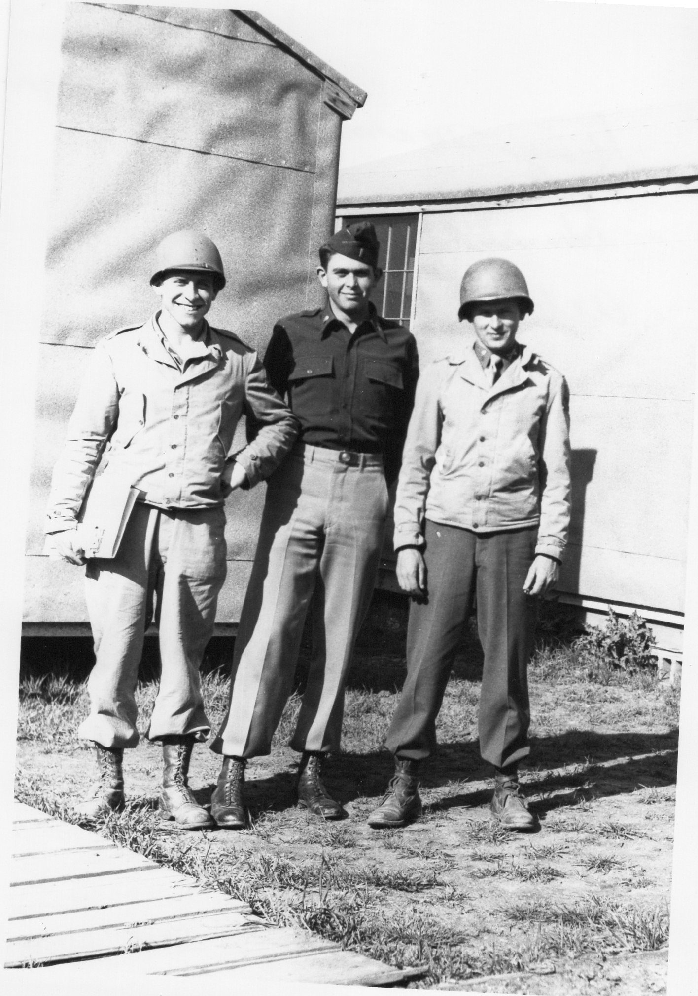
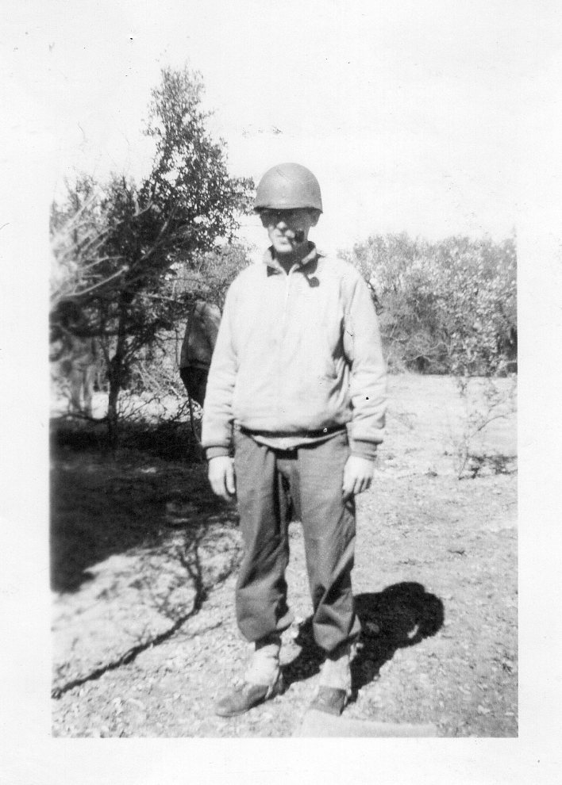
1944 Camp Bowie
Art arrived at Camp Bowie TX in January 1944 for training for deployment, then to Ft. Dix in New Jersey for transport to Europe.
1943 Camp Bowie TX
Art on Right

Slide 21
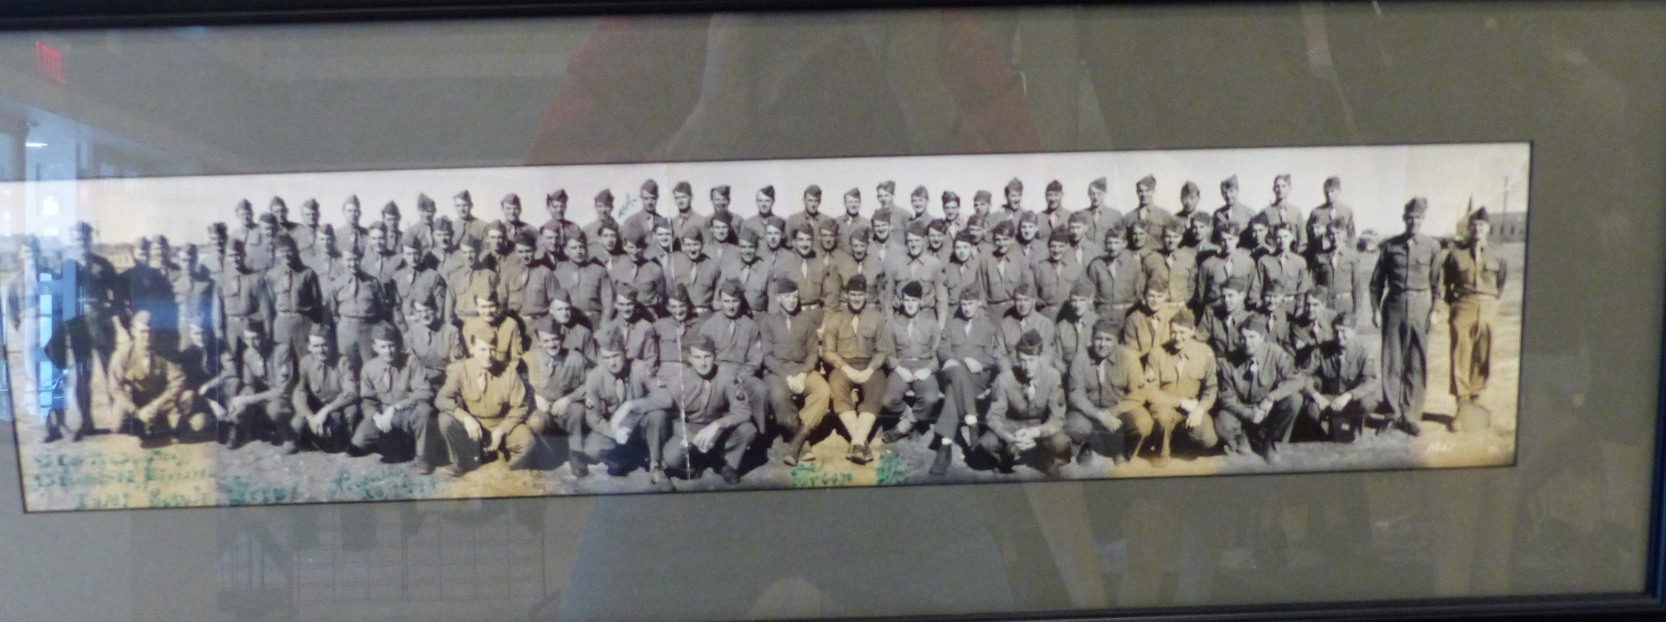
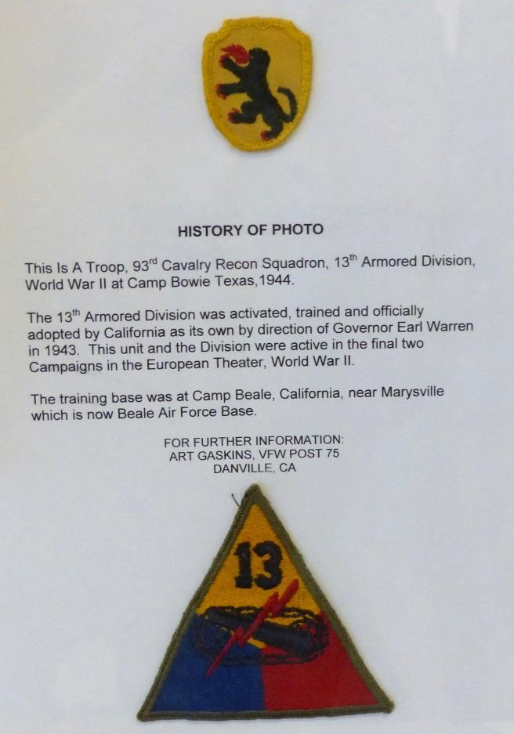
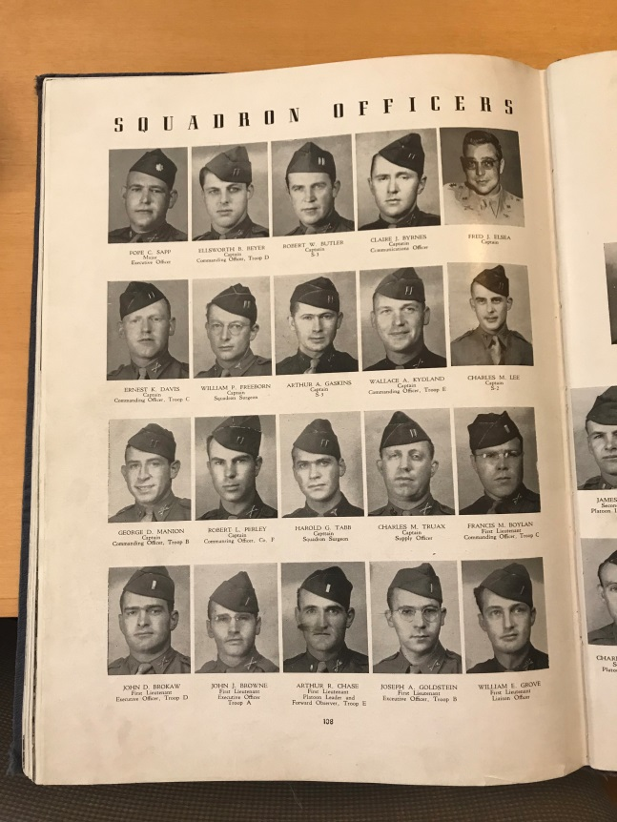
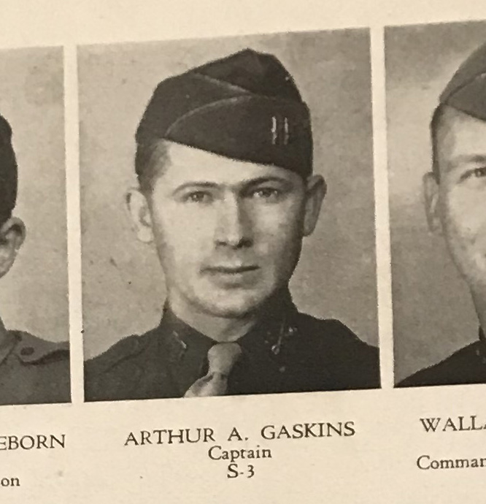

Slide 22
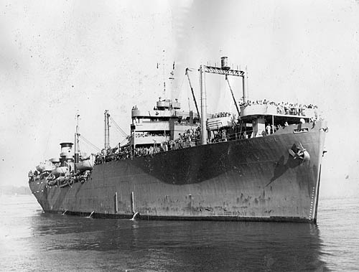
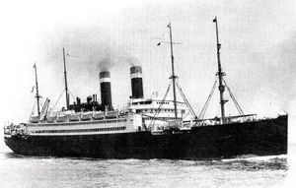
The first ship “the Marine Devil” broke down near Newfoundland and had to be towed back to New York.
Finally boarded the George Washington, acquired form the Germans as reparations from WW I.
This same ship had taken the U.S. Olympic team to Germany for the 1936 Olympics.

Slide 23
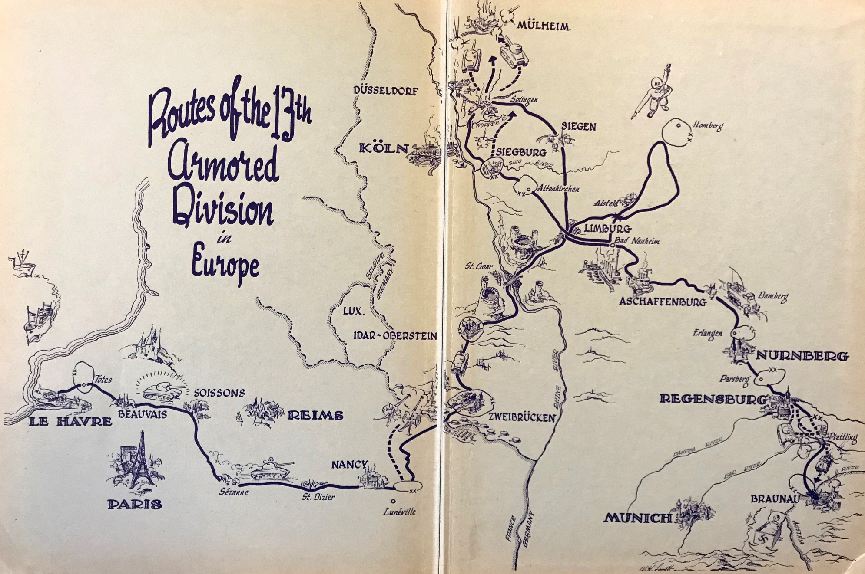
In January 1945 the ship docked at Le Harvre, France.
Art stayed in St. Saens for a few weeks then moved through Beauvais, Soissons, Nancy, Lunnelle then through the Sigfried Line at Zweibruken.

Slide 24
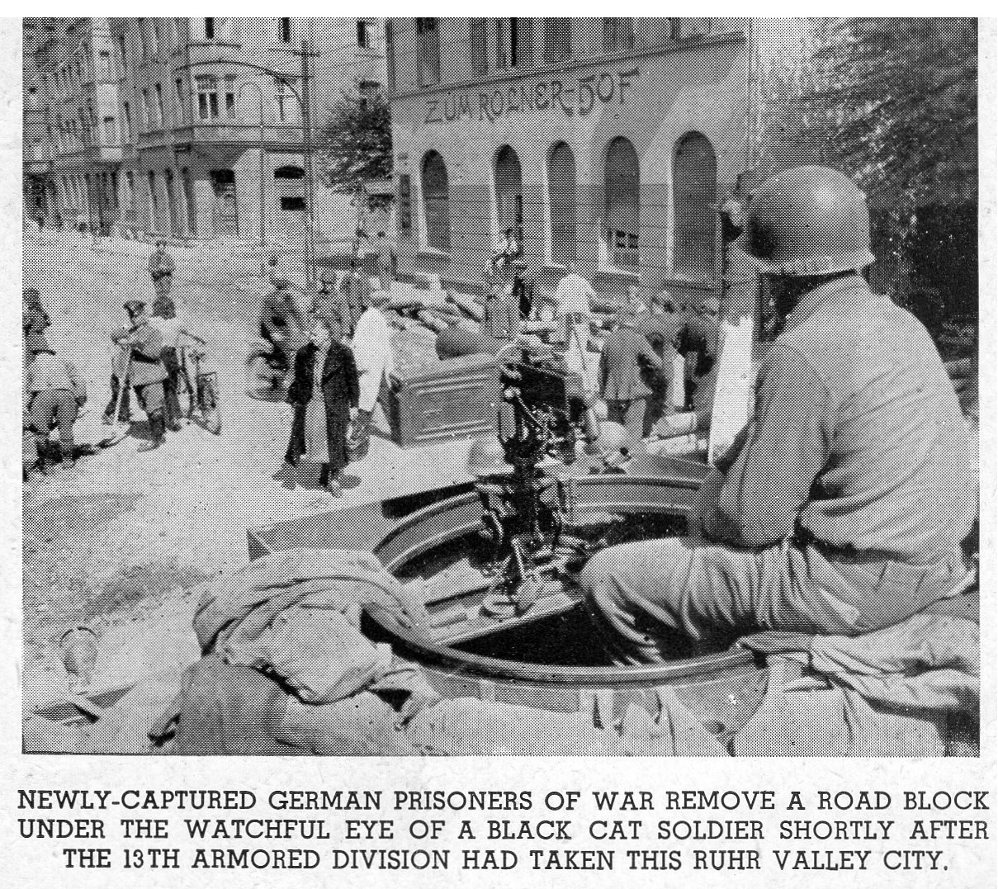
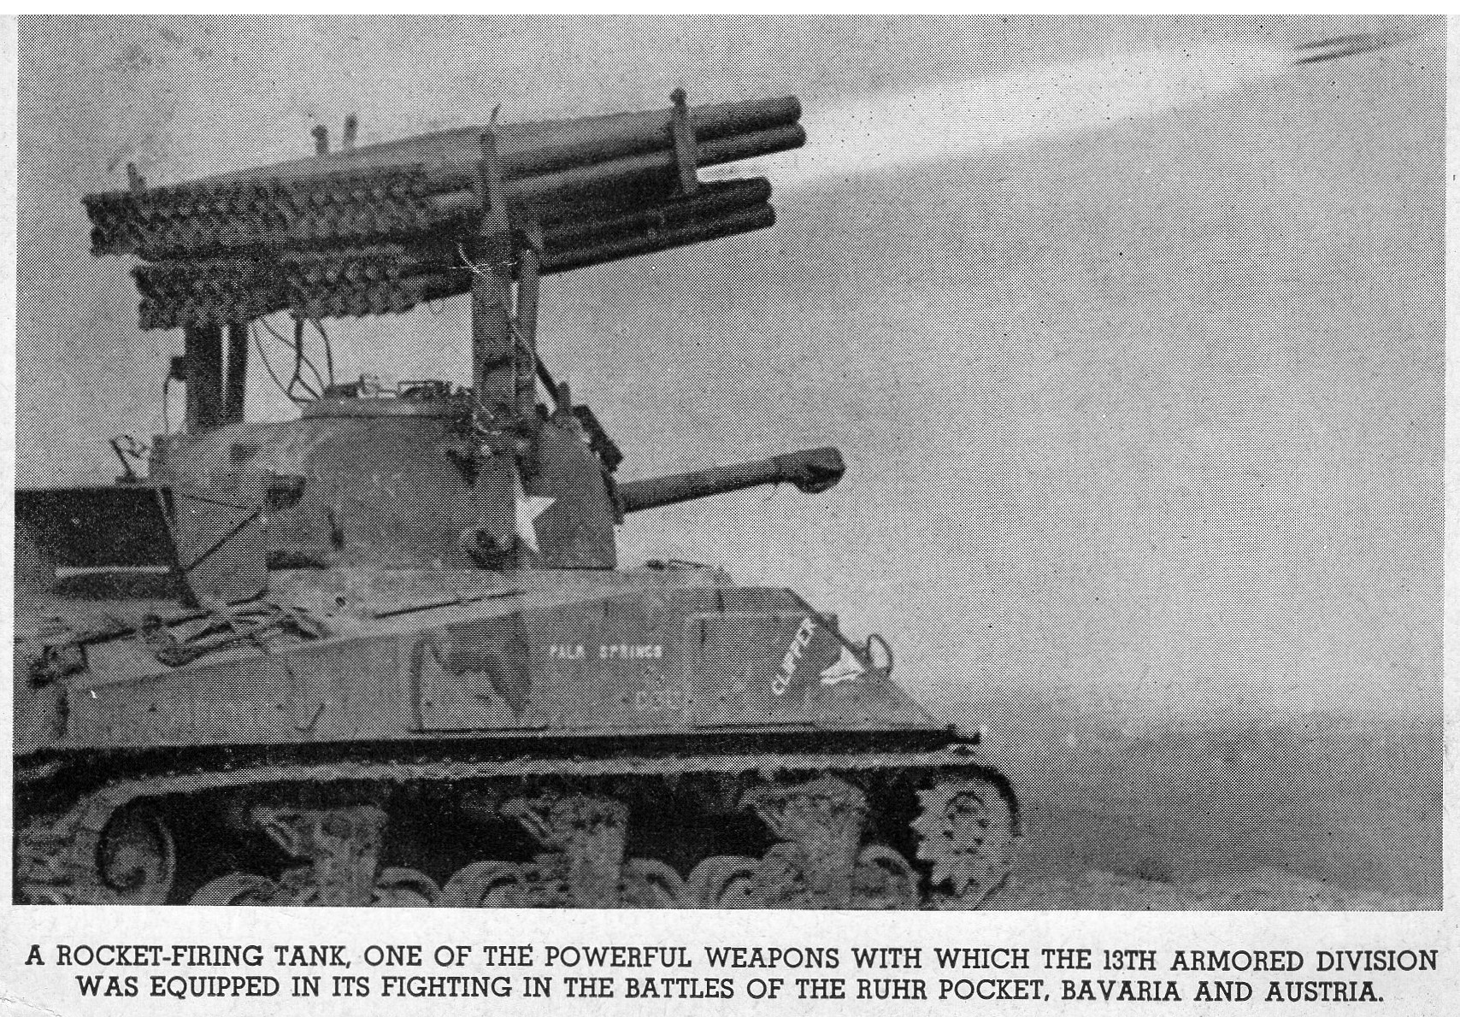
Late March 1945, outside Altenkirchen, the 13th saw it’s first action.
One tank unit was being heavily shelled and Combat Command A lost communications.
Art was tasked to set up an emergency communications system and shortly thereafter, communications were again operational.
We believe this is what he was awarded his Bronze Star for.

Slide 25
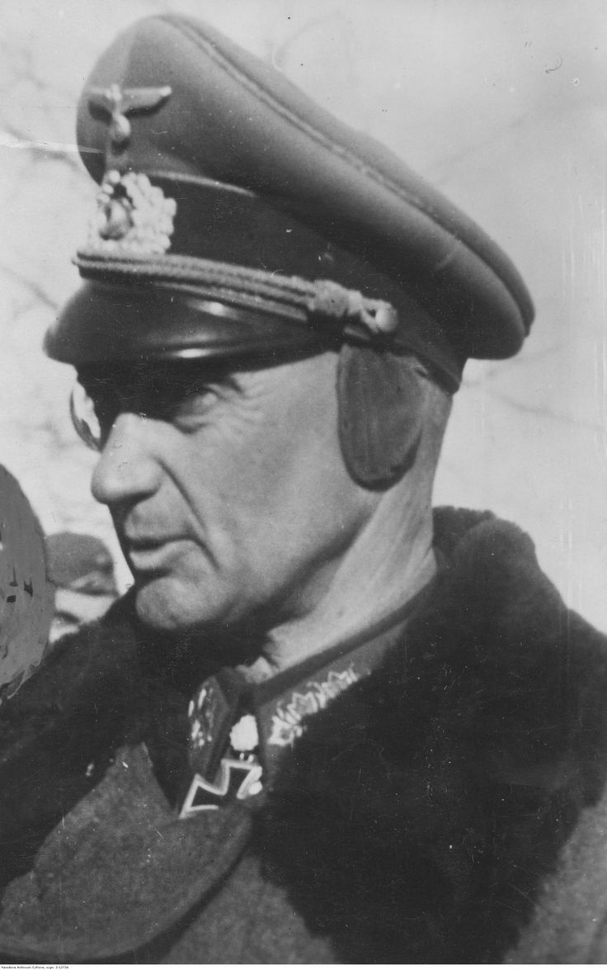
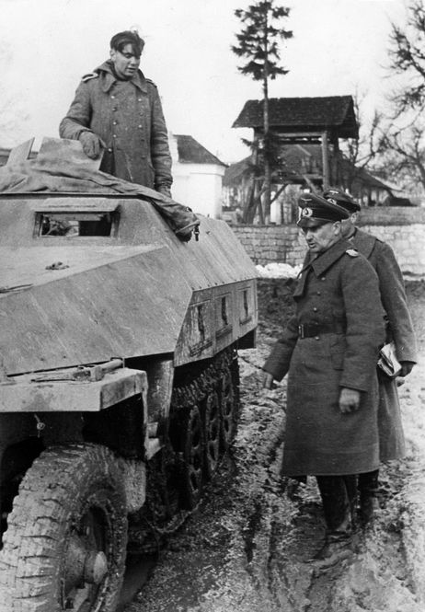
In Late March/early April 1945 Art’s troop was tasked to protect a group of ranking officers from his division while a German officer met with them. Several days later the German Army Commander surrendered all his troops except himself. He was Walter Model who had been one of the top German tank commanders on the Russian front.
On May 5, 1945 orders were to hold their position. The war was officially over May 8, 1945.

Slide 26
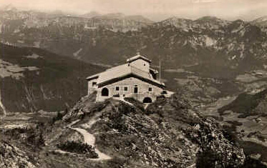
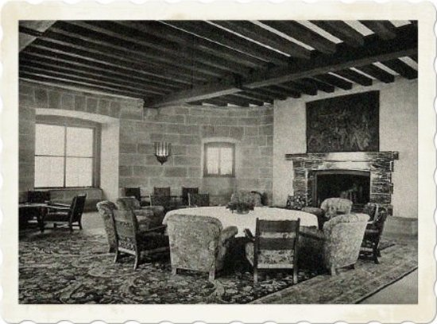
After a week or two of occupation, Art and his Sergeant drove to Hitler’s Eagle’s Nest. They climbed the trail and lit a fire in the main room to heat their lunch rations.
They also spent hours touring the “track Car Collection” where Hermann Goering tried to hide a priceless collection of looted fine art, taken from occupied countries.

Slide 27
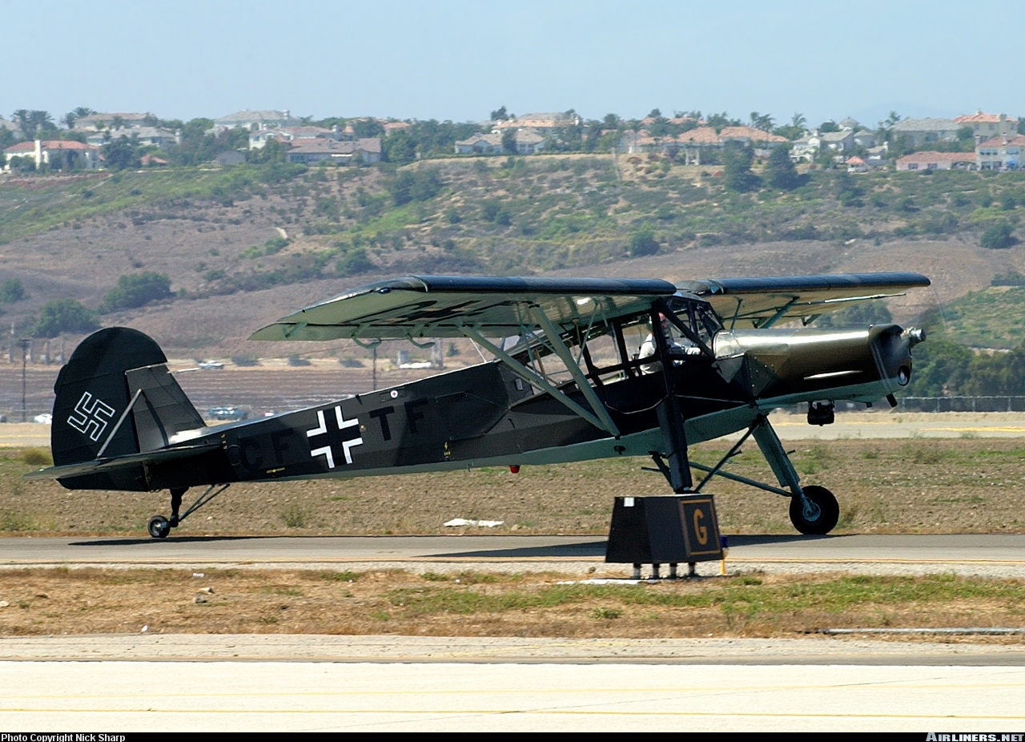
During that same time, Art and his Sergeant happened upon an airplane hidden behind the trees. It was a German Feilser Storch. They hooked it up to the jeep and took it back to camp. They painted it with the stars and bars and it became their surveillance vehicle.

Slide 28
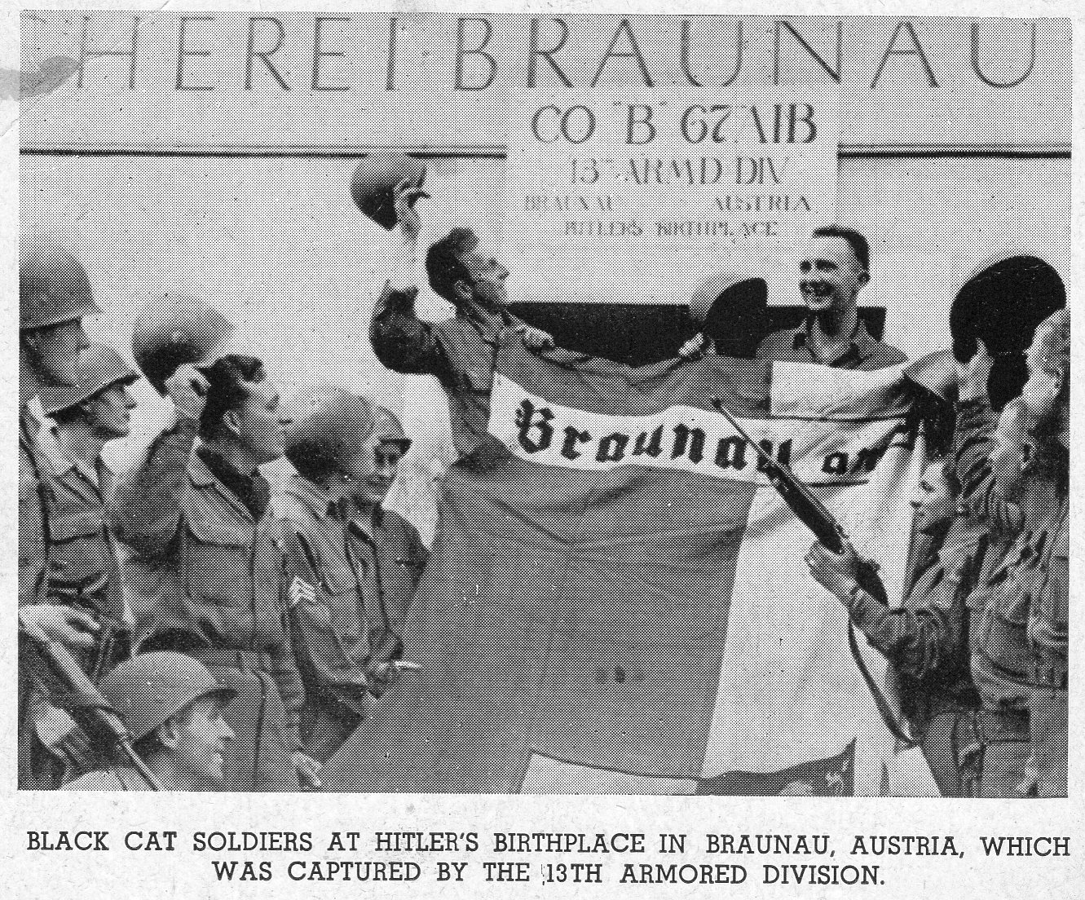
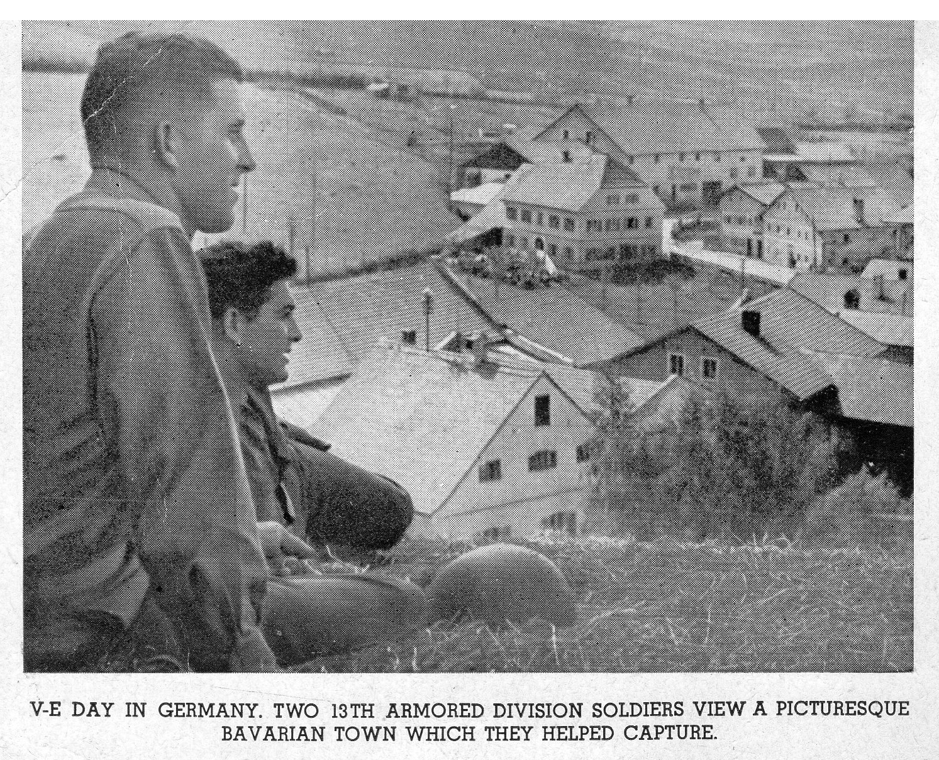
“Postcards from the front”

Slide 29
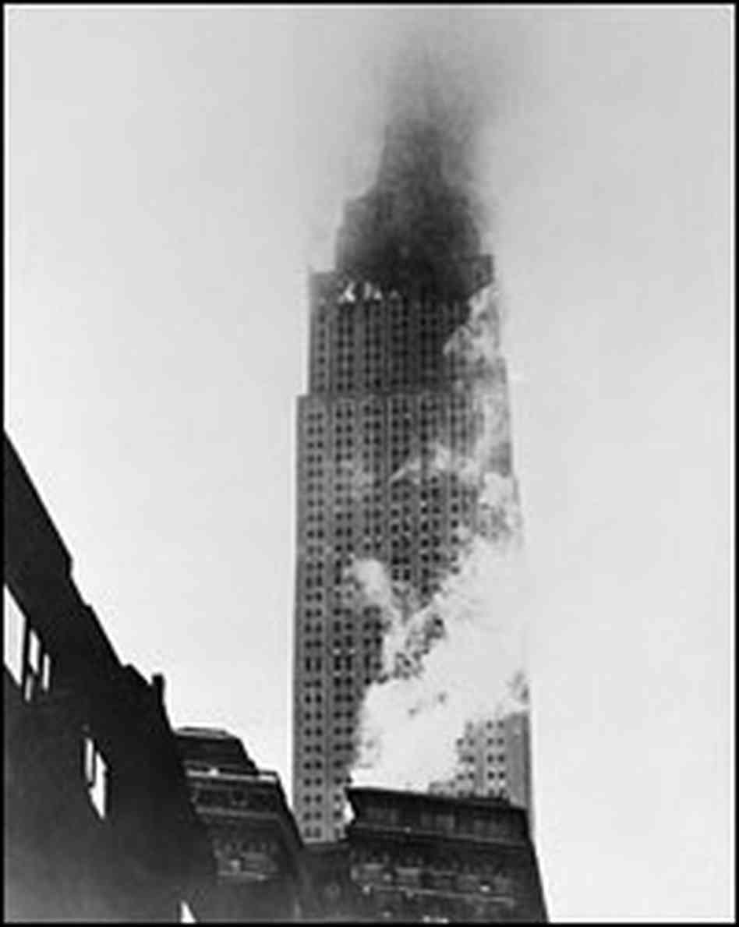
July 1945 Art Departed LeHavre for Camp Cook, CA (Vandenberg AFB now) via Boston.
He was in New York City on July 28, 1945 – the day that a B-25 bomber flew into the Empire State Building in heavy fog.
Dorothy met Art at Santa Maria and spent his 30 days leave in the hills above Willits, CA. No radio, no electricity, no newspaper - a real vacation.

Slide 30
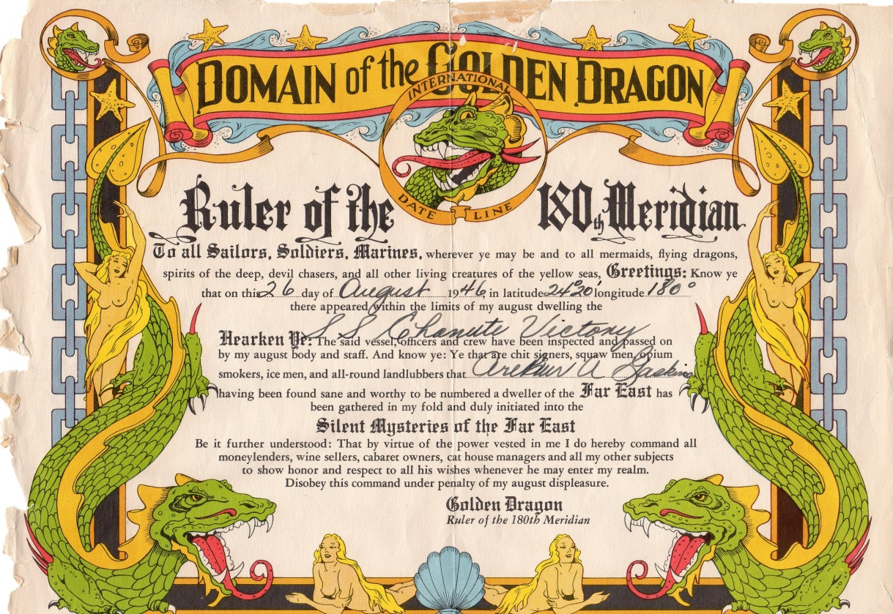
In October 1945 Art had orders to report to Command and General Staff College at Ft. Levenworth. After graduation he was sent to St. Hood, TX and assigned to Combat B, 2nd Armored Division which he had been in some years earlier. Three months into a three year assignment he was ordered to the 24th Corps in Seoul, Korea in the Army of Occupation. He arrived in Inchon after 23 days at sea.

Slide 31
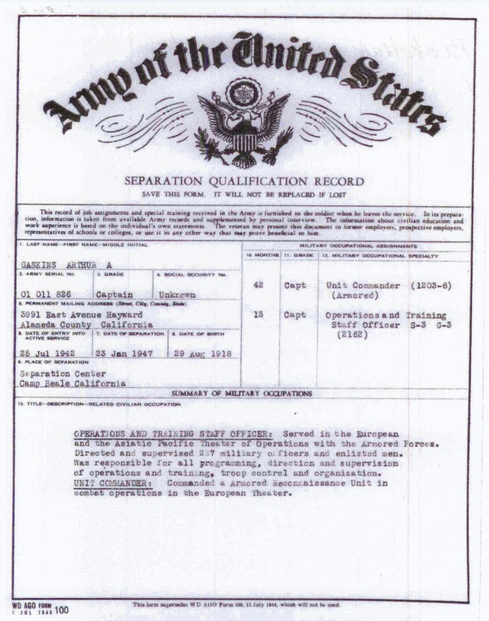
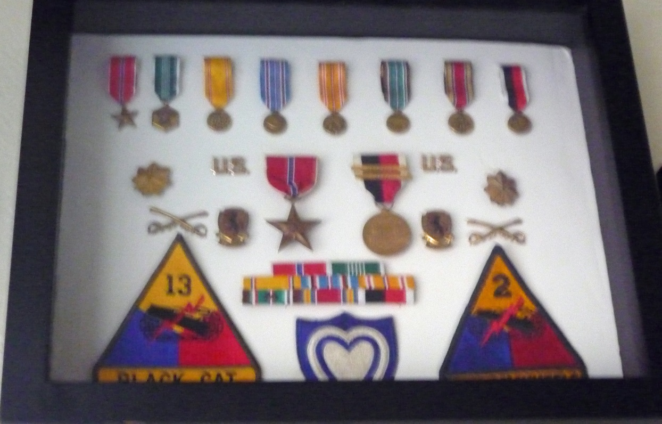
This was to be Art’s last active duty assignment.
In late 1946 Dorothy wrote about her father’s failing health- he had an irreversible liver condition and would not be able to continue in his business. Art flew home and Charlie died in February 1947. It became apparent that his family needed him more than the Army, so he was relieved from Active Duty and entered the Reserves as a Major.

Slide 32
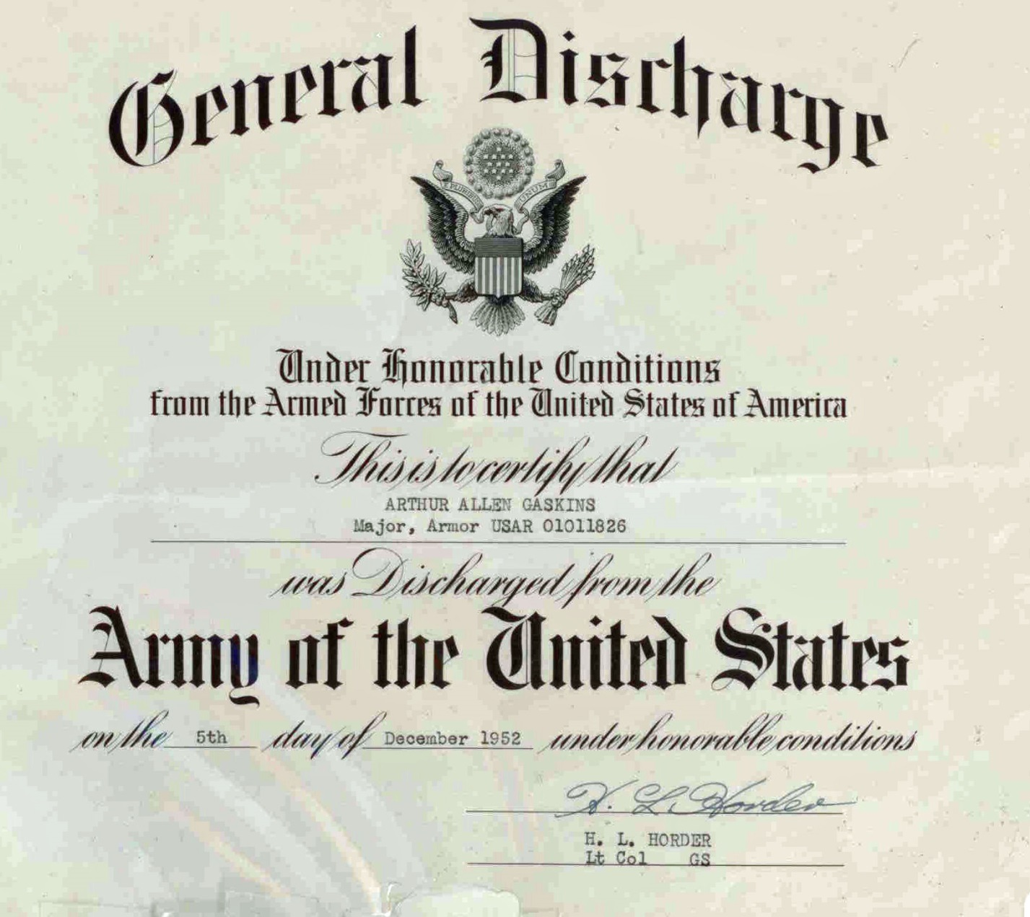
Art was discharged as a Major on December 5, 1952

